Slide 1
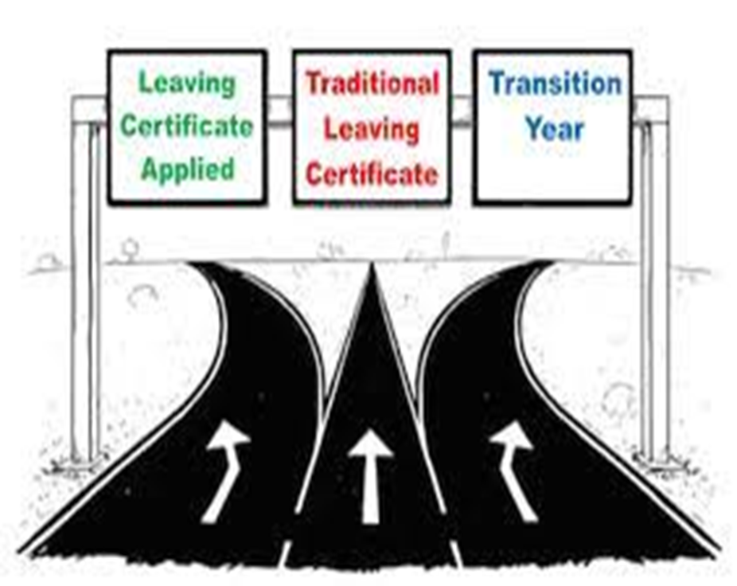


Senior Cycle Options 2026 2027
Junior Cycle
Welcome
Failte
ласкаво просимо
Willkommen
добро пожаловать
مرحبا
witamy
OR
OR
Transition Year
LCE 5th Year
LCA 5th year
5th Year
LCE
6th Year
LCA 6th year
University/ Technological University/ PLC/ Apprenticeship/ Work
PLC/ Apprenticeship/ Work
6th Year

Slide 2
Senior Cycle Options
Transition Year Programme

Slide 3
TYProgramme Student Dimensions
Personal Growth
Being a Learner
Civic and Community Engagement
Career Exploration

Slide 4
TY Student Dimensions
Personal Growth Student Experiences to allow students mature socially and emotionally
Being a learner Student Experiences to allow students build on their previous experiences to develop as senior cycle students

Slide 5
TY Student Dimensions
Civic and Community Engagement Student Experiences to allow student difference make a positive in their school, community and society
Career Exploration Student experience diverse and future pathways and develop career related competencies

Slide 6
TY Curriculum Components
Continued learning in some subjects
Subject Sampling
TY Specific modules
Other components to provide additional growth experiences

Slide 7
TY Curriculum Dimensions
Continued learning in English, Maths, Irish, MEL, PE, DS, SPHE
Subject Sampling in the sciences, Business, Art, DCG, Engineering, Construction, Accounting, Home Ec, Music, LCPE, Computer Science, Geography, History, Society & Politics, Sustainability
TY Specific Modules in YSI, Art Modules, Future Leaders, Active Schools, Erasmus,

Slide 8
TY Curriculum Dimensions
Other Components to provide additional growth experiences may include Drama, Gaisce, Outdoor Education Trip, Work Experience, Segway, Barista, Inspireland, Forensic, Bodhran, Law Education, Driving Ed- Car and Tractor, Career Investigation, Sustainability, CPR, Science Projects

Slide 9
Work Experience
Organised by Parent/Guardian with child
Integral and Compulsory part of TY
1 week in Term 1 in one placement
2 weeks in Term 3 in one placement

Slide 10
Garda Vetting for Work Experience
Garda Vetting is required for all placements with children and vulnerable adults
Students must be 16 years of age to be Garda Vetted
To begin the Garda Vetting process forms are available from the school office
Garda Vetting may take as many as 6 weeks to complete

Slide 11
Assessment and Reporting
Student Portfolio
Student Interview
Credits awarded for completion of work, participation
Term Reports in Jan & June

Slide 12
TY Certification in BCC
End of year Certification awarded in the following categories:
Distinction-100%-85%
Merit- 84%-70%
Pass- 69%-60%
Partially Achieved- 59% and below

Slide 13
TY Application Process
Step 1- Express interest in a place in TY on Programme Option form by Friday March 6th at 2pm
Step2. Complete TY Application form- link emailed by Ms.Cunningham by Friday March 20th at 2pm
Step 3. Secure 2 Work Experience placements by completing Work Experience form and returning to Ms.Cunningham by Friday May 8th
Step 4. Pay TY Expenses of €300 on WAY2PAY no later than April 13th at 5pm
Step 5. Pay €275 for Outdoor Education Trip to Killary Adventure Centre no later than June 26th

Slide 14
Senior Cycle Options
LCA PROGRAMME

Slide 15
LCA Programme Rationale
Prepares students for adult and working life
Recognises talents of all students
Promotes communication and decision -making skills
Applies knowledge and skills to the solution of real problems

Slide 16
➤ LCA is a Full -Time Two Year programme

Slide 17
Attendance-90%
Four sessions, 2 each year
90% Attendance is compulsory in all courses (subjects) in order to complete Key Assignments and achieve credits

Slide 18
Leaving Certificate Applied Terminology
Session
In Leaving Certificate Applied the school year is divided into two sessions
Session I - September to the end of January in 5th year
Session II - February to June in 5th year
Session III- September to the end of January in 6th year
Session IV- February to June in 6TH year
The two- year full time programme has four sessions altogether

Slide 19
Leaving Cert Applied Terminology
Courses
A course is an area of study made up of a number of modules e.g English and Communication is a course
LCA students will study core courses in English & Communication, Maths Application, Social Education, 2 Specialisims , Gaeilge , 1 MEL with written, oral and practical exams
In addition to core courses LCA students will study DS, Leisure &Rec, Arts Ed,, VPG and 2 Elective courses

Slide 20
Leaving Cert Applied Terminology
Modules
A module is a topic within a course and will be taught in 3-4 class periods per week over one session e.g Personal and social communications is one module in the English and Communication Course

Slide 21
Leaving Cert Applied Terminology
Tasks
Seven tasks to be completed over the 2 years:
1 in Session I Year 1-Task Interview
2 in Session II Year I -Task Interviews
3 in Session III Year II -Task Interviews
Personal Reflection Task to be completed over the two years. (Two reflective statements – one at the end of Year I and one at the end of Year II no Task Interview

Slide 22
Leaving Cert Applied Terminology
Key Assignments are important areas from each module.
To gain credits for each module you must complete 4 Key Assignments usually, and attend the course for at least 90% of the time

Slide 23
Leaving Cert Applied Terminology-
CREDITS- Continuous Assessment
Credits awarded for modules and tasks at the end of each session

Slide 24
Leaving Certificate Applied Assessment
3 Types
Satisfactory completion of Modules 68 credits
7 Student tasks 74 credits
Final exams 58 credits
Total Credits 200 credits
Leaving Certificate Applied Assessment

Slide 25
Work Experience
Work Experience is a compulsory element of the LCA Programme
Work Experience takes place every Wednesday of term time in LCA
Work Experience is organized by parents/guardians with their child
Garda Vetting is required for placements with children or vulnerable adults e.g Schools, creches, nursing homes etc

Slide 26
Garda Vetting Requirement
To be Garda Vetted you must be 16 years of age
Forms are available from the school office to begin the Garda Vetting process
Garda Vetting takes can take up to 6 weeks to complete the process

Slide 27
How to apply for LCA in BCC
Step I- Express interest in a place in LCA by completing the Programme Option form by Friday March 6th
Step 2- Complete the online LCA Application form-link emailed by Ms.Cunningham by Friday March 20th
Step 3- Secure 2 Work Experience placements, complete Work Experience form and return it to Ms. Cunningham by May 8th
Step 4- Pay LCA Expenses on school’s Way2Pay of €150 by Monday April 13th

Slide 28
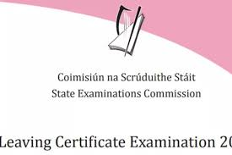

Senior Cycle Options Leaving Cert. Established
2 year academic programme studying 7 subjects at HL/ OL
FL maths is available however it may have college implications
Assessment is through terminal exam (some subjects offer practical elements)
You would benefit from the LC if you enjoy learning, feel at ease with the structure of the junior cycle, would like to progress to college/ university

Slide 29

LC Subject Choice getting the right mix will affect your future
Choose favourite subjects. If you enjoy the subject, you will excel at it. You could boost your ability by choosing subjects which compliment each other i.e. biology and agricultural science.
Support informed decisions by talking to subject teachers/ senior students, examine text books (most available online), use Qualifax/Careersportal, use results from aptitude and ability tests (CAT4).
Take into account future college/career paths & ensure your choices meet college entry requirements.

Slide 30

Do | Don’t
Choose subjects you enjoy | Choose a subject because your friend is taking it
Choose subjects you’re good at | Choose a subject because you like/dislike the teacher
Choose subjects you need for your chosen career | Choose a subject because you think it will be easy
Keep your options open for the future by making a balanced choice now | Choose a new subject without finding more about it.
Talk to your Guidance Counsellor and your teachers | Make a decision at the last minute without thinking about it
Talk to your parents/guardians | Don’t panic

Slide 31

Consequences of poor subject choice
Poor subject Choice:
Increases the risk of being unhappy within a subject for two years which ultimately leads to poor motivation
Increases the risk of not performing to full potential - may impact on overall attainment/ points
Increases the risk of not studying a subject required for course of choice
Making subject/class changes throughout fifth year causes disruption to study as you attempt to catch up on the curriculum covered

Slide 32

Factors to consider when making Subject & level Choices It’s NOT all about the Points!
The subjects & Levels needed for a particular college i.e matriculation or minimum entry requirements
The subjects needed for a particular course i.e specific subject requirement
The subjects useful for a particular course
Institution | Minimum grades | Required subjects
NUI Colleges: UCD, MU, UG, UCC, RCSI, Shannon College of Hotel Mgmt. | 2H5 + 4O6/H7 (Level 8) | O6 in English, Irish and Third language*
Trinity College Dublin | 3H5 + 3O6/H7 (Level 8) | O6 in Maths, English & another language
Dublin City University | 2H5 + 4O6/H7 (Level 8) | O6 in Maths, English or Irish
University of Limerick | 2H5 + 4O6/H7 (Level 8) | O6 in Maths, English & Irish or another language
Technological Universities | 2H5 + 4O6/H7 (Level 8) Level 7 courses require 5O6/H7 | O6 in Maths, English or Irish
There are some course exceptions, e.g., specific requirement for Primary Teaching in DCU – H4 Irish. Engineering at UG – H4 Maths |  | e.g specific requirement for Primary Teaching in DCU – H4 Irish. Engineering at UG – H4 Maths

Slide 33
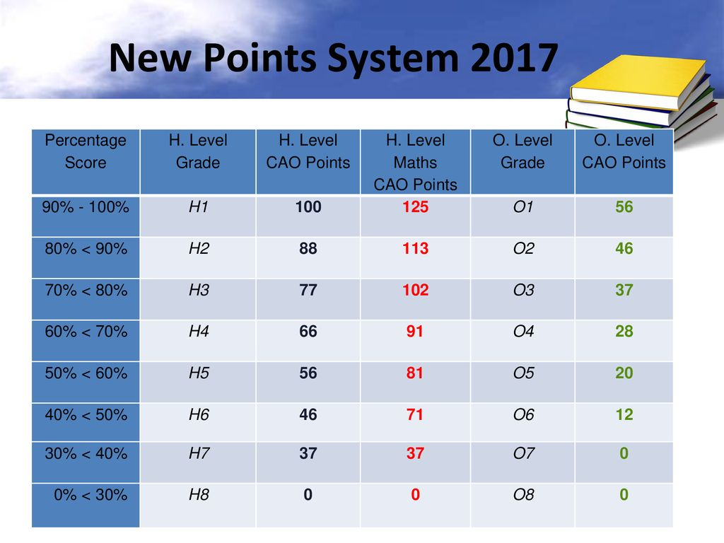
CAO Points are calculated from your 6 Best Subjects
Your choice of level for Maths deserves due consideration – the 25 bonus points reward students for the time, effort & determination it demands

Slide 34
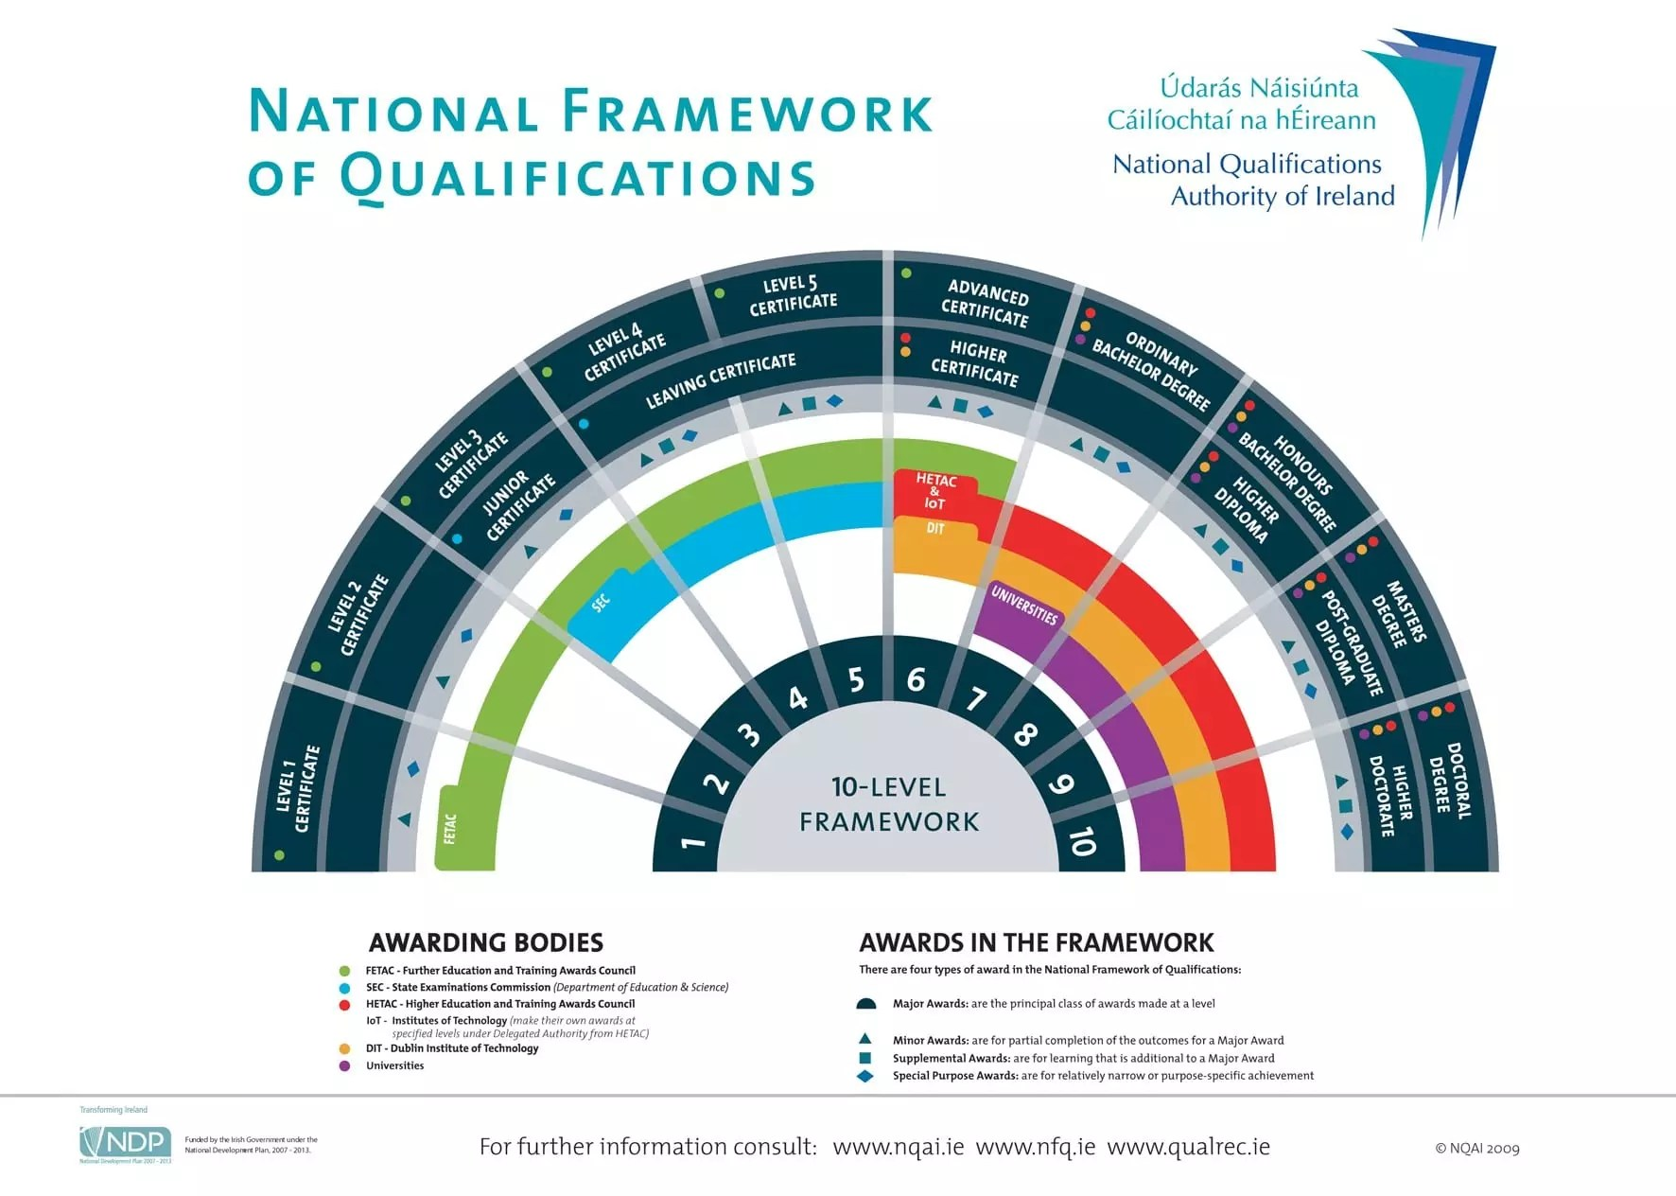

Slide 35
Leaving Certificate Subjects offered at Borrisokane CC
Compulsory Subjects
Irish
Maths
Practical Group
Construction Studies
Engineering
Science Group
Ag Science
English
Design & Communication Graphics (compliments the artistic group)
Biology
Chemistry
Physics
Computer Science
Artistic & Creative Group
Art
Music
Languages Group
French
German
Humanities & Social Group
History
LC Physical Education
Geography
Home Economics
Business Group
Business
Accounting
LCW – previously LCVP
Politics & Society

Slide 36

Practical Group
These subjects are 'hands-on' and involve working with tools and machinery on physical things like wood, metals and plastic. They may involve designing, planning and building things.
Construction Studies
Engineering
Design Communication Graphics

Slide 37

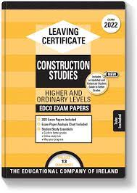
Leaving Certificate Construction Studies
What is covered? Built Environment Design & Engineering Building Fabric Services & Control
Examination: Written Exam: 50% Course work project submitted at Easter: 30% Practical skills test in May: 20% All practical skills learned in JC carry forward. Theory in LC is not related to JC MTW so can be a fresh start.
Careers/Courses: Sustainable Energy Consultant, Civil Engineering, Mechanical Engineering, Construction Management, Architecture, Quantity Surveyor, Site Foremen, Plumber, Carpenter, Joiner.

Slide 38

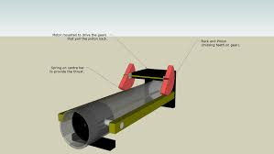
Leaving Certificate Engineering
What is covered? Workshop Processes: Health and safety / Benchwork / Heat treatment of metals / Plastics processing / Fabrication and finishing of metals / Machining / Technology. Materials and Technology: Classification and origin of metals / Structure of metals / Iron and steel / Non-ferrous metals / Corrosion of metals / Materials testing / Plastics / Joining of materials / Machining / Metrology / Manufacturing processes / Mechatronics / Fluid dynamics.
Examination: Written Exam:50% Project: 50% Practical day exam has been removed in new LC syllabus
Careers/Courses: Agricultural Engineering, Aircraft Technician, Fitter/Turner, Industrial Design / Operatives, Mechanics, Mechanical Production, Motor Mechanic, Structural and Civil Engineer, Toolmaker and Welder

Slide 39
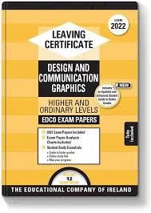
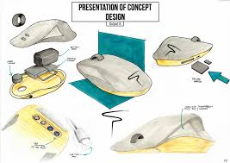
Leaving Certificate Design and Communication Graphics
What is covered? DCG involves visualizing and understanding information presented verbally or graphically. Drawings and designs (2D / 3D) are prepared using sketching, traditional drafting equipment and Solidworks.
Examination: Written Exam:60% Course work submitted at February: 40% of which CAD (Solid Works) will form a significant component.
Careers/Courses: Civil Engineering, Mechanical Engineering, Construction Management, Architecture, Product Design, Quantity Surveyor, Draughtsman, Graphic Design and Teaching.

Slide 40

Science Group
These subjects demonstrate how to explore nature using carefully planned methods, and teach the basic methods and findings of scientific investigation.
Agricultural Science
Biology
Chemistry
Physics
Computer Science**
LC PE**
**(Considered a science subject for a number of specific/related courses- NOT lab sciences)
Holding on to one Science subject for Senior Cycle (Biology, Physics, Chemistry, Agricultural Science) keeps several college options open including all Healthcare courses, most Science courses, Sports & Physical Education and Engineering courses.

Slide 41
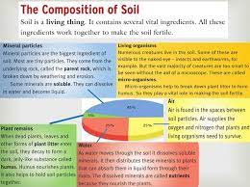
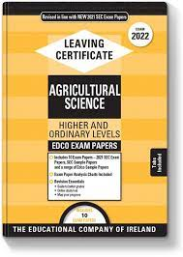
Leaving Certificate Agricultural Science
What is covered? Soils/plants/farm crops - cereal/roots/grassland/trees & shelter. Structure and function of the animal body – the cow, the sheep, horse, and pig. Farm buildings and farm-house environment.
Examination: Written examination: 75% Project/Coursework: 25% The Project – (i) portfolio of activities and investigations, including laboratory and field investigations, farm visits and other appropriate activities. (ii) a student project, through which a topic of agricultural significance is explored in greater depth. This will be based on a theme, which will be set annually by the State Examinations Commission.
Careers/Courses: Agricultural Engineering, Inspector, Animal Breeder, Animal Trainer, Butter/Cheese-maker, Creamery Manager, Dairy Scientist, Farmer, Fish Farmer, Forester, Horticulturalist, Lab Technician, Stud Farm, Veterinary Surgeon

Slide 42
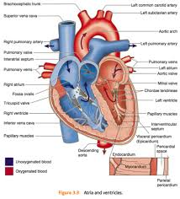
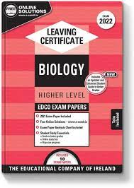
Leaving Certificate Biology
What is covered? 1.The study of Life : Scientific Method, Characteristics of Life, Ecology, Nutrition. 2.The Cell: Structure, Diversity, Continuity, Metabolism, Genetics. 3.The Organism: Diveristy, Organisation, Transport & Nutrition, Breathing, Excretion, Responses, Reproduction & Growth.
Examination: Written Exam (60%) Biology in Practice Investigation (40%) The course is long. Students need to like learning off information.
Careers/Courses: Nursing, Beautician, Health Professionals, Marine Biology, Food Industry, Environmental Officers

Slide 43

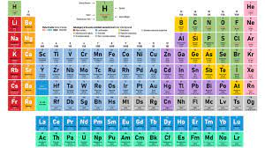
Leaving Certificate Chemistry
What is covered? Periodic Table and Atomic Structure, Chemical Bonding, Stoichiometry, Formulas and Equations, Volumetric Analysis Fuels and Heats of Reaction, Rates of Reaction, Organic Chemistry, Chemical Equilibrium, Environmental Chemistry: Water and Options: Industrial and Atmospheric or Metals and Electrochemistry. A mixture of theory (definitions), calculations and 28 mandatory experiments and demonstrations. Must start learning immediately in 5th year as you can get lost easily. Must be logical, analytical, numerate and creative.
Examination: Written Exam 60% Chemistry in Practice Investigation 40%
Careers/Courses: Medicine, Dentistry, Science & Engineering

Slide 44
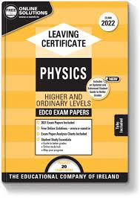

Leaving Certificate Physics
What is covered? Nature of Science, Mechanics, Temperature, Heat, Waves, Vibrations and Sounds, Light, Electricity and Modern Physics. Covers a good mixture of theory (definitions), calculations and mandatory experiments (24). A lot of maths involved.
Examination: Written Exam (60%) Physics in Practice Investigation (40%)
Careers/Courses: Renewable Energy, Environment and Climate, Communications, Music and Television, Sports and Games (without Physics there would be no iPads, games consoles or the internet!!), Transport, Medicine, Education

Slide 45
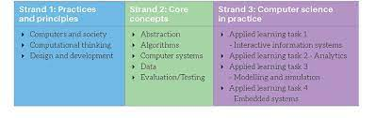

Leaving Certificate Computer Science **
What is covered? Computer Science is the study of algorithms and programming, and the impact computers have on society. Assessment Learning Tasks (ALTs): Computer Science is a practical subject, with 4 Assessment Learning Tasks to be completed over 2 years. What will students learn: Programming: Python, JavaScript, HTML, CSS Theory: Ethics and Societal Impacts of Computers, History of Computing, Computational Thinking, Web Design, Number Systems, Embedded Systems (micro:bit), Algorithmic Design
Examination: 70% end of course examination: 38% - written & 32% - computer based 30% individual final year course work
Careers/Courses: Computers, ICT, gaming, programming, cyber security, cloud computing

Slide 46

Artistic & Creative Group
These subjects involve developing creativity and the appreciation of the work of others. This involves learning the methods and techniques of the subject and producing your own work using these skills.
Art
Music

Slide 47
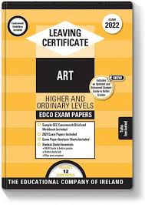
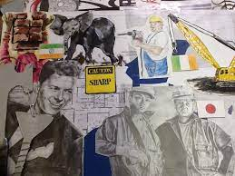
Leaving Certificate Art
What is covered? Art - Drawing, Painting, Sculpture, Still life etc Craft - Ceramics, Lino Printing, Batik, Textiles etc. Design - Illustration, Infographics, Mixed media etc Visual Studies. Encourages creative thinking (INNOVATION) and critical analysis (PROBLEM SOLVING) Don’t need to have done Art for Junior Cert. Portfolio preparation not part of course.
Examination: Project over 10-12 weeks on a theme decided by the state exams (50% Practical exam: (20%) Visual Studies exam (30%) in June: (2.5 hs
Careers/Courses: Animation, Media & Communication, Architecture, Content creation, Art Education, Art Therapy, Fashion and Textile Design, Film Making, Fine Artist, Graphic Design, Interior Design, Photography, Ceramics, Theatre Design, Product Design, Web Design... Endless list of careers that reward creativity and innovative thinking.

Slide 48


Leaving Certificate Music
What is covered? The course is divided into 3 components: Performing 50% Performing is fundamental therefore to the course and classwork Composing 25% This involves learning about the rudiments and Basic theories of Music. The students learn how to Compose a short melody and how to add backing Chords to a piece of Music. Listening 25% This involves analysing four different pieces of Music which includes Music by JS Bach,, Mozart, The Beatles and Queen. The students also study Irish Music and various other styles of Music
Examination: The Practical exam is 50% of the overall mark and each student performs either 6 pieces on 1 Instrument, or 4 + 4 on two different instruments - A student may also use Music Technology for part of their practical exam. This exam takes place on the March/April before the Written exams. The written exam is in two parts: The Composing paper and The Listening paper
Careers/Courses: Arranger, performer, teacher, composer, music producer, advertising, sound engineer

Slide 49

Languages Group
It is widely believed that if a student does not study a language for the Leaving Cert they will not be able to attend third level - this is not entirely the case, however the decision to drop a language should not be taken lightly.
Impact of Dropping a Language
Most third level colleges do not require entrants to have a European language in order to meet the matriculation, or minimum entry requirement.
At Trinity College Dublin, students are required to pass English and another language, and Maths or Latin.
The matriculation requirements for DCU are Maths and English or Irish.
UL requires students to have English, Maths and Irish or another language.
So, a student who does not take a foreign language at Leaving Cert will typically meet the entry requirements for these universities, as long as they take Irish, or have an Irish exemption.
NB: NUI Colleges require a MFL for many but not all courses; use Qualifax/Careers Portal to cross check requirements for your course of interest
Exemption from Irish
A student with an Irish exemption may apply for an exemption from the requirement to present Irish as a matriculation subject from the university they will be applying to
The Technological Universities generally expect students to have O6/H7 in English and Maths - not choosing a language should have no impact on a candidate's ability to get place in one of their programmes.
PLC colleges do not require students to have taken a language.
A modern European language will also be required for application to cadetships in the Defence Forces.
So, while not choosing a language will not affect entry to the majority of third level institutions, it will restrict choice to some extent.

Slide 50

Leaving Certificate French & German
What is covered? Three components: Basic Communicative Proficiency Language Awareness Cultural Awareness
Examination: Written Exam: 2.5 hrs (55%). Aural: 30 mins (H.L: 20%; O.L: 25%) Oral: 12/15 mins (H.L: 25%; O.L: 20%) Need a good foundation to do or get honours.
Careers/Courses: European Studies, Marketing, Hotel Management, Translation, EU, Teaching, Cadets, Tourism & Leisure.

Slide 51

Humanities & Social Group
These subjects explore the ways in which humans live and communicate in the world. Human life is examined by looking at our past, our present and into our future. These subjects help people to express themselves clearly and develop their reasoning ability.
These subjects explore common issues faced by all people living in society. They develop the skills and knowledge used to manage personal resources and guide human behaviour.
History
Geography
Home Economics
Physical Education
Politics & Society

Slide 52
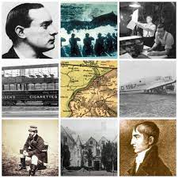
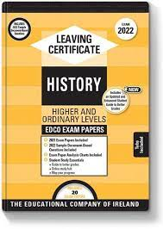
Leaving Certificate History
What is covered? Students cover Modern Irish History and two topics from European history The course is divided into three areas: A research study (20%) – this is pre-submitted March of Leaving Cert. Document based study (20% of the Exam) Three topics (60% of the Exam) - from Irish and European History. Develops critical, analytical and communication skills based around learning about the world of politics, economics, religion, philosophy.
Examination: Written Exam 80% (4 Q’s): 2 hrs 50 mins. Investigation 20% : Extended essay.
Careers/Courses: Politics, Journalism, Local Government, Law, Archaeology, Media, Museum Work, Librarian, Civil Service

Slide 53
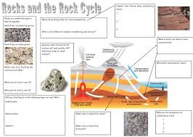
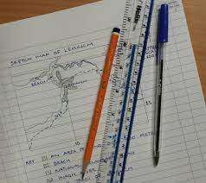
Leaving Certificate Geography
What is covered? 3 Core Units: Physical Environment 2. Regional Geography 3. Investigation and Skills (Fieldwork) 1 of 2 Elective Units: 4. Economic Geography 5. Social Geography 1 of 4 Optional Units: 6. Global Interdependence 7. Geo-Ecology 8. Culture and Identity 9. The Atmosphere
Examination: ➢ Written Exam (HL: 80%; OL: 75%): 2 hrs 50 mins. Short Answer Questions/Multi-Part Questions/Essay (optional HL only) ➢ Fieldwork Project due in April: (HL: 20%; OL:25%) Involves drawing maps, figures, statistics, charts
Careers/Courses: Urban Planning, Map Making, G.P.S. / G.I.S. Environment, Teaching, Demographer, Weather / Climate

Slide 54
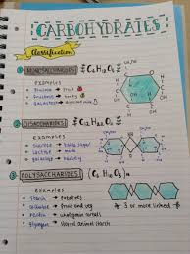
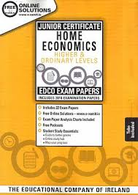
Leaving Certificate Home Economics
What is covered? It’s an academic subject with very little cooking unlike in JC. 3 core areas and 1 elective. Core: Food Studies (45%), Resource Management & Consumer Studies (25%) Social Studies (10%). Electives: 3 of which 1 is chosen (20%): Home Design and Management, Textiles, Fashion and Design
Examination: Written Exam: 80%: 2.5 hours (Core: 60% & Electives: 20%) Practical coursework: 20% 2 (2028 will have less questions to answer and more choice as a result of Covid accommodations)
Courses/Careers: Hotel, Catering & Tourism, Culinary Arts, Fashion & Design, Childcare, Home Economics Teaching, Social Care, Food Science

Slide 55
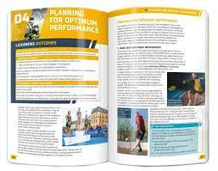
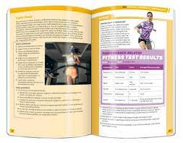
Leaving Certificate Physical Education**
What is Covered? LCPE is the equivalent of studying sports science in first year in college. As the written assessment comprises 50% of the marking, ability in the physical activity alone will not be sufficient, students will need to engage with the classroom section of the course. Theoretical knowledge such as how to analyse skills and improve nutrition, will directly benefit student’s physical performance goals. Course Content: Strand 1 Topics: Skill learning, participation and performance. Strand 2 Topics: Physical and psychological demands of performance. Strand 3 Topics: Factors influencing participation in physical activity. In addition two of the following each year: Physical activity and inclusion. Technology, media and sport. Gender & Physical Activity Business & Enterprise in Physical activity & sport Project – You can only choose from a specific list of activities including gymnastics, kayaking, badminton, golf, GAA
There are three assessment components in LCPE: Physical activity project and Performance assessment – 50%. Written examination – 50%.
Career Sectors This subject builds skills and knowledge that are particularly useful for careers in the following Career Sectors: sports and fitness occupations, Physiotherapy, physical training or sports coaching, Strength & Conditioning.

Slide 56
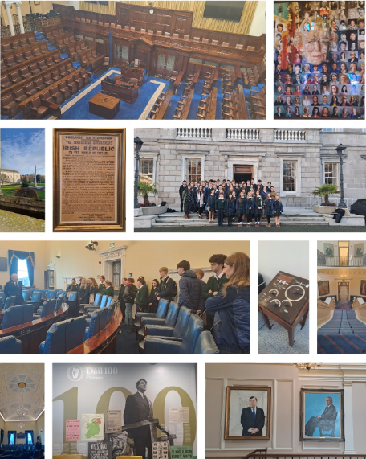
Politics & Society
What is Covered? It's the study of social systems within which people act locally, nationally and more widely across the world. Course Content: Strand 1 – Power and decision making: in school, national and European level Strand 2 - Active citizenship: effectively contributing to communities, rights and responsibilities in communication with others. Strand 3 – Human rights and responsibilities: in Ireland, Europe and the wider world. Strand 4 – Globalisation and Localisation: Globalisation and identity, sustainable development.
There are two assessment components: Project 20% Written 80%
Career Sectors Politician, civil servant, Garda, sociologist, political researcher.

Slide 57

Business Group
These subjects teach the skills and knowledge needed to understand how business works.
Accounting
Business
LCW (LCVP)

Slide 58
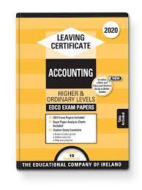

Leaving Certificate Accounting
What is covered? 2 Sections Financial Accounting (Final A/C’s of Sole Traders/Companies, Club/Service Firm A/C’s, Cash Flow Forecasts) 2. Management Accounting (Costing (Product & Marginal) & Budgeting) ➢ Accurate, organised and reasonably good at Maths. ➢ Prepared to be challenged and complete the task.
Examination: Written Exam :100% (3 hrs). All long questions : Marks vary from 60m – 120m (3 Parts) Part 1 & 2 : Financial Accounting Part 3 : Management Accounting
Careers/Courses: Banking, Advertising, Taxation, Secretary, Law, Sales, H.R, Marketing, Insurance.

Slide 59
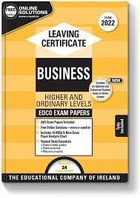

Leaving Certificate Business
What is covered? Unifying Strand: investigating Business Strand 1: Exploring the Business Environment Strand 2: Understanding Enterprise Strand 3: Leading in Business Strand 4: Being Informed & Making Informed Decisions ➢ Business Studies for the Junior Cert is NOT necessary. ➢ Does not contain a lot of accounting (Tax Calculation, Ratio Analysis, B/E charts) ➢ Learning definitions, assessing companies, regulations/legislation and applying knowledge to case studies. ➢ Must like learning things off, but unlike English no essays – bullet point form
Examination: Written Exam: 60% Business Alive Investigative Study: 40%
Careers/Courses: Banking, Advertising, Taxation, Secretary, Law, Sales, H.R, Marketing, Insurance.

Slide 60
Life Community & Work (previously LCVP)
What is covered? Leaving Certificate Life, Community and Work (LCW) is a two-year, common-level senior cycle course commencing in September 2026 that focuses on personal development, community engagement and preparation for the world of work. It is structured into two modules (Me and My Future and Community and Work) with four strands covering self-awareness and transferable skills, progression and career pathways, community participation and enterprise, and workplace readiness. Students engage in real-life, experiential learning such as goal setting, career planning, volunteering, collaborative community problem-solving, job applications and work experience, supported by ongoing reflection and skill development.
Assessment: Assessment is divided into a Portfolio in Action worth 60% and a Written Examination worth 40%. The Portfolio in Action is completed in sixth year in response to an SEC brief and is marked using four criteria: Participating, Reflecting, Applying and Communicating with students drawing on evidence built up through four Applied Learning Tasks over the two years. The written exam, taken at the end of sixth year, assesses learning across all four strands and students’ ability to apply their learning and experiences. Final results are awarded using a 4-point grading scale: Distinction (80–100%), Merit (65–79%), Pass (50–64%), and Not Achieved (0–49%)

Slide 61

Remember! YOUR choices may have unintended consequences in 2 years’ time, when paths into college are blocked by unfortunate subject gaps
Familiarise yourself with specific college and course requirements.
Know which subjects are useful/essential for particular courses/careers
Pick subjects you like/are good at to sustain your motivation over two years
There is no such thing as an easy subject in Leaving Cert. All subjects require hard work and effort.
Keeping a science and language subject will increase third level options (even if you have a ‘definite’ career interest)
Don’t leave your decision until the last minute, rushed decisions have costly implications

Slide 62
HEAR & DARE
Accesscollege.ie
HEAR – potential reduced points, extra college supports and financial assistance for students from a low socio-economic background.
DARE - potential reduced points and extra college supports for those with a disability/difficulty such as:
ASD, Asperger’s, Hearing or Visual impairment, DCD, Dyspraxia, Neurological condition, physical disability, speech and language disorder, literacy or numeracy issues (report required with no age limit).
ADD, ADHD, Mental Health Condition or significant ongoing illness, your report must be less than 3 years old from when you apply in February of 6th year.

Slide 63
International Students
A student must be resident in Ireland or the EU for 3 of the past 5 years to avoid paying international fees for third level.
Please contact colleges for more information about this.
The Irish Refugee council offer scholarships to refugees and people seeking protection. Please visit this link to find out more information University (Sanctuary Scholarships) Funding - Irish Refugee Council

Slide 64


Who can help decide?
➢ Parents & Guardians Play a major role when it comes to Subject Choice. (ESRI 2011)
➢ Teachers They will discuss what their subject is like at Leaving Certificate Level.
➢ Past Pupils & Older Siblings - ask those who are already studying subjects at senior cycle what they think of them but factor in that everyone has UNIQUE interests and abilities
➢ Guidance Counsellor Make sure to ask questions regarding subjects and future goals.
Examine Subject Textbooks - Exam Papers – www.examinations.ie
www.studyclix.ie

Slide 65

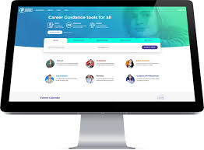
On-Line Research
➢ www.qualifax.ie It gives information on which subjects are needed for what courses, as well as information on all college courses. Look up 'Minimum Entry Requirement' under 'Useful Tools'
https://www.qualifax.ie/index.php?option=com_wrapper&Itemid=26&Mainsec=courses&Subsec=min_courses_select&view=wrapper&xpt=0.61113000%201429190312&xpt=0.87098800%201429191164
➢ www.careersportal.ie Subject information & personal assessments. Also gives information on jobs such as qualifications needed.
https://careersportal.ie/school/subject_explorer.php
Our Borrisokane Community College Career Guidance page: Borrisokane Community College | Guidance & Counselling Website (careersportal.ie)

Slide 66
How to apply for LCE in BCC – Next Steps
Fill out the MS forms sent by Ms Molly choosing LCE
Closing date for from – March 6th 2026​
5th Yr Subject Options open on VSWare - March 13th 2026​
5th Yr Subject Options close on VSWare – March 20th 2026

Slide 67
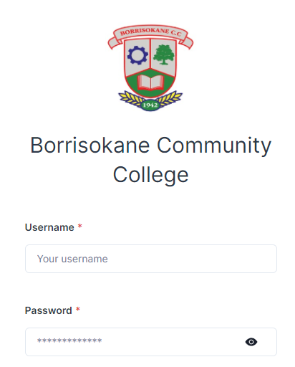
Step One
Log into the Vsware app with username and password
Any issues with logins, please email the school on info@borrisokanecc.ie

Slide 68
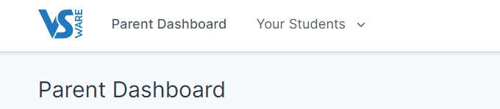
Step Two
Click on ‘Your Students’ and select the student for whom you are picking option subjects

Slide 69
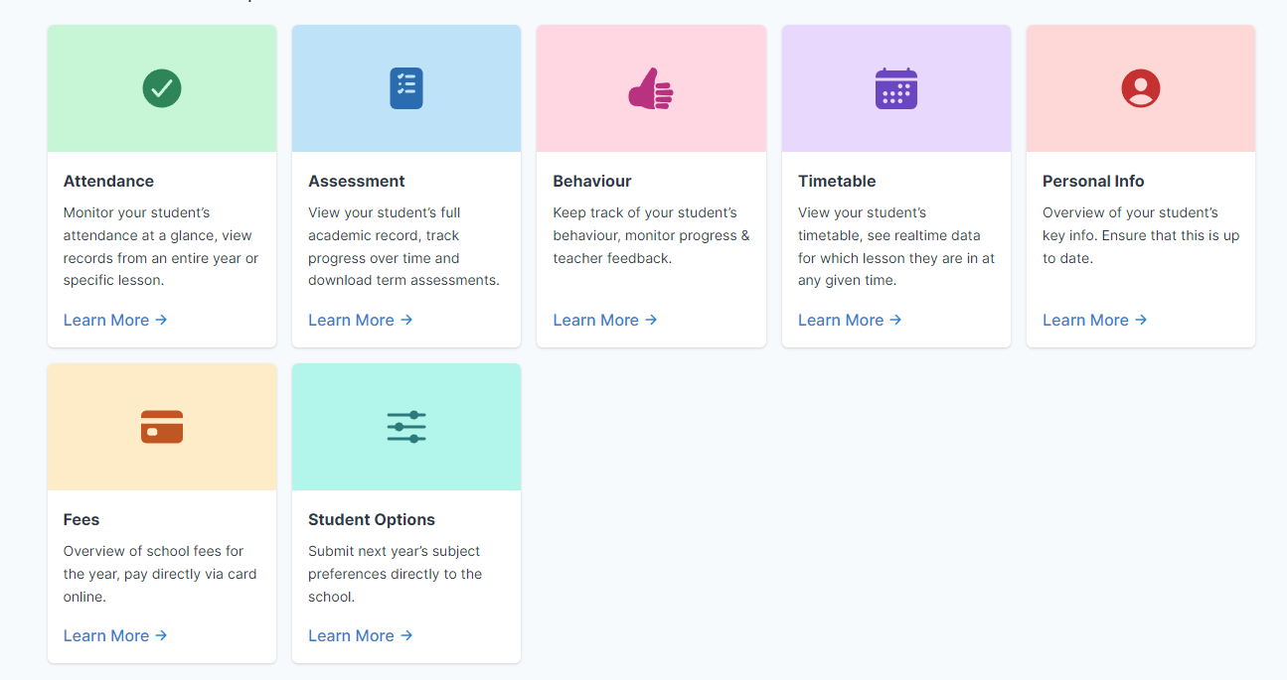
Step Three
Click the student options tab

Slide 70
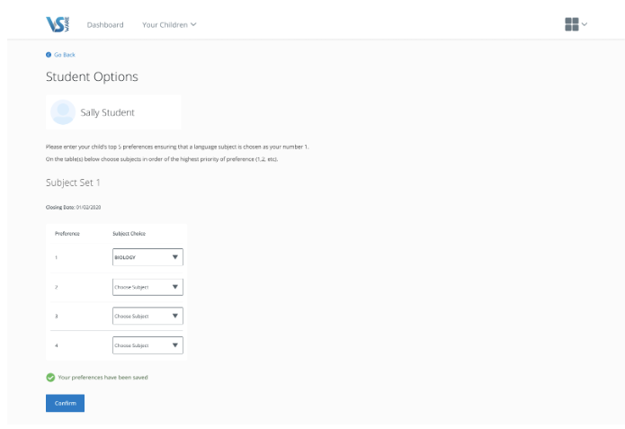
Step Four
On next screen, choose 6 subjects in order of preference and click confirm.

