Slide 1


Borrisokane Community College Seeking to promote a caring and committed school community
Junior Cycle Subject Choice

Slide 2
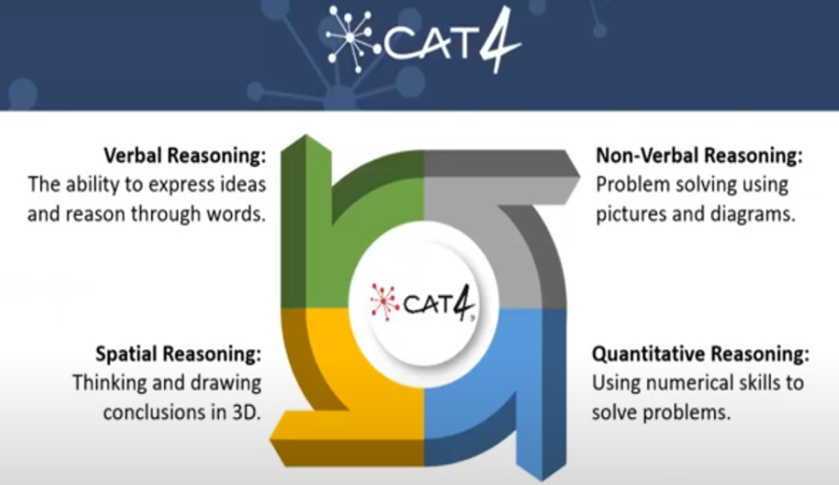
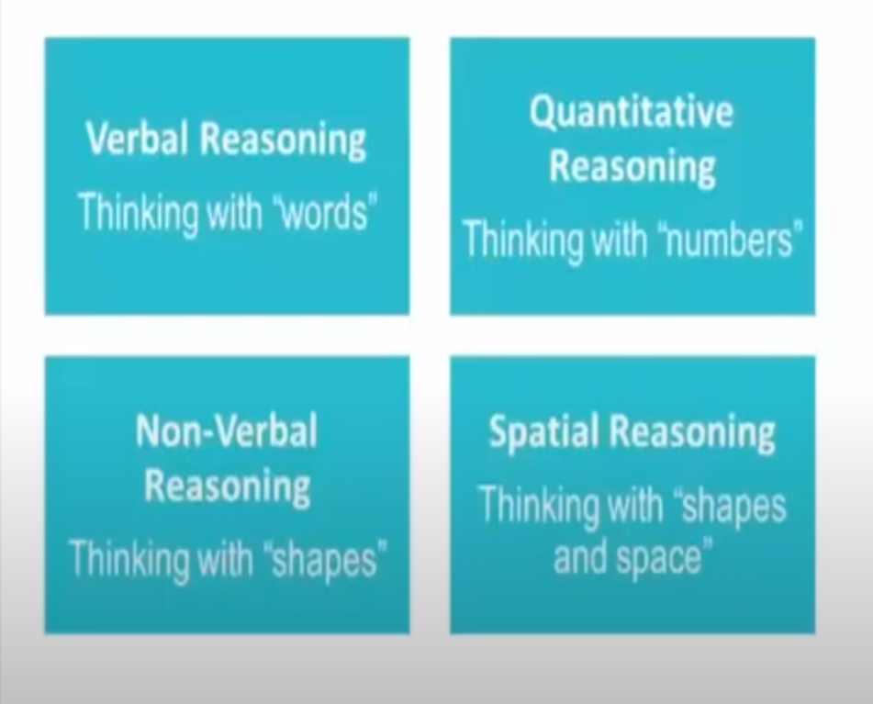
CAT 4

Slide 3
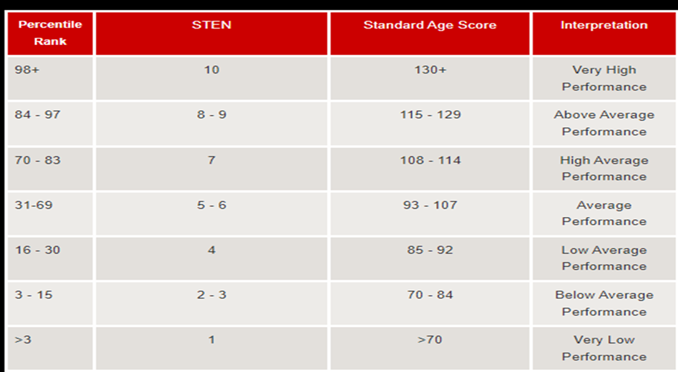

Slide 4
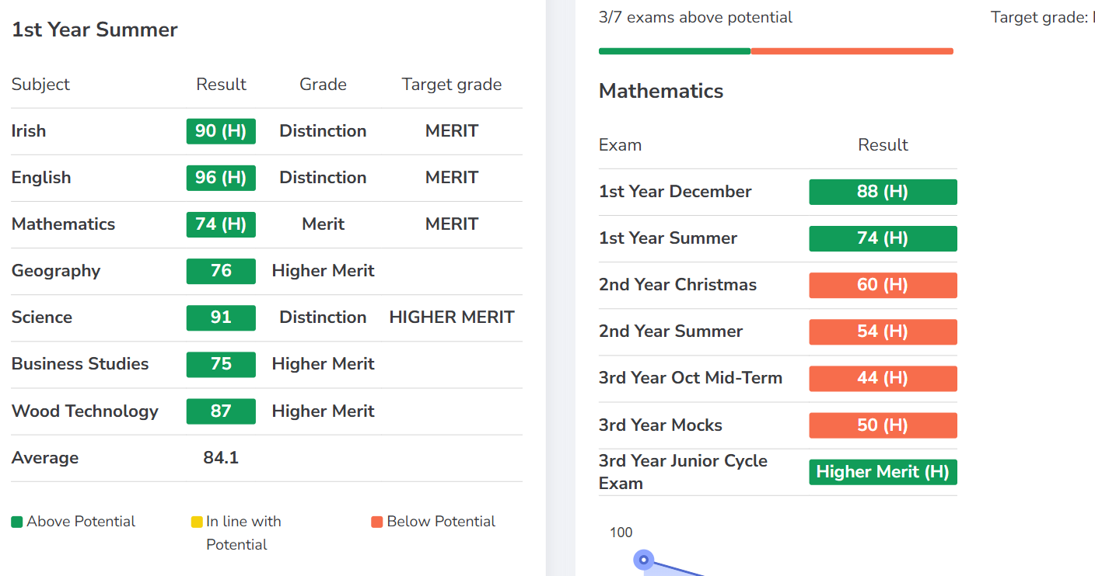
Athena

Slide 5
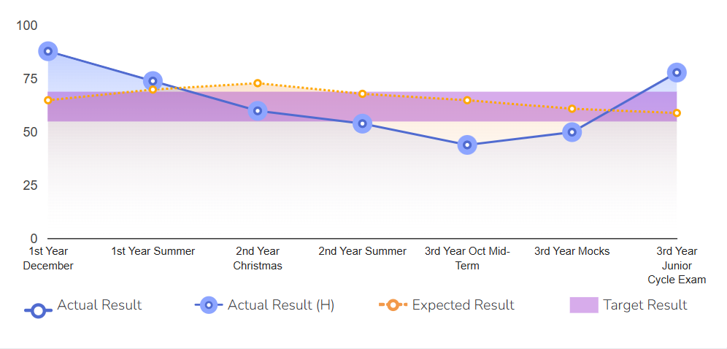

Slide 6
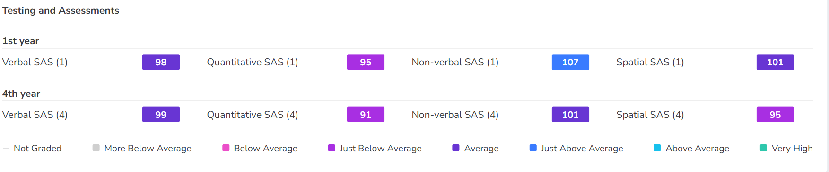

Slide 7
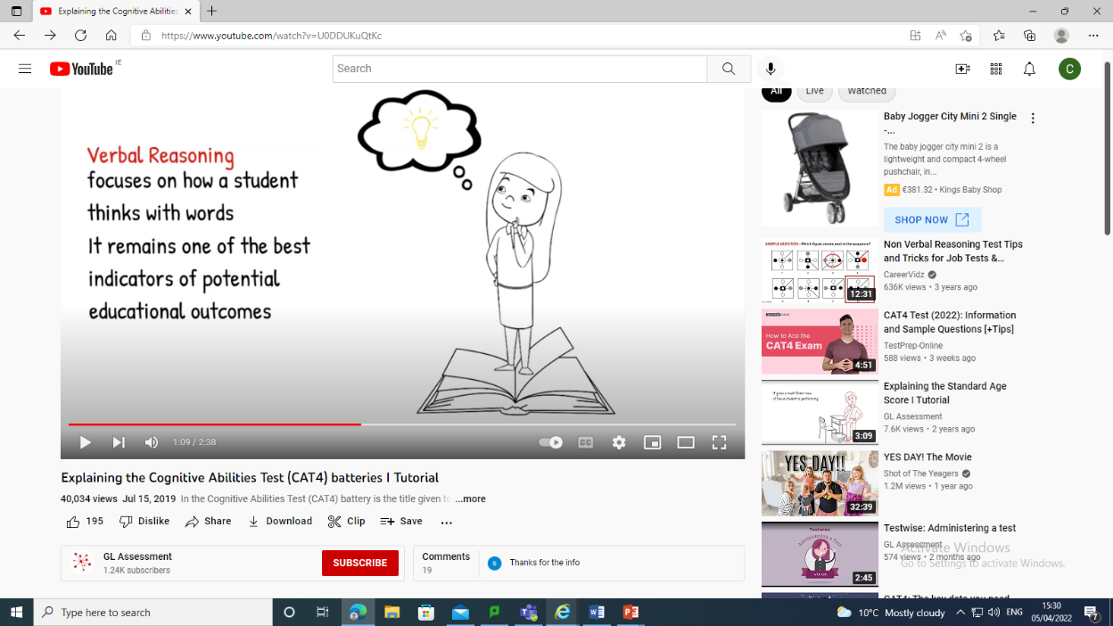
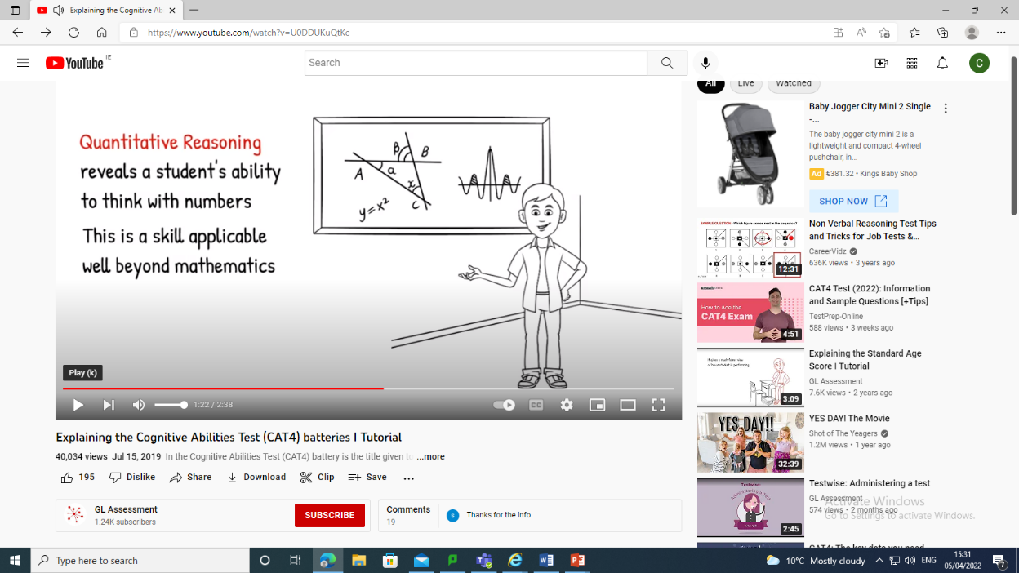
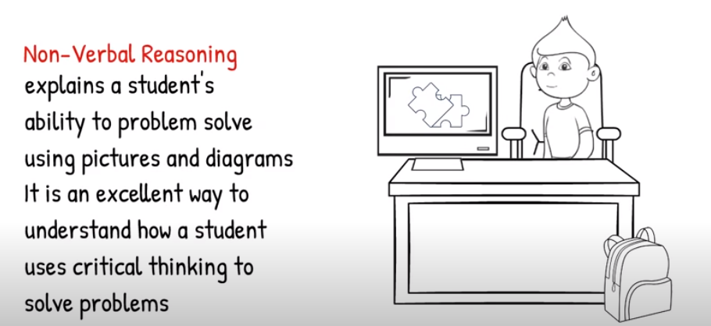
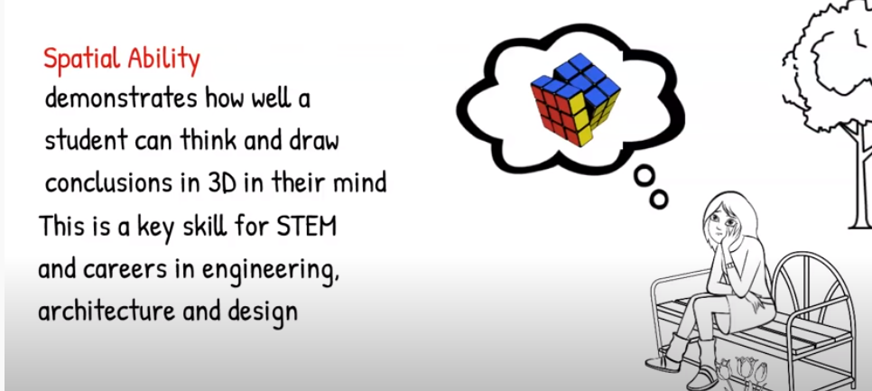
Consider their SAS (Standard Age Score) in the following Batteries:
Verbal Reasoning subjects: Languages, History, Geography, Home Economics & Business.
Quantitative Reasoning subjects: Maths, Metalwork, Graphics, Science
Non-Verbal Reasoning subjects: Maths, Art, Graphics, Metalwork, Wood Technology, Science
Spatial Ability subjects: Art, Metalwork, Home Economics, Wood Technology, Geography & Graphics.

Slide 8
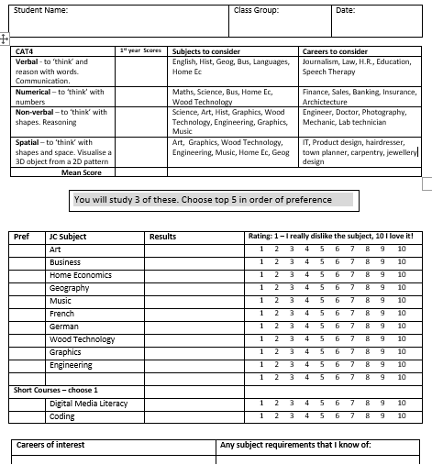

CAT4 scores
Rank your subjects in order of preference
Class test results
How much you like the subject
Career/ subject requirement

Slide 9


Subject Choice Pathways Through BCC
1st Year
2nd Year
3rd Year
TY
LCA
LCE
At various stages students make subject or programme choices.
The first term of 1st year allows students to sample all subjects.
This facilitates an informed decision regarding subject choice for Junior Cycle

Slide 10
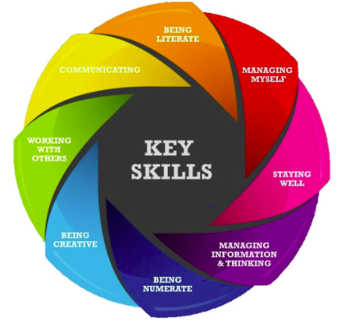
Junior Cycle Core Subjects – (compulsory)
Irish (unless exemption)
English
Maths
Science
Religion
History
PE
SPHE
CSPE
Wellbeing & Guidance
These 4 subjects make up 400 hours of WELLBEING at BCC and include learning through
Whole School Guidance:
Developing Myself
Developing My Learning
Developing My Career Path

Slide 11

3 Junior Cycle Optional Subjects – (Choice)
Art
Business
Home Economics
Geography
Music
French
German
Wood Technology
Graphics
Engineering
short courses (100 hours approx.):
Digital Media literacy or Coding
Students will study three options for Junior Cycle.
Place five subjects in order of preference.
Indicate which short course you wish to take.

Slide 12
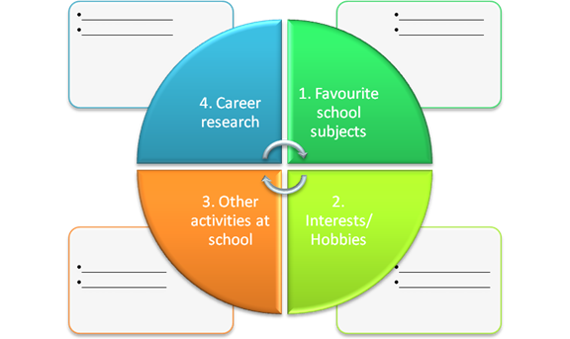
General advice when Choosing Subjects
Choose subjects you enjoy.
Choose subjects you excel in.
Be aware of College requirements (eg. Language).
Be aware you may receive your 4th/5th choice.
Talk to teachers of the subjects.
Research subjects using www.curriculumonline.ie
Ask for advice from Guidance Dept.

Slide 13
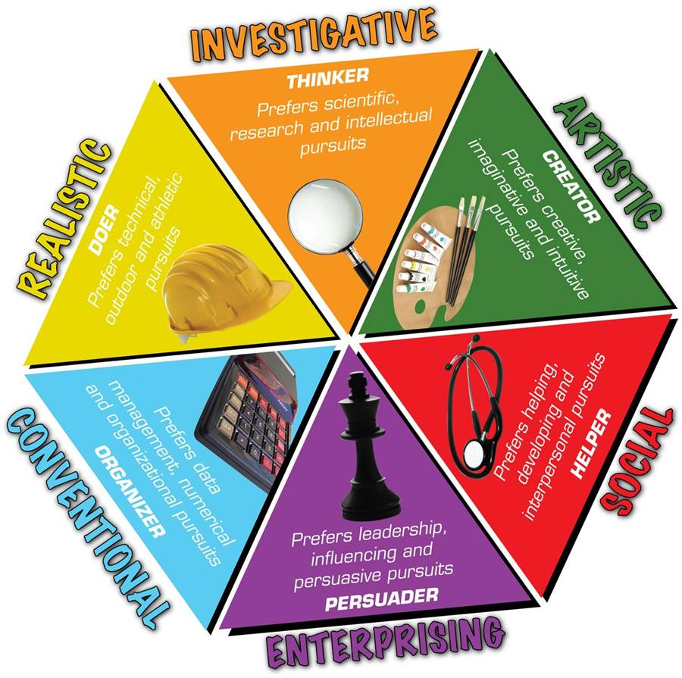
How do you like to learn?
Consider:
Do you like reading & learning factual information?
Do you prefer practical hands-on tasks?
Do you enjoy discussion and analysing information?
How are you at problem solving?
Are you creative and enjoy expressing yourself through creativity?
Do you prefer project work or assignments or performing in exams?
https://classroomguidance.ie/test/learning-styles-2/

Slide 14

Future Career & Study Path
Discussion & reflection on possible careers & further study supports decision making.
Be mindful JC subjects may have an impact on senior cycle subject choices.
Skills & knowledge learned in subjects at Junior Cycle are expanded upon in most Senior Cycle subjects.
https://classroomguidance.ie/test/musaic-psychometric-test/

Slide 15
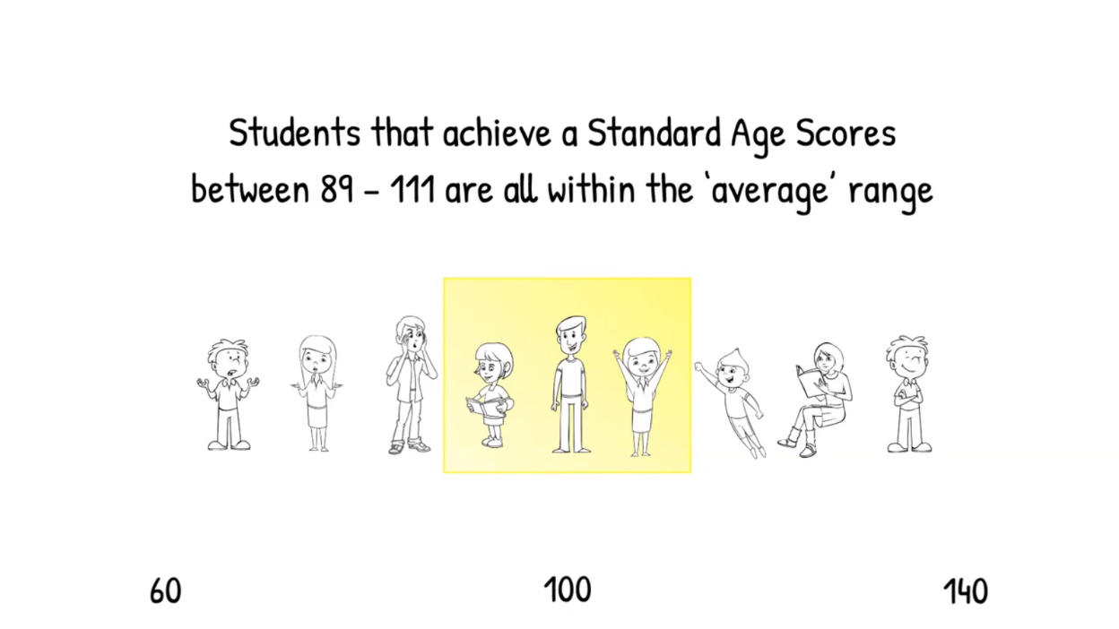
What is CAT4 used for? CAT4: Cognitive Abilities Test Fourth Edition
Understanding how a student thinks
Identifying academic potential
Determining where further support may be necessary
Informing decision making regarding subject choice
Students that achieve a Standard Score of between 90 and 110 are within the ‘average’ range.

Slide 16
Further Information
www.curriculumonline.ie
www.jct.ie
www.examinations.ie
www.qualifax.ie
www.careersportal.ie
Choices
Interest
Ability
Motivation
Results

Slide 17
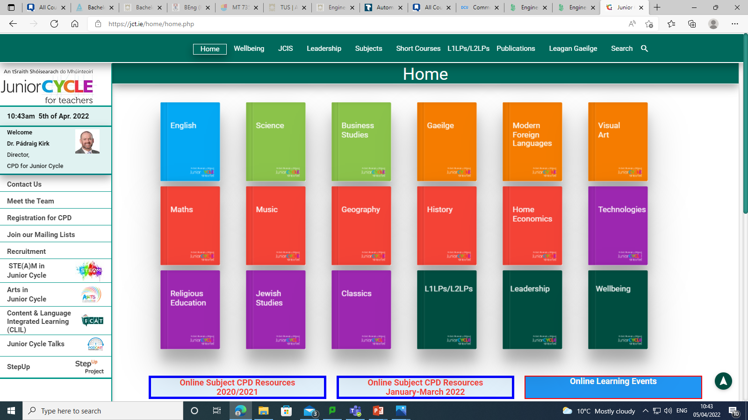
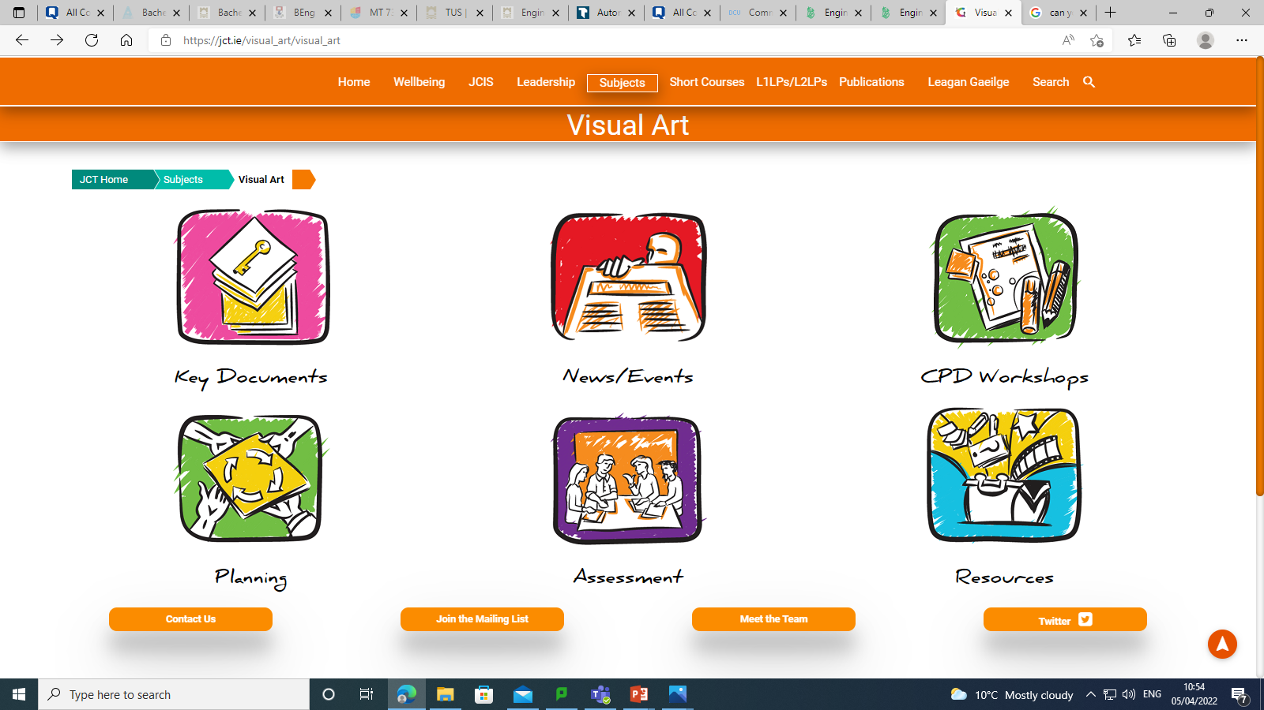
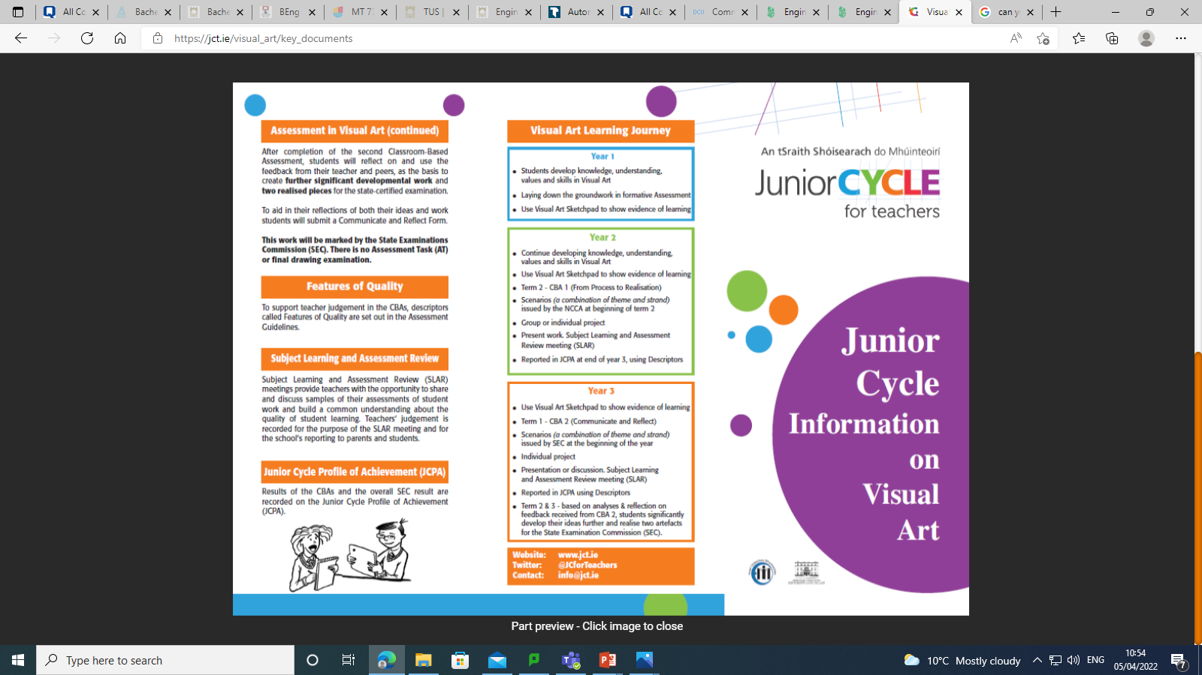
‘Information Leaflet’

Slide 18
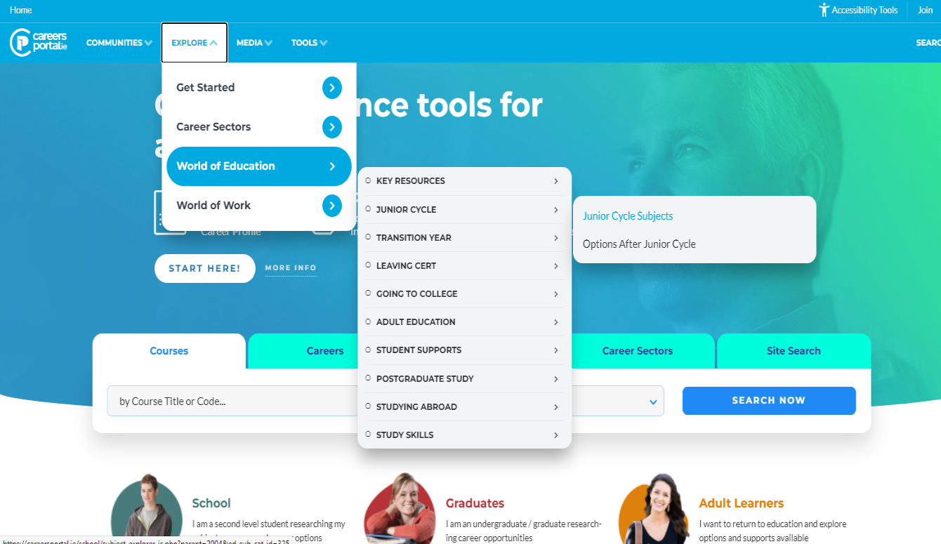
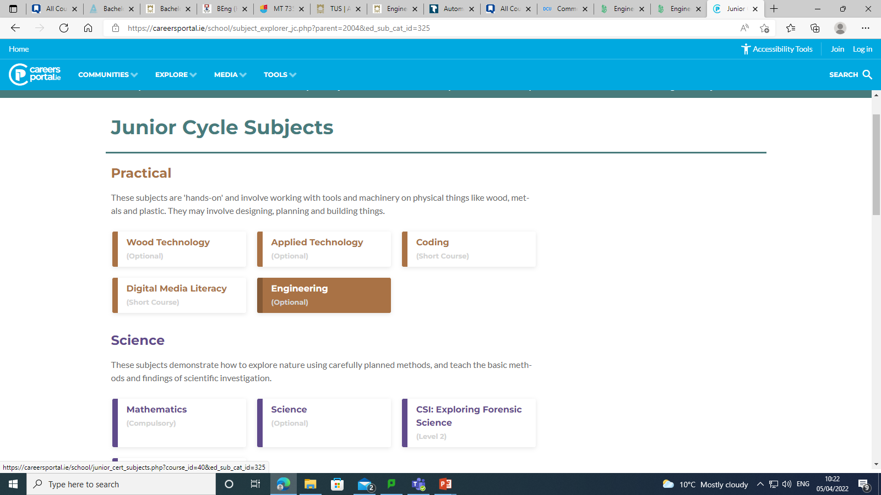
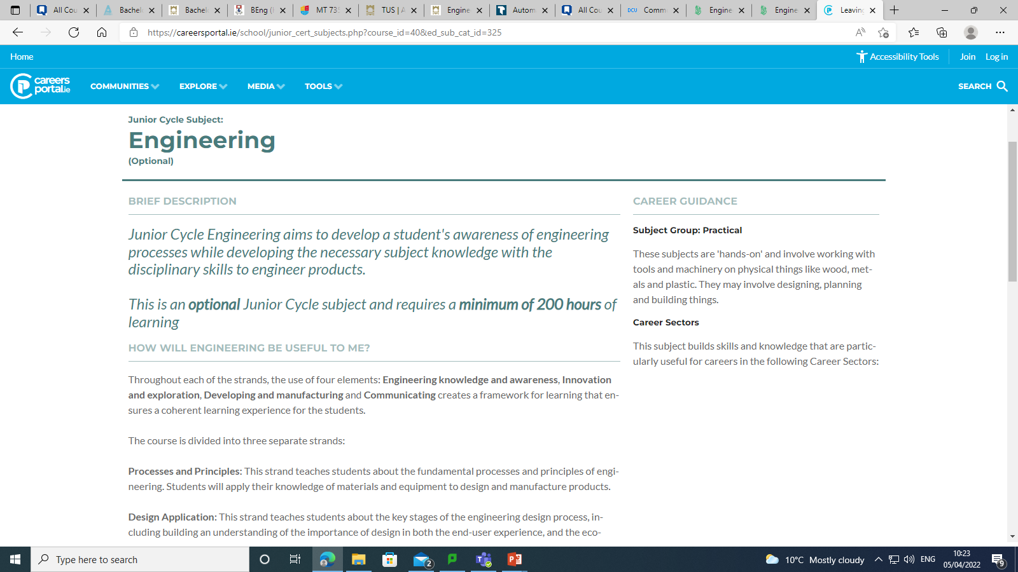
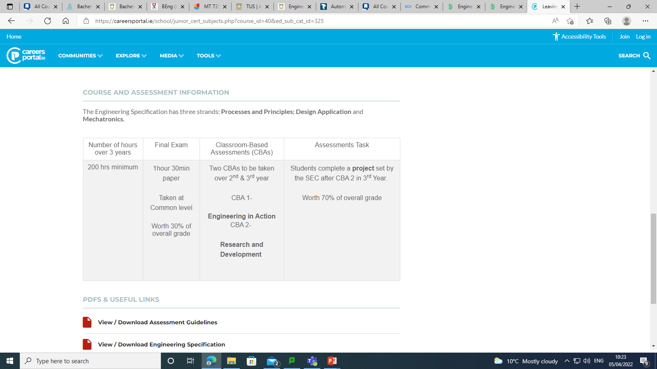
1
2
3
4
Breakdown of course

Slide 19
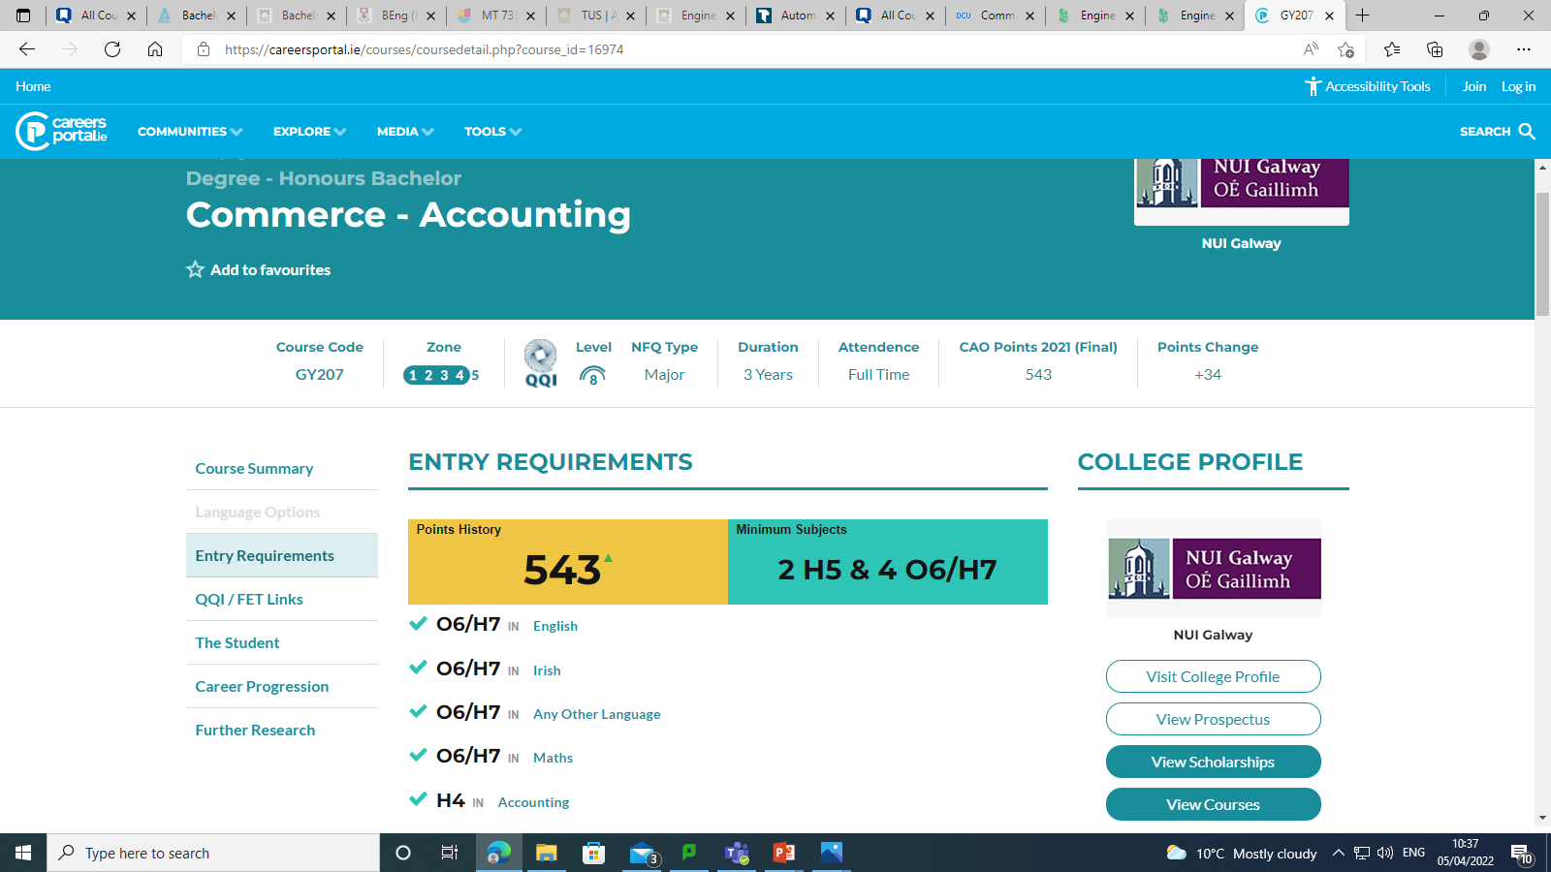
www.careersportal.ie

Slide 20
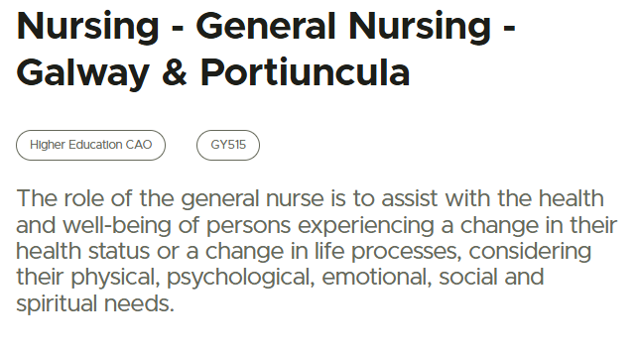
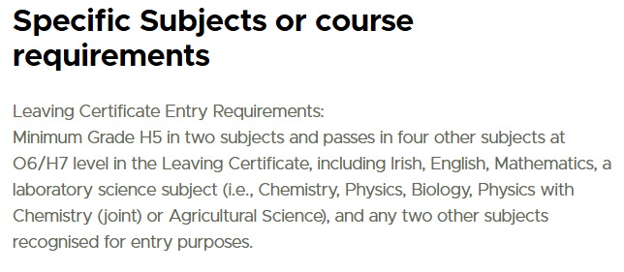
www.qualifax.ie
Specific Subject Requirement: Irish, Eng, Mat, Lab Sc O6/H7
*Irish Exemption Contact admissions office*

Slide 21
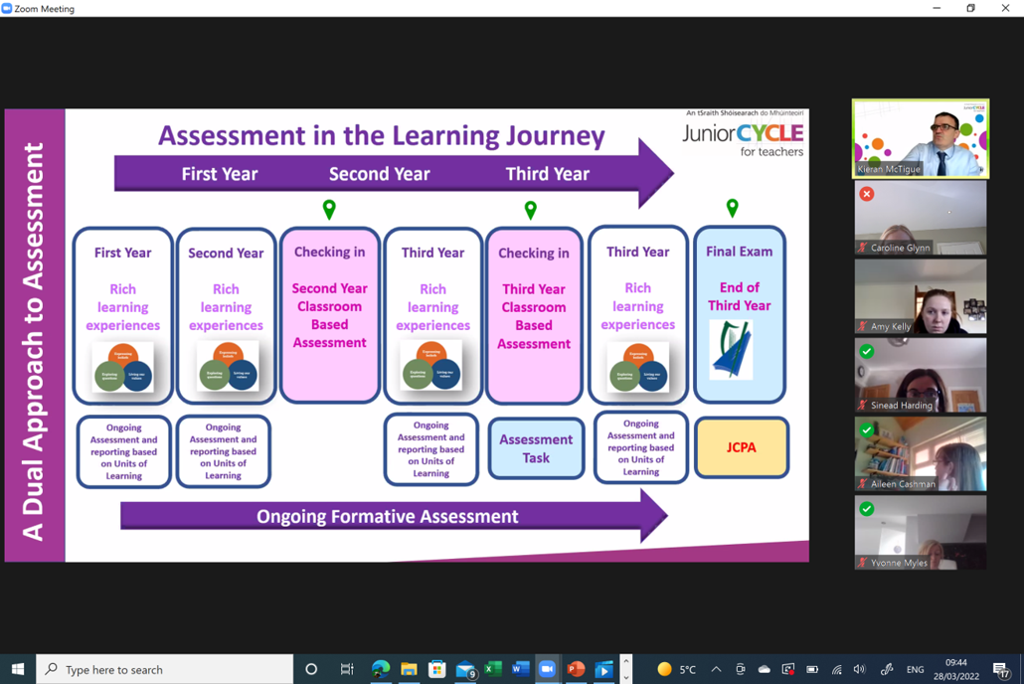
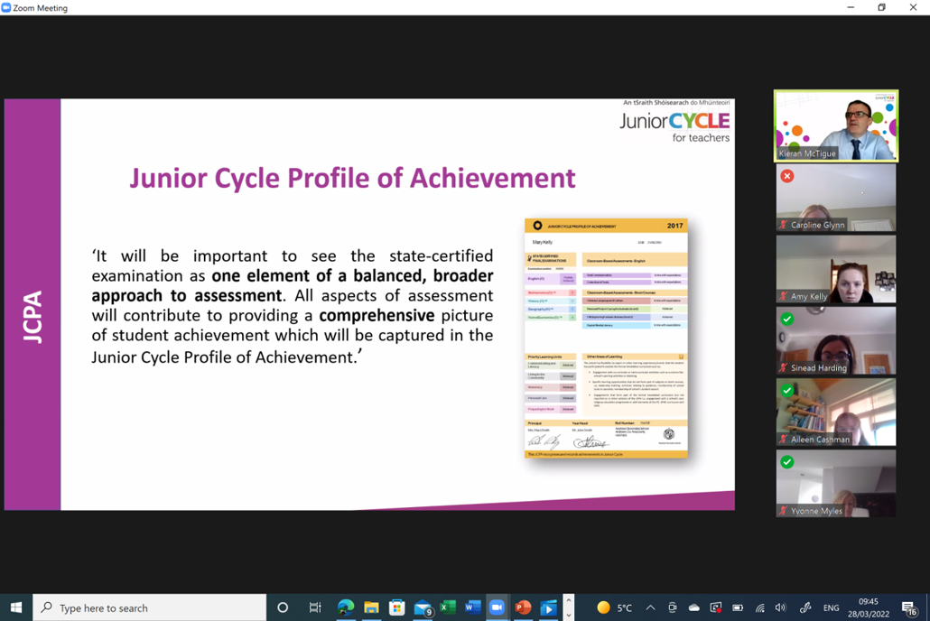
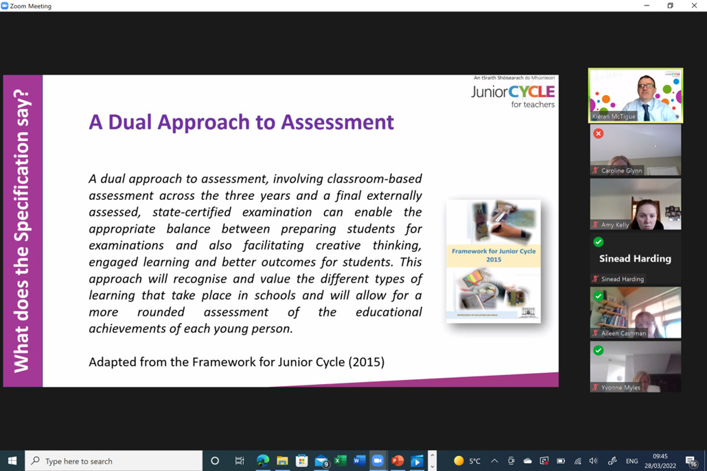
When considering the subjects you wish to take keep in mind that throughout 2nd & 3rd year there will be CBA’s (Classroom Based Assessments); with a final exam in 3rd year*

Slide 22

Modern Foreign Languages
Choice between French or German.
Modern Foreign Languages | Curriculum Online
3 Strands: Communicative Competence Language Awareness Socio-cultural Knowledge & Cultural Awareness *For 4 of the 7 universities you need a foreign language (exceptions: Science, Nursing and Engineering).
Examination: CBA 1 (2nd Year) Oral Presentation CBA 2 (3rd Year) Language Portfolio SEC Examination: Final Exam (1 Common Paper) (Aural)
Careers/Courses: European Studies, Marketing, Hotel Management, Translation, EU, Teaching, Cadets, Tourism & Leisure.

Slide 23

Business
Business Studies is concerned with understanding the environment in which business operates including households. 3 Main Sections: 1)Personal Finance 2)Our Economy 3)Enterprise
Examination : CBA 1 (2nd Year) Business in Action CBA 2 (3rd Year) Presentation SEC Examination:Written Test (1 Common Paper).
Careers / Courses : Accounting, Banking, Bookkeeping, Administration, Insurance, Sales, Marketing, Customs and Excise, Taxation and Law.
https://curriculumonline.ie/Junior-cycle/Junior-Cycle-Subjects/Business-Studies/Rationale

Slide 24
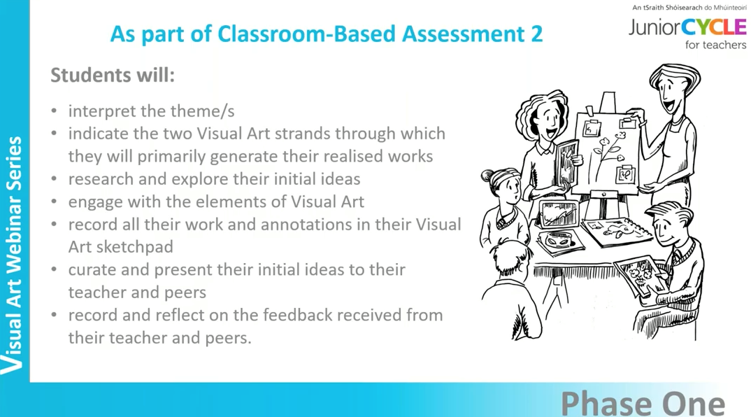
Visual Art
This course aims to develop the expressive, communicative and functional modes of art, craft and design with drawing as the central activity. Four main areas: Art (drawing: life, still life) Design (layout, composition, lettering) Crafts (pottery, puppetry, embroidery & collage etc) History & Appreciation
Examination: CBA 1 (2nd Year) From Process to Realisation CBA 2 (3rd Year) Communicate & Reflect SEC Examination: a school-based project, chosen from a list of themes completed during 3rd year
Careers/Courses: Graphic Design, Film, Animation, Teaching.
https://curriculumonline.ie/Junior-cycle/Junior-Cycle-Subjects/Visual-Art/Rationale/

Slide 25
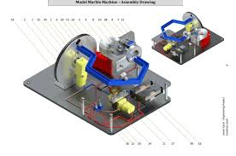
Engineering
In Engineering you will learn how to work with metal and assemble different parts. Plastics and wood are also investigated. What will you do: examine properties of metal/wood/plastics examine how things work freehand sketching joining and assembling materials learn about basic electronic components
Examination: CBA 1 (2nd Year) Engineering in Action CBA 2 (3rd Year) Research & Development SEC Examination: Project 70% & Written Examination 30%
Careers/Courses: Aircraft Technician, Fitter/Turner, Industrial Design / Operatives, Mechanics, Mechanical Production, Structural and Civil Engineer, Toolmaker and Welder.
https://curriculumonline.ie/Junior-cycle/Junior-Cycle-Subjects/Engineering/Rationale/

Slide 26
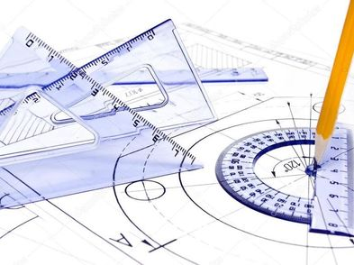
Graphics
In Technical Graphics you will learn how to represent 3-D objects on paper and on computer. What will you do: produce neat drawings of everyday items create models on the computer sketching, colouring and shading of objects make cardboard / paper cut-outs of items
Examination: CBA 1 (2nd Year) Communication through Sketching CBA 2 (3rd Year) Graphical Presentation Skills SEC Examination: Project 70% & Written Examination 30%
Careers/Courses: Civil Engineering, Mechanical Engineering, Construction Management, Architecture, Product Design, Quantity Surveyor, Draughtsman, Graphic Design and Teaching .
https://curriculumonline.ie/Junior-cycle/Junior-Cycle-Subjects/Graphics/Rationale/

Slide 27

Wood Technology
In Woodwork you will learn to design small projects and the skills required to use tools and equipment to make your designs. Main sections: Examine trees & the environment Sketching Design Project & Folder Woodwork theory
Examination: CBA 1 (2nd Year) Wood Science in our Environment CBA 2 (3rd Year) Student Self-analysis & Evaluation SEC Examination: Project 70% & Written Examination 30%
Careers/Courses: Sustainable Energy Consultant, Civil Engineering, Mechanical Engineering, Construction Management, Architecture, Quantity Surveyor, Site Foremen, Plumber, Carpenter, Joiner.
Wood Technology | Curriculum Online

Slide 28
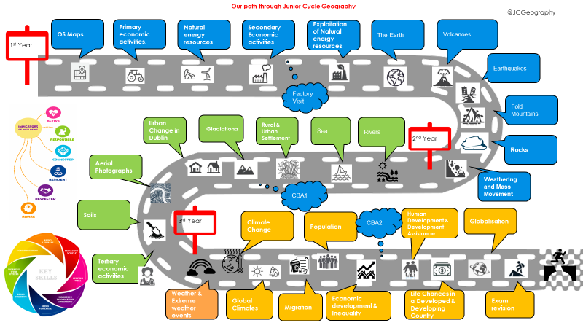
Geography
Enlarge this image so you can see all the topics covered.
Geography is the study of the Earth’s landscapes, peoples, places, and environments. The study of geography helps to explore and understand the world around you. What will you learn? The Human Habitat - Processes and Change Population, Settlement Patterns and Urbanisation Patterns in Economic Activity
Examination : Written Test (1 Common Paper).
Careers/Courses: Town planning, Teaching, Engineering, Geology.
https://curriculumonline.ie/Junior-cycle/Junior-Cycle-Subjects/Geography/

Slide 29
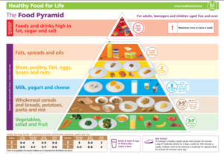
Home Economics
Junior Cycle Home Economics develops knowledge, understanding, skills and values necessary for healthy and sustainable living as an individual and as a member of families & society. 3 Strands: Food, Health & Culinary skills Responsible Family living Textiles & Craft
Examination: CBA 1 (2nd Year) Creative Textiles CBA 2 (3rd Year) Food Literacy Skills Brief SEC Examination: Cookery Exam 50% & Written Exam 50%
Careers/Courses: Hotel, Catering & Tourism, Culinary Arts, Fashion & Design, Childcare, Home Economics Teaching, Social Care, Food Science
https://curriculumonline.ie/Junior-cycle/Junior-Cycle-subjects/Home-Economics/Rationale/

Slide 30
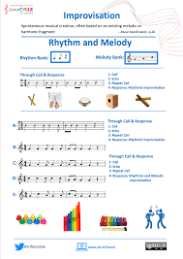
Music
In Junior Certificate Music, you will sing and possibly learn how to play an instrument. You will listen to many types of music such as pop, classical and traditional Irish music. You will also start composing. What will you do: learn about many types of music learn how to read and write music learn how to sing songs and maybe how to play an instrument.
Examination: CBA 1 (2nd Year) Composition Portfolio CBA 2 (3rd Year) Programme Note (Leads on to Practical Exam) SEC Examination: Practical Exam 30% & Written Examination 70%
Careers/Courses: Composer, Conductor, Sound Engineer, Primary School Teaching, Drama & Theatre & Communications.
Music | Curriculum Online

Slide 31
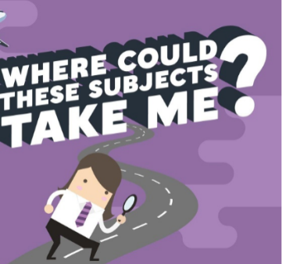
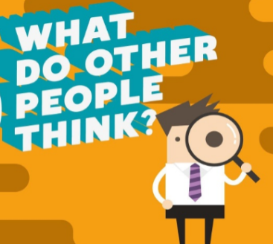

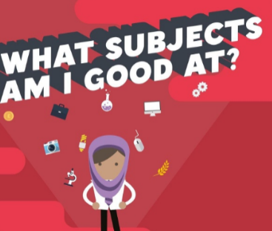
Choosing subjects
Take the time to make an informed decision
When choosing subjects you need to consider 2 main questions:
What subjects do you enjoy?
What subjects are you good at?
Please talk to your parents/guardians and also contact your teachers for advice if you are unsure
Use the hyperlinks attached to this presentation to research the subjects on offer; to assess the type of learner you are or identify possible career interests

Slide 32
Thank you for listening
trudy.carroll@borrisokanecc.ie

Slide 33
Subject Options – 1st Year 2025/2026

Slide 34
Choosing subject options
All subject options will be chosen through VSWare
The options will become Friday morning Jan 9th at 9am and will remain open until 16th Jan 2026
Once submitted, changes can be made up to closing date
The following slides will help with choosing the options

Slide 35
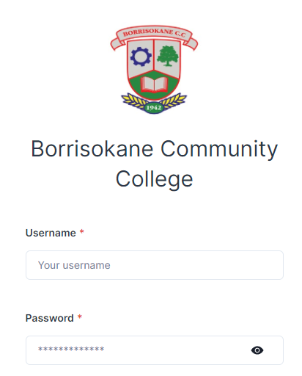
Step One
Log into the Vsware app with username and password
Any issues with logins, please email the school on info@borrisokanecc.ie

Slide 36
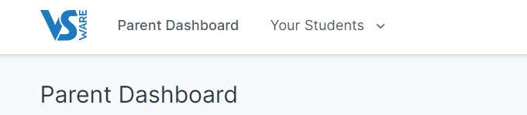
Step Two
Click on ‘Your Students’ and select the student for whom you are picking option subjects

Slide 37
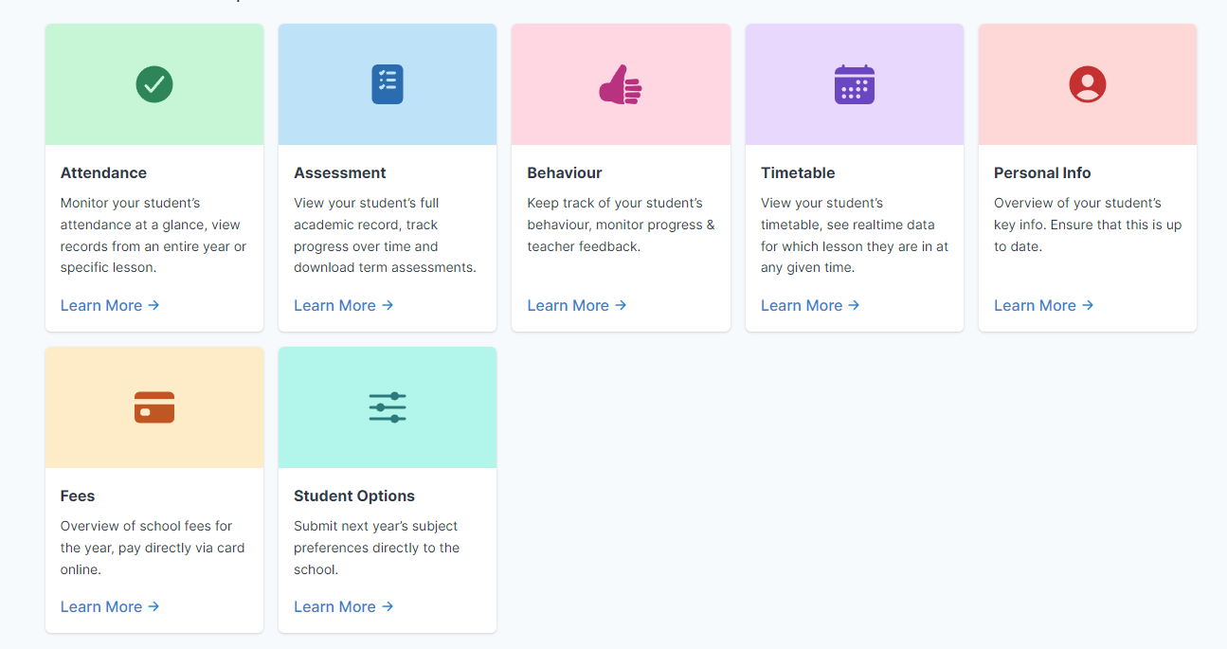
Step Three
Click the student options tab

Slide 38
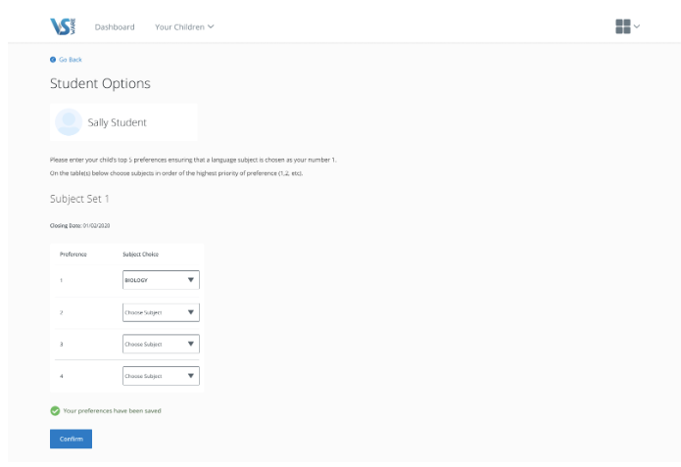
Step Four
On next screen, rank top five subjects in order of preference and click confirm.

Slide 39
Reminders - Behaviour
Behaviour in hallways - make sure you are lining up outside your classrooms before the beginning of class. Keep the hallways clear: keep your bag on your back, against a wall or on a bag-rack.
Behaviour at lunchtime - remember that senior students are still in class, be respectful when on the halls at lunchtime. Always be respectful in the canteen, do not litter and treat the canteen staff with respect (say please and thank you!)
Only buy food for yourself with your lunch card.
Helmets must be worn at lunchtime when hurling with no exceptions.
VSWare Points – 100 points required for end of year trip (Emerald Park)

Slide 40
Reminders
Uniform - full school uniform must be worn every day, including the school jacket. PE uniform must be worn on days students have PE only.
iPads - iPads must be fully charged coming to school every day. iPads are for school business only. iPads must be kept flat on the desk at all times in school unless with explicit permission from your teachers. When the iPad is not in use, keep it in your school bag.
Journals - Homework must be recorded in your homework journal at the end of each lesson.
Organisation - All students in First Year were provided with stationary at the beginning of the year, you must each bring your calculator, log tables and maths set to school each day, as well as pens, pencils, copy books and all other required equipment.
Phones - no phone use is permitted in school.
Bullying - All incidents of bullying will be dealt with in line with our Bí Cineálta policy. If any students are being bullied, do not join in! Report the issue immediately to me, Ms Maher or Ms Molloy (no innocent bystanders)

Slide 41
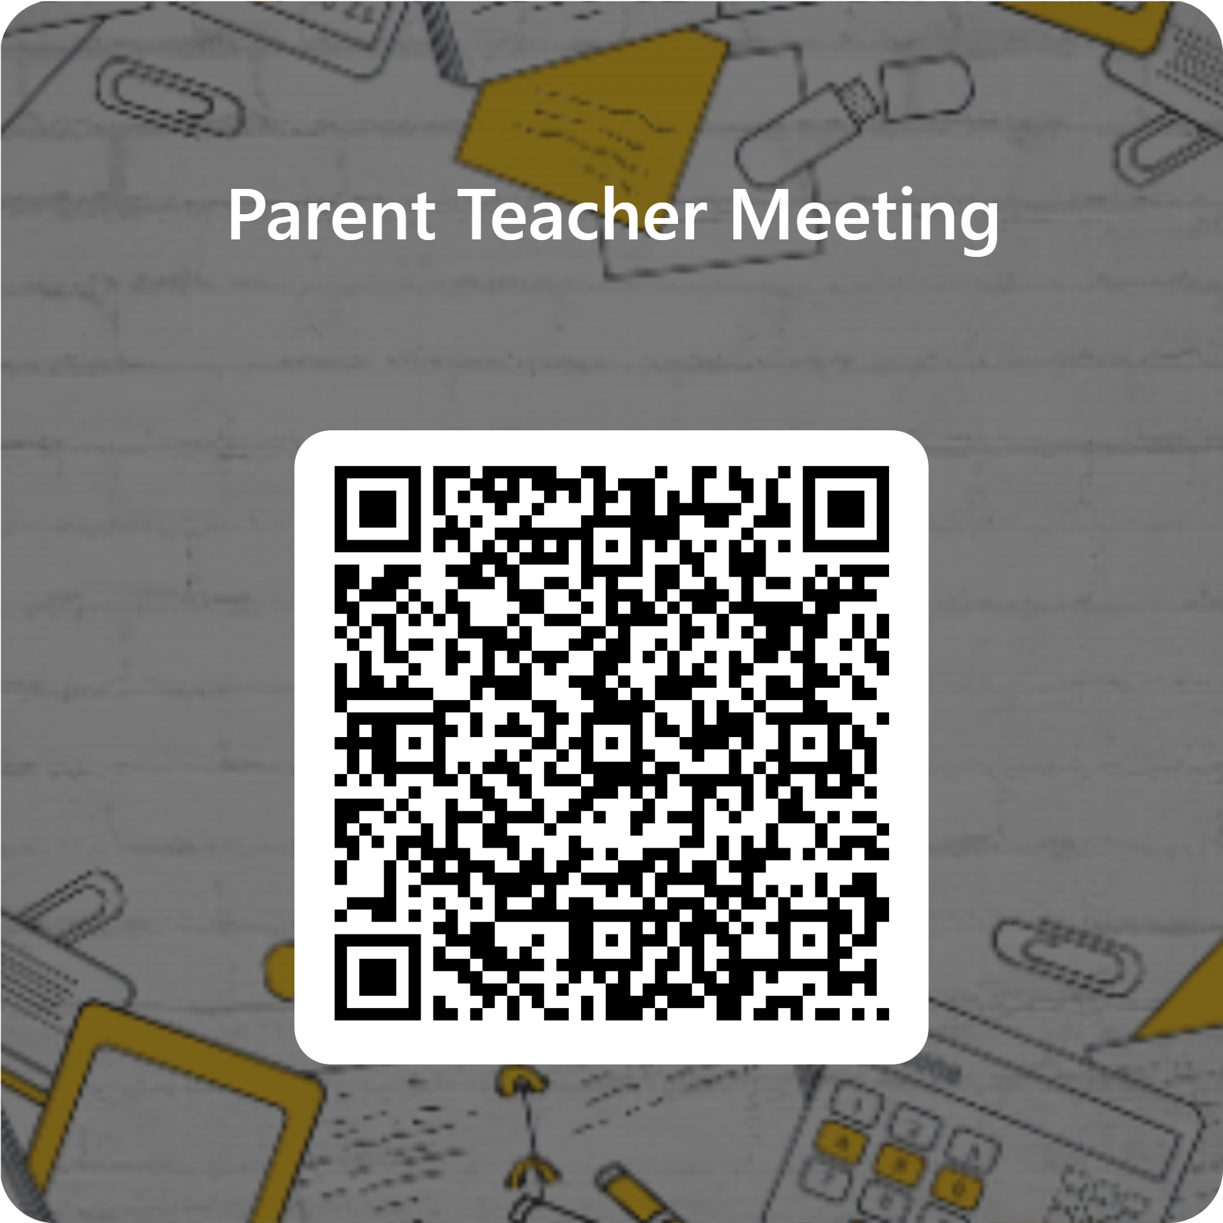
Reminders
A link was sent to all first years with a registration form for Thursday's Parent-Teacher-Student meeting.
( ← QR Code)
Please fill this in before Thursday
If your child has yet to submit their vaccination form, please do so as soon as possible.
This form must be returned whether your child is getting vaccinated or not.

