Slide 1


Borrisokane Community College Open Night 2026 2027

Slide 2
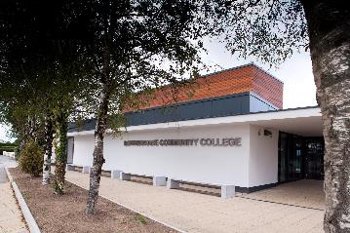
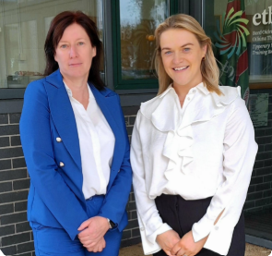
Principal: Paula Molloy Deputy Principal: Caitríona Maher
School Community
Notes:
What Borrisokane Community College has to offer in relation courses, subjects and activities.

Slide 3
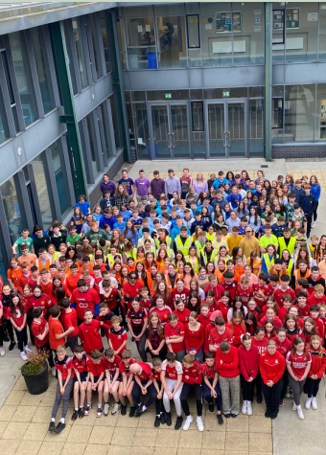
School Community
Students 720
Teachers 58
S.N.A.s 10
Admin 2
Caretaker 2

Slide 4


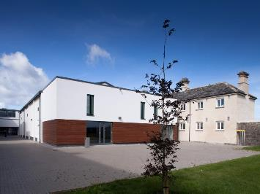
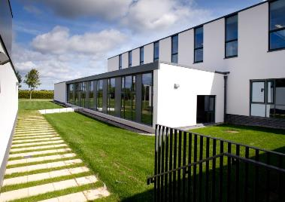
Mission Statement
“We seek to promote a caring and committed school community which will facilitate the education of our students and where each individual is valued as a unique human being.”
“Is ar scáth a chéile a mhairimid”
Notes:
Caring
Committed Staff
Each Individual
'we all exist in each others' shadow'

Slide 5
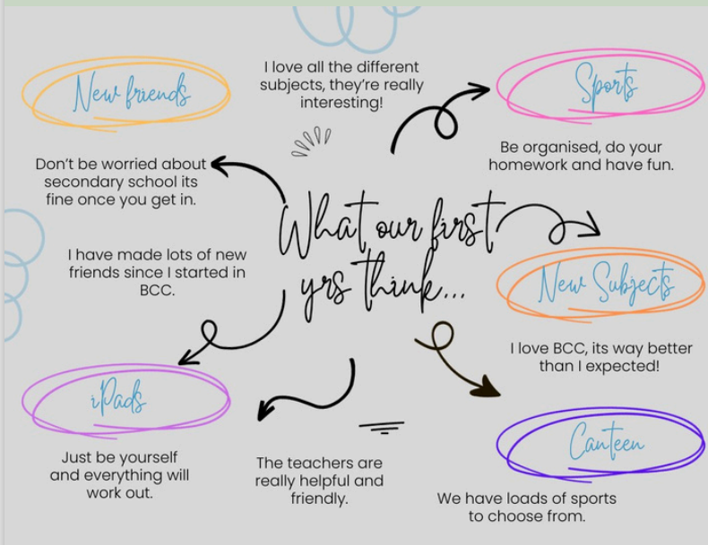
What our First Years say

Slide 6

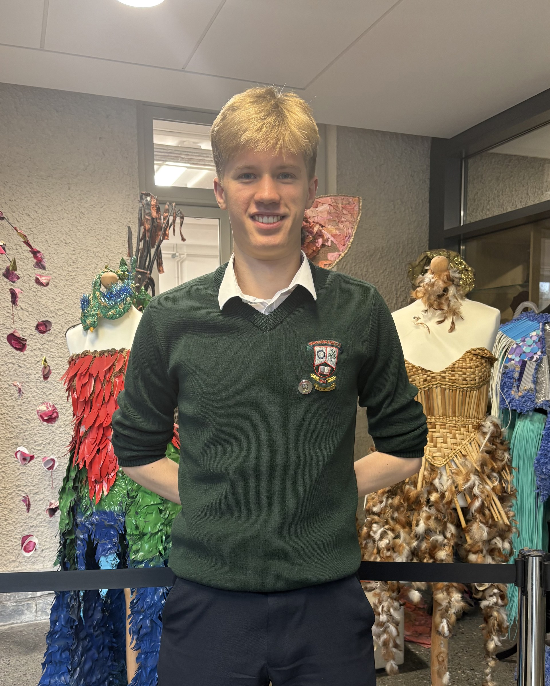
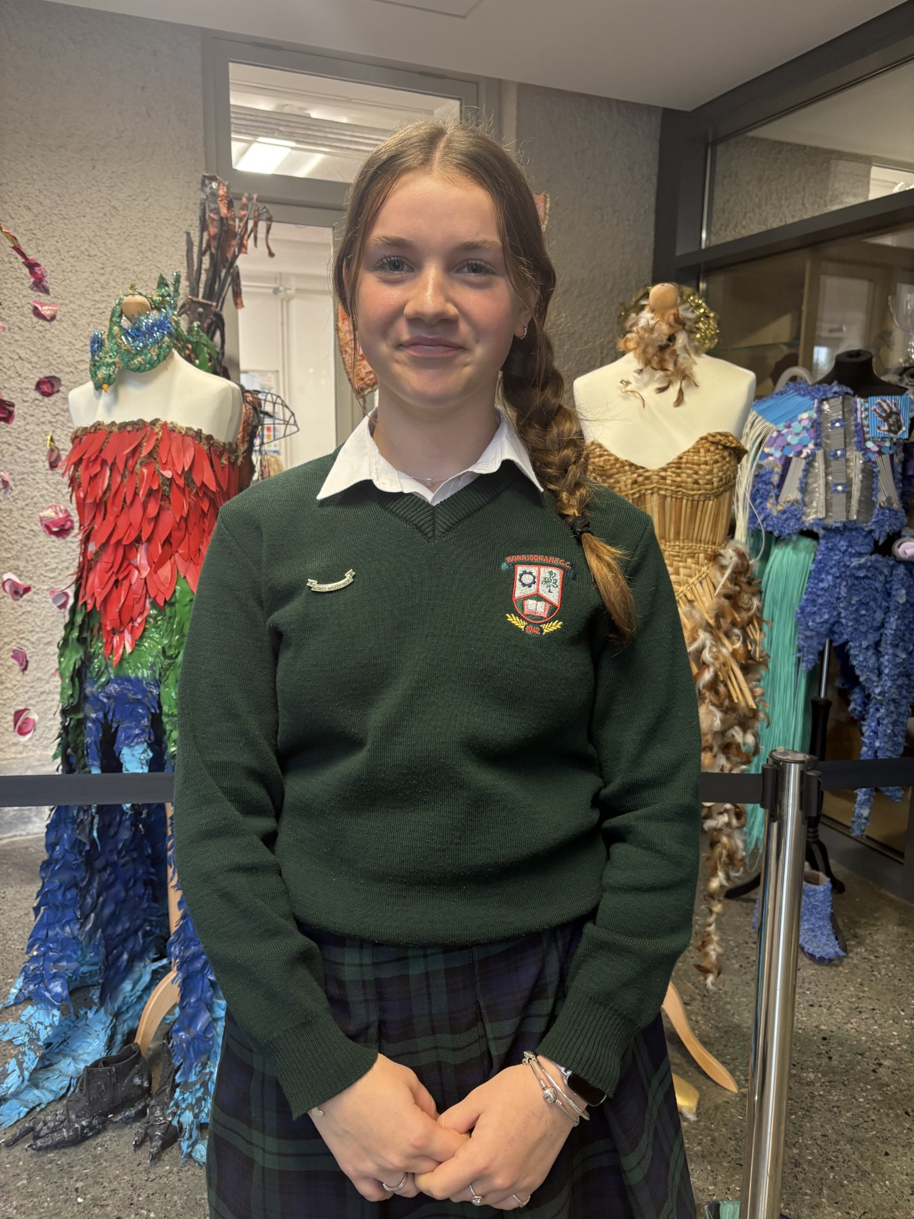
Student Council Reps
Dan Ryan
Grace Pearse

Slide 7
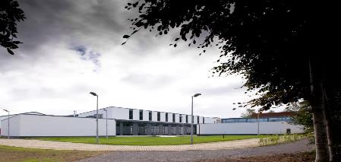
Programmes on Offer in Borrisokane Community College
Junior Cycle
Transition Year
Leaving Certificate
Leaving Certificate Vocational Programme
Leaving Certificate Applied Programme

Slide 8
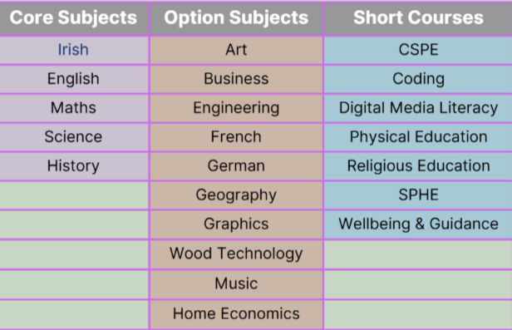
Junior Cycle
Sept-Dec/Jan Rotation of Option Subjects
Select 3 Options and continue until end of 3rd Year.
Complete Classroom Based Assessments (CBA’s)
Notes:
Option Subjects for first year choose four at end of year.

Slide 9
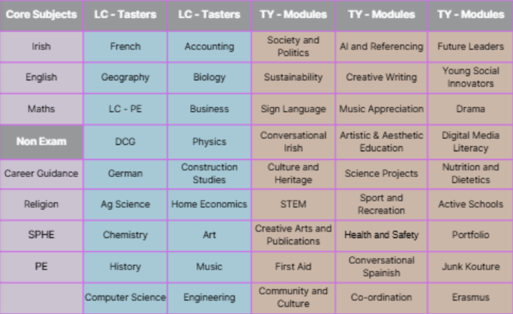
Transition Year
Transition Year offers students a valuable opportunity to explore new subjects, develop life skills, and engage in personal growth outside the traditional exam-focused curriculum.
TY encourages creativity, independence, and teamwork through a wide range of activities including drama, music, fieldwork, and workshops
Borrisokane Community College - Open Night 2026

Slide 10
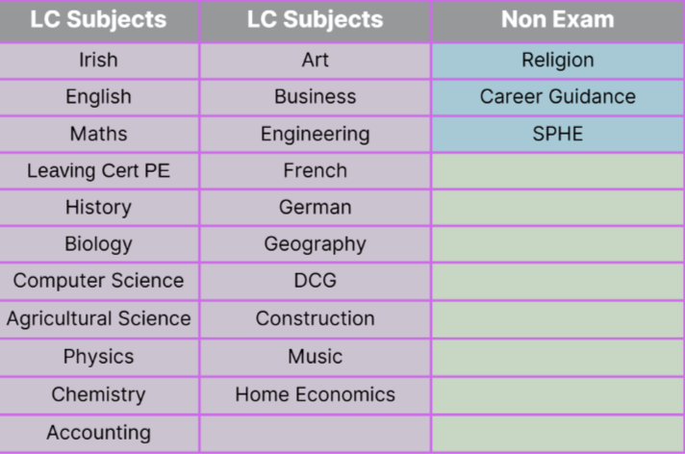
Leaving Cert Programme
The Leaving Certificate Programme at Borrisokane Community College offers students a broad and balanced curriculum to prepare them for further education, training, or employment.
Students typically study three core subjects, with additional options tailored to their interests and career goals.
The programme is supported by continuous assessment and term assessments.
New Senior Cycle Course – minimum 40% project component
Notes:
Students study 4

Slide 11
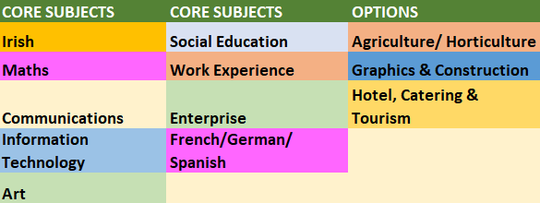
Leaving Certificate Applied Programme
The Leaving Certificate Applied Programme is a practical, hands-on programme designed for students who prefer continuous assessment and work-related learning.
It focuses on personal development, vocational preparation, and real-world skills through modules and tasks.
Students benefit from small group support, mentoring, and tailored guidance to help them succeed in further education or employment

Slide 12
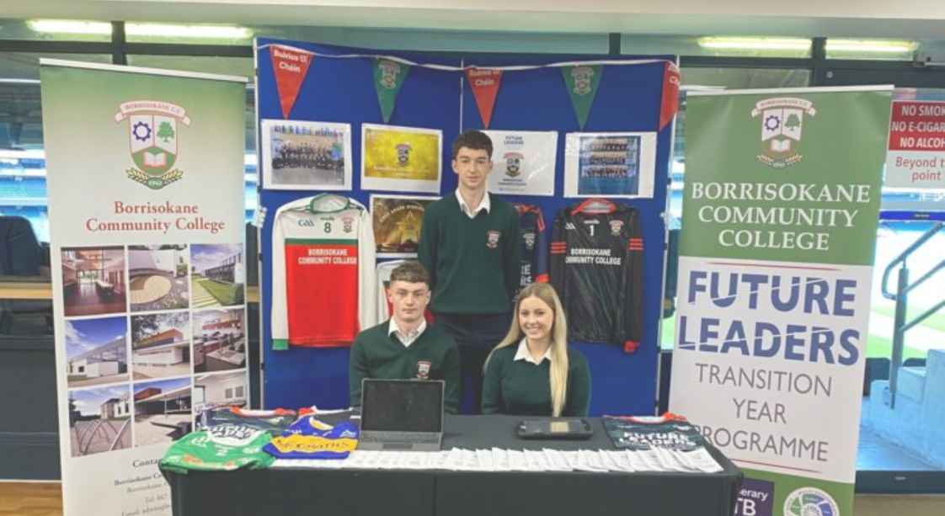
Supporting Our Learners
Continuous Assessment
Athena Academic Tracking
Mentoring Programme
Anti Bullying Programme
Erasmus+
One Good School
Active Schools Programme
Planet Youth
Future Leaders

Slide 13
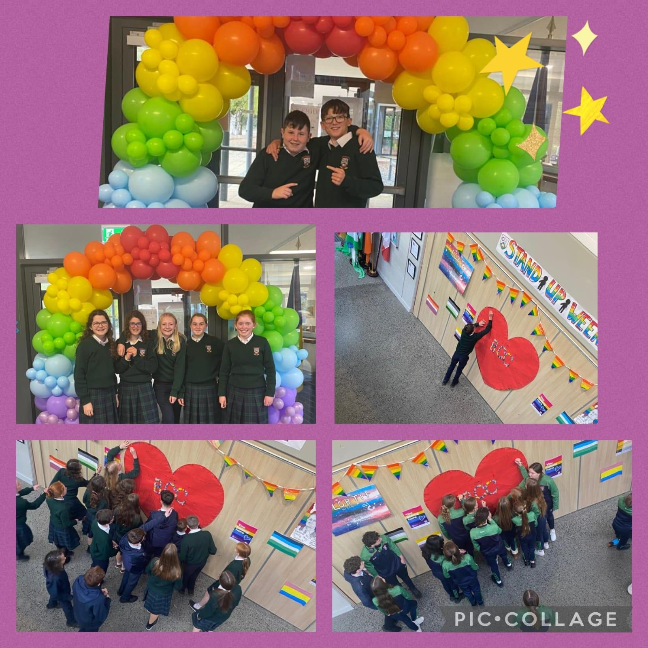
Student Supports
Student Support Team
Class Mentors
Year Head
Guidance Counsellors
Check and Connect
Sona
Counselling and Small Group Support
Cairde
Cinnire
Deputy Principal & Principal

Slide 14
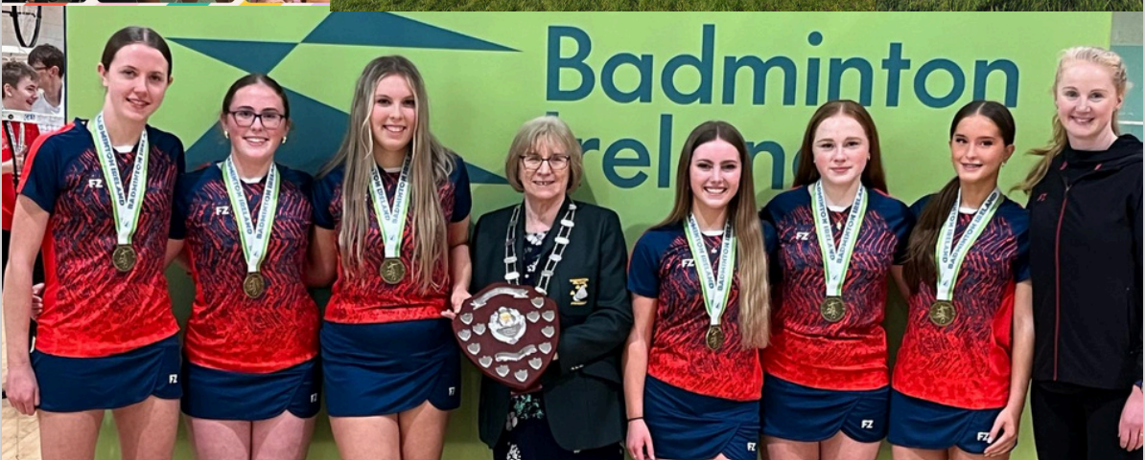
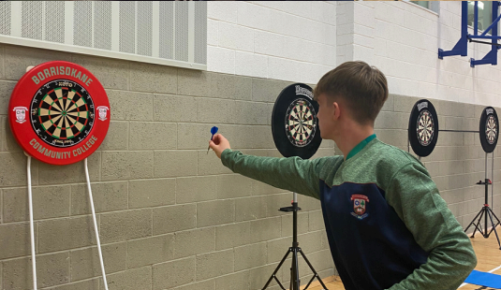
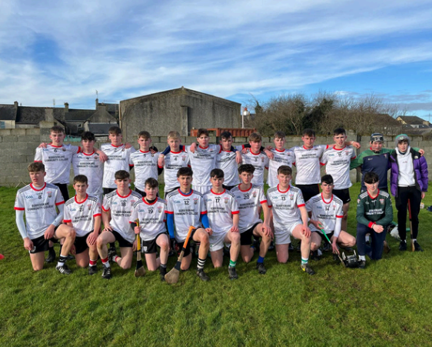
Activities Extra & Co Curricular
Camogie ​
String Music​
Rugby ​
Drumming ​
Debating & Public Speaking
Creative Writing​
Aerobics
Concerts​
Quizes
Traditional Music​
Basketball ​
Public Speaking​
Badminton ​
Soccer​
Athletics ​
Hurling ​
Drama​
Dance
Ladies Football ​
Gym
Chess
Darts
Table Tennis
Equestrian
Golf
Swimming

Slide 15
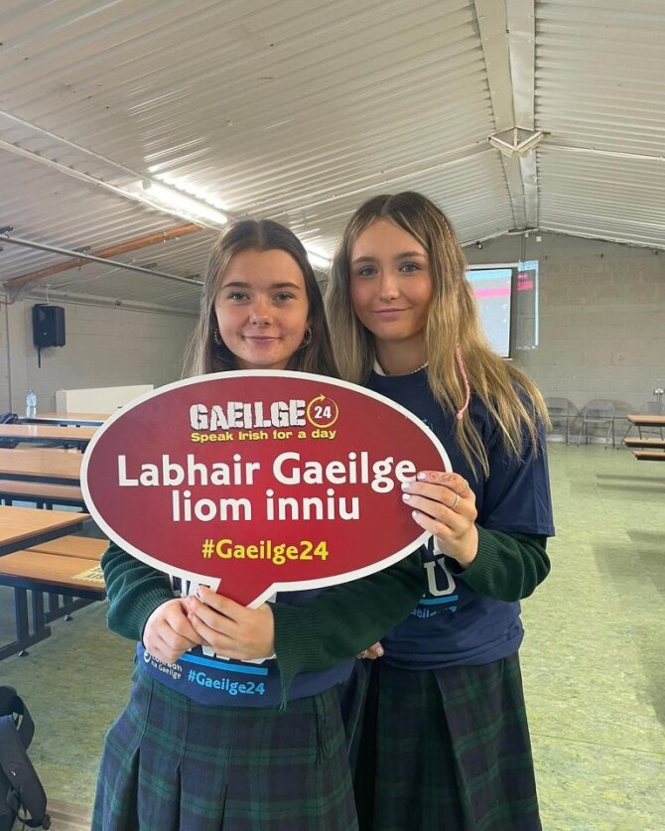
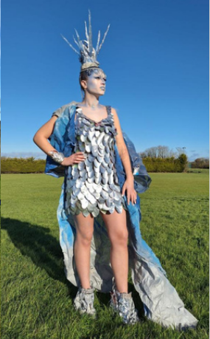
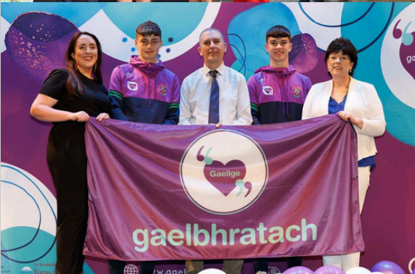
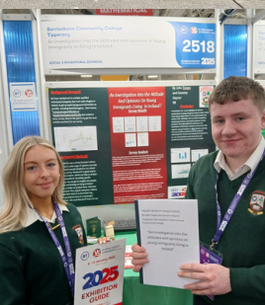
What else can I get involved in?
Gaisce Awards
Green Team
Club na nÓg
Gaelbhratach
Gaeltacht Scholarships
MFL Scholarships
Junk Kouture
Young Scientist
Angus Beef
SciFest
Stem Passport for Girls
TY Young Cooks

Slide 16

When do Teachers and Parents meet?
Induction meeting for parents in September
Parent/Student/Teacher Meeting in November/December
Meet all class teachers
Information from Career Guidance teacher
Parent/Student/Teacher Meeting in March/April
Meet all class teachers

Slide 17
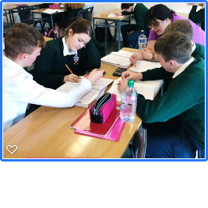
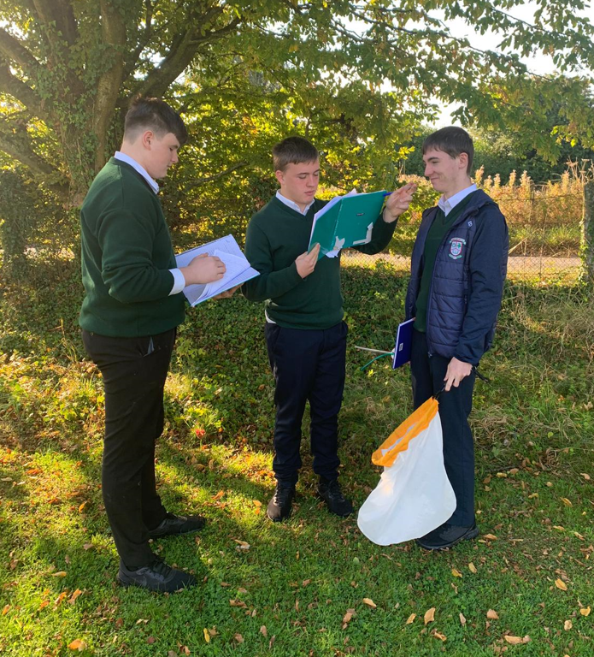
Students with Additional Needs
Submit Psychological/Specialist Reports where available
All students assessed
Cognitive Ability Test
Reading Test (CAT4 and NGRT)
Tuition – Small Groups, Individual and Team Teaching
Supporting Gifted and Talented Students
Notes:
Gifted and Talented – In class – extension exercises
Courses in colleges during holidays.

Slide 18
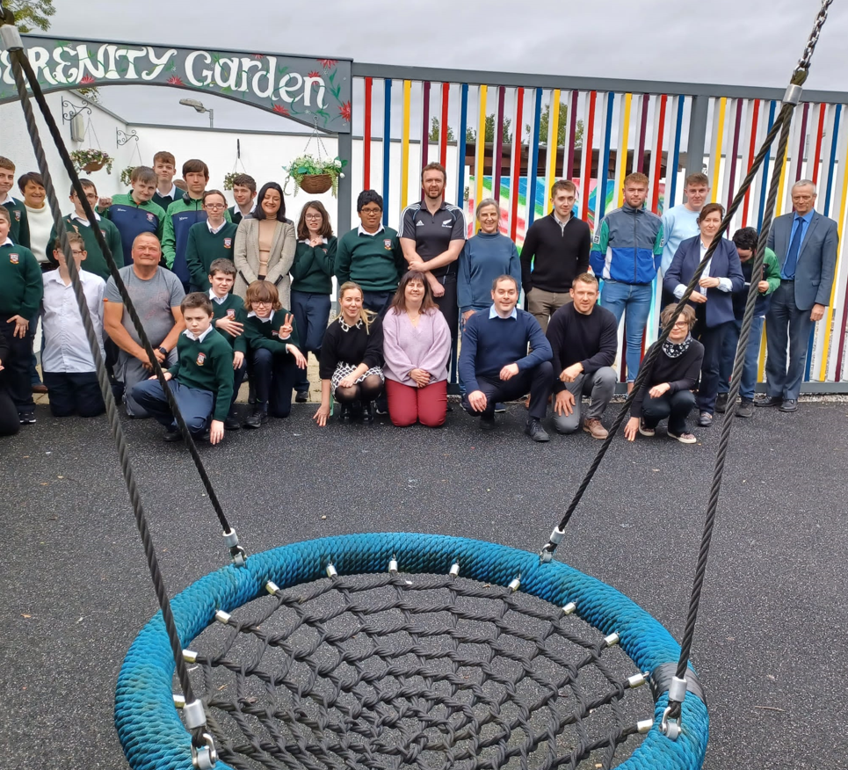
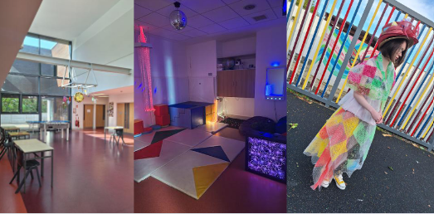
Centre for Young People with Autism
Cater for students on Autistic Spectrum and with recommendation for Special Class Setting.
Currently eighteen students in Centre. Max 18 students.
Students are integrated into mainstream where possible depending on their needs and abilities.
Notes:
Autism Centre currently full.

Slide 19

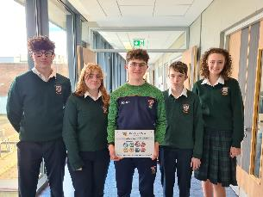
Integration of Digital Technology
iPad currently used by Students.
Advantages
Students are introduced to modern technology
More active learning through video, research topics, etc.
Fits in very well with Junior & Senior Cycle - Research, Projects, etc.
Textbooks are on the iPad as required.
Lighter school bags.
Teachers share information with students – Email, SharePoint, Teams, OneNote etc.
IPad, Books and other materials.
iPad including setup and managing for 3 years - €500 approx
€60 per student included is Personal Accident Insurance, Cat4, NGRT testing and other costs for three years of Junior Cycle.
School Book Scheme implemented
Further information for parents in January 2026

Slide 20
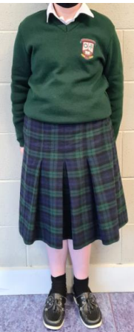
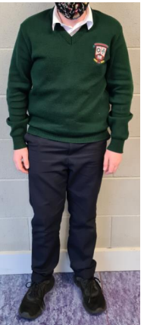
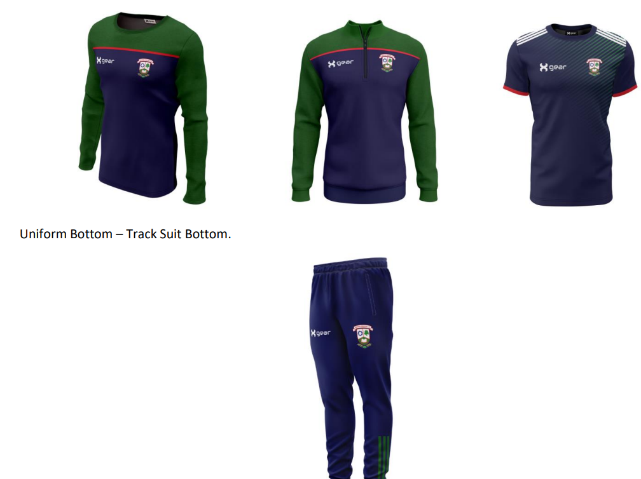
Uniforms in Borrisokane Community College
School Uniforms are available in Slatterys in Nenagh (skirt, crested jumpers, trousers)
School PE Uniform is available for www.xgear.com

Slide 21

Communication - Home/School
School Journal, Text, Email, School App.
VSware – Parents can log into school record system – Timetable, Attendance, Exam Results, Behaviour Records etc.
School Website – www.borrisokanecc.ie
Individual Parent/Teacher Meetings
Notes:
The best method of resolving issues is to involve parents.

Slide 22
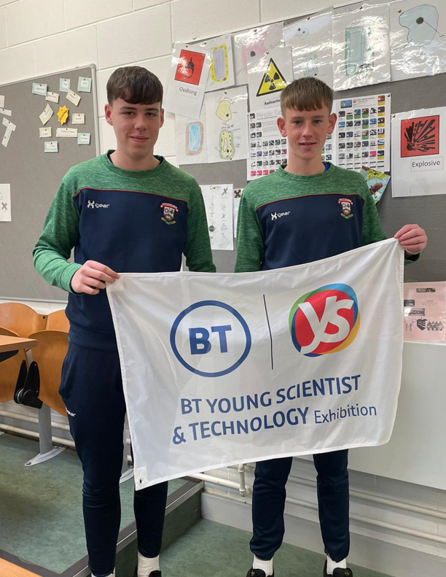
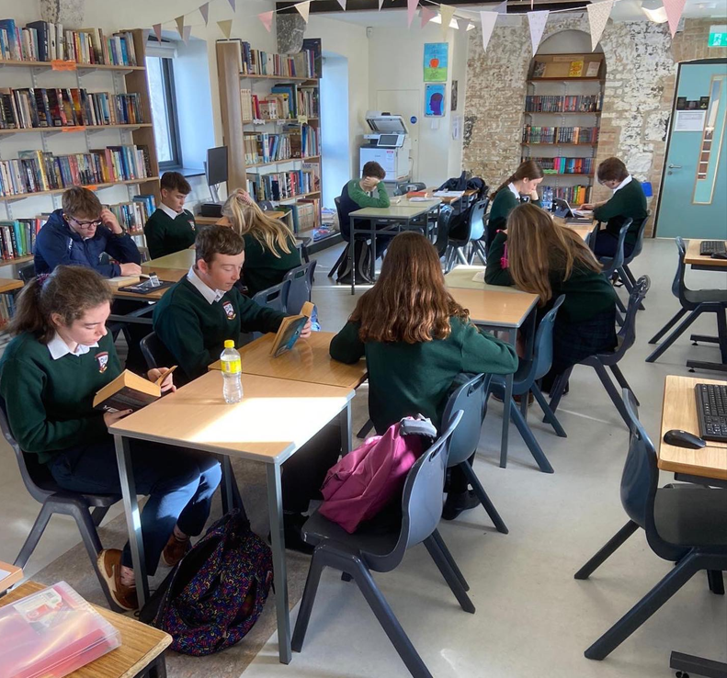
Where do our students study after LC
University Courses
Institutes of Tech
Colleges outside Ireland
Agricultural Colleges
FET Colleges
PLC Courses
Tertiary Courses
Apprenticeships
Work

Slide 23
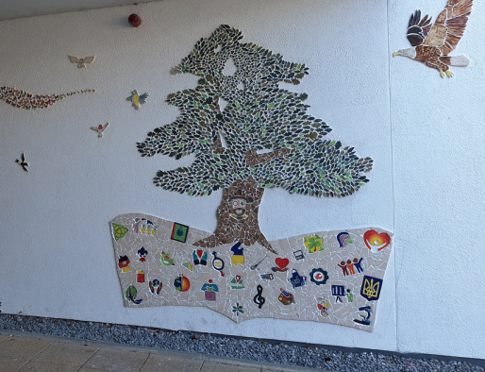
Other points of interest
Student Centered School.
Buses to and from the school door
Supervised grounds from 8.05a.m. to 4.00p.m.
Students remain on school campus during lunchtime
Strict but fair discipline structure
Supervised Study/Study Hub
Excellent Canteen Facilities/ Canteen Card
School Meals Programme
Active Parent’s Association

Slide 24
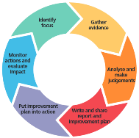
Wellbeing Inspection Report
Available on Department of Education and school website
Parents surveyed feel welcome in the school and are very happy with how the school is run.
Students surveyed are proud of their school and get on well with each other.
A wide range of very good student supports is in place.
The committed and hardworking staff of the school are one of its key strengths.
We work well as a team.

Slide 25
Transport to BCC
Bus Eireann scheme
Application – www.buseireann.ie
Reside not less than 4.8km from school.
Nearest school.
Closing date – Last Friday in April
schools.limerick@buseireann.ie 061 217484.
Private Buses
Aidan Claffey 087 6531777
Andy Kennedy 086 2664060

Slide 26
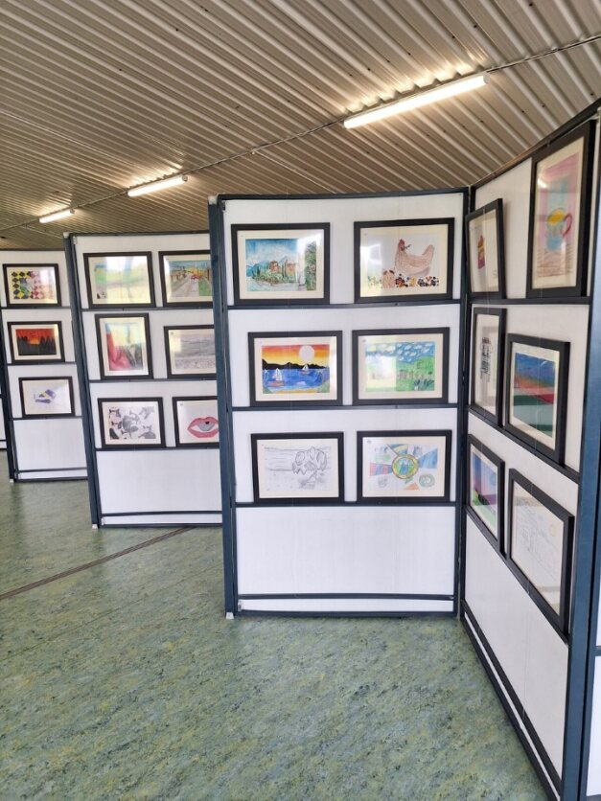
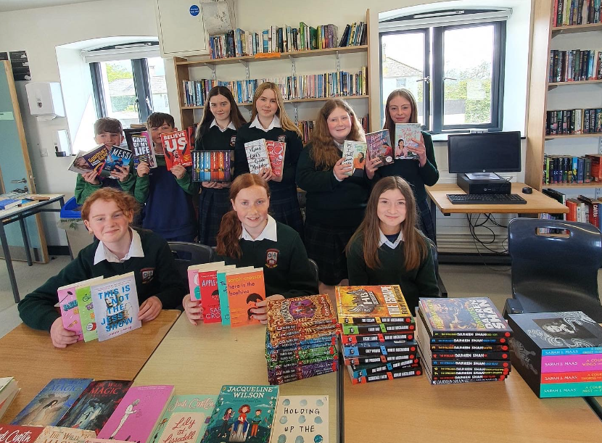
BCC Parents Association
A voice for parents
Support to the school
Discuss Policies as they are developed
Provided facilities - Canteen, Oratory, Bus Shelter, Sports Equipment, Support Extra Curricular Activities, Support Supervised Study, Equipment for Autism Centre, Ball Wall and Dressing Rooms, Solar Panels.
Organise Information talks for Parents
Family Levy - €50
Encourage Parents to join the committee.
Notes:
Book Fair

Slide 27
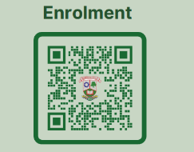
Important dates
Application Forms, Admissions Notice and Admissions Policy on school website.
Enrolment Forms can be handed in at registration desk, completed online or posted to the school.
Closing Date for Enrolment 06/11/2025
All applicants will be notified by the 27/11/2025
Acceptance forms must be returned by the 11/12/2025

Slide 28
How to contact us
Contact the school
Telephone: 067 27268
Email:
paula.molloy@borrisokanecc.ie
catriona.maher@borrisokanecc.ie
info@borrisokanecc.ie

Slide 29

Questions
Questions

