Slide 1

Future Options & Central Applications Office (CAO) Information Evening

Slide 2
Aim for this Evening:
What is CAO?
What are CAO Requirements?
Importance of Researching Courses
CAO application, key dates & offer stage
HEAR & DARE access route to college
SUSI grant & Scholarships
Alternative Options to CAO

Slide 3
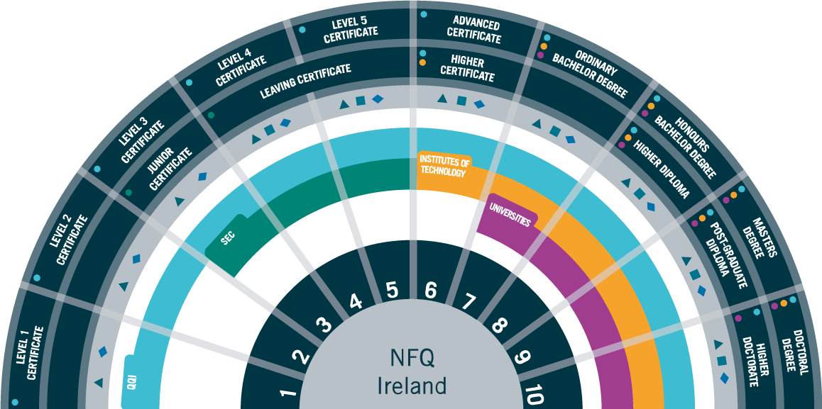
What is CAO? (Central Applications Office)
CAO processes Irish college applications (incl. fee paying colleges)
Students can complete 2 choice lists (level 6/7 ordinary degrees & level 8 honours degrees)
Students can apply for up to 10 level 6/7 courses & 10 level 8 courses
It is possible to receive an offer from both lists
https://careersportal.ie/school/cao_courses.php

Slide 4
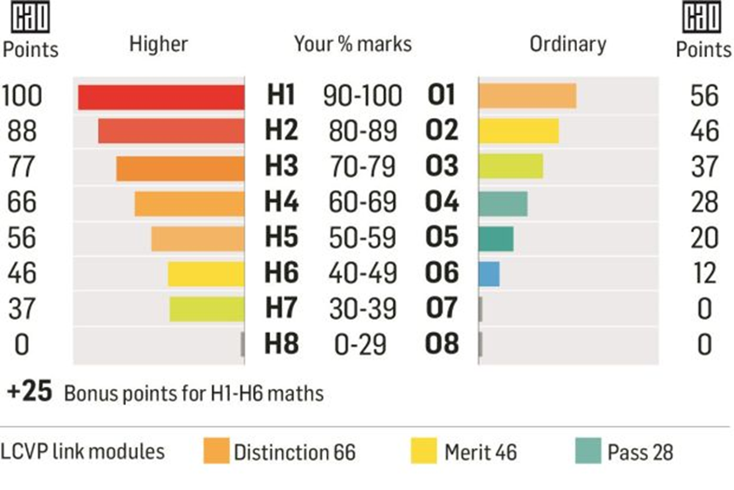
CAO Requirements
Subject Specific Requirements:
Points Requirement:
Minimum Entry Requirements:
Level 8: typically: 2x H5 & 4x O6/H7*
Level 7: 5xO6/H7
Primary teaching Mary I Irish = H4;
Sport & Exercise Science UL Science = O3/H7;
Mathematical Science UG Maths = H5/O1
Total points from Students’ best six subjects
***Additional Requirement:
Certain courses are Restricted-Application Courses
They have early assessment procedures
E.g. HPAT; Art portfolio; Interview
Check cao.ie
(incl. maths, Eng, Irish &/Or 3rd lang.*)
(*bonus maths)
(must apply by 1st Feb)
Example:
How points are calculated
NB Research is crucial (rash decisions re subjects/ levels can be costly)
https://cc.careersportal.ie/courses/calculator/pointsCalculator.html#/

Slide 5

RESEARCH! Make an Informed Decision
Don’t assume knowledge of a course by its title!
Don’t choose a course / college based on friend’s choices!
Research the modules across the 3 / 4 year degree
Are there work experience or year abroad options?
How will you be examined (group work / lab/ presentations)?
Get the college prospectus / Check college websites
Go to the Open / Taster Days
Consider the subjects you enjoy and excel in
Talk to students and friends who have completed the course
Discuss it with Guidance Counsellor

Slide 6
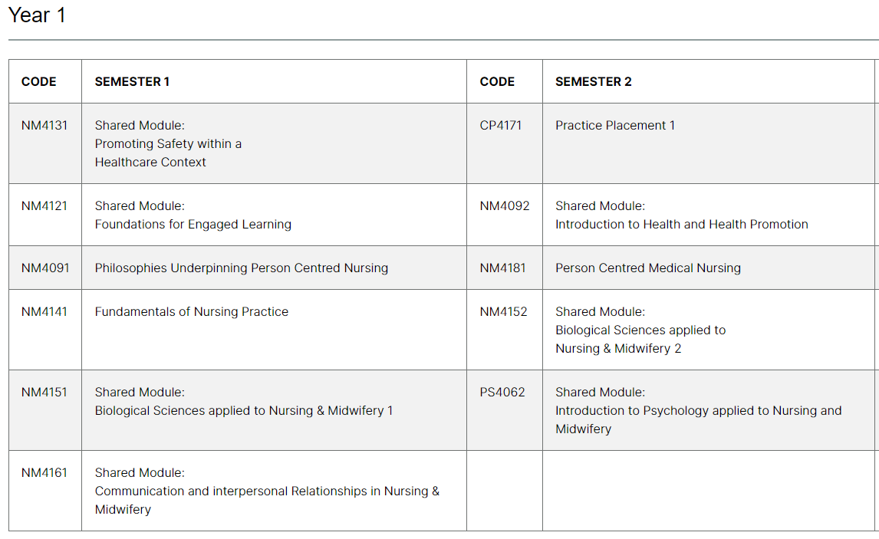
Use college websites to research modules
Module list per semester: Nursing in UL (LM 150)
Visit the Book of Modules page and type the module code to access a detailed description of credit weighting, learning outcomes, form of assessment etc.
https://bookofmodules.ul.ie/Default.aspx

Slide 7
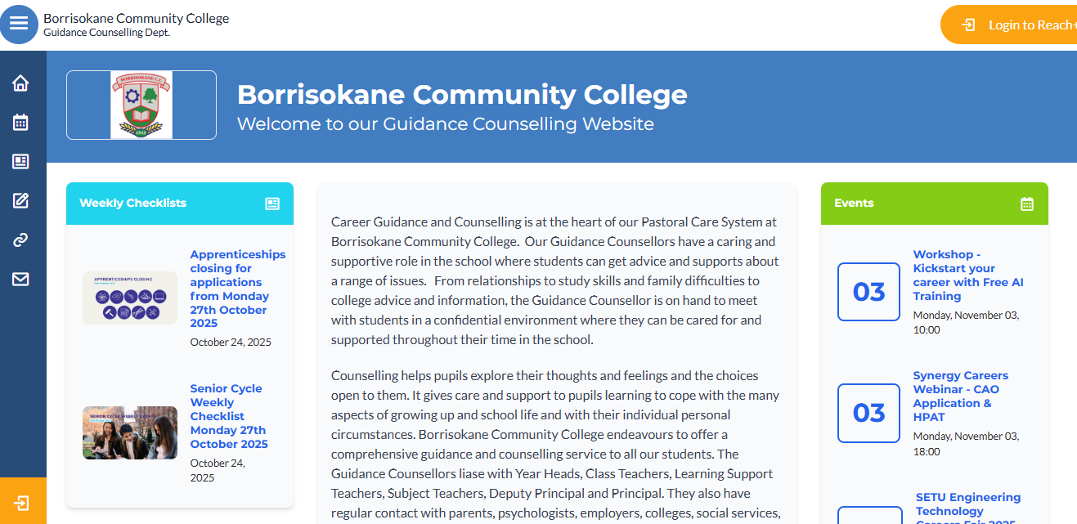
Be Informed https://www.borrisokanecc.ie/
Keep checking our school Careers webpage for regular updates on open days & deadlines

Slide 8

Why Research is Crucial Zurich Cost of Education Survey 2023
Cost of college
Cost of repeating

Slide 9
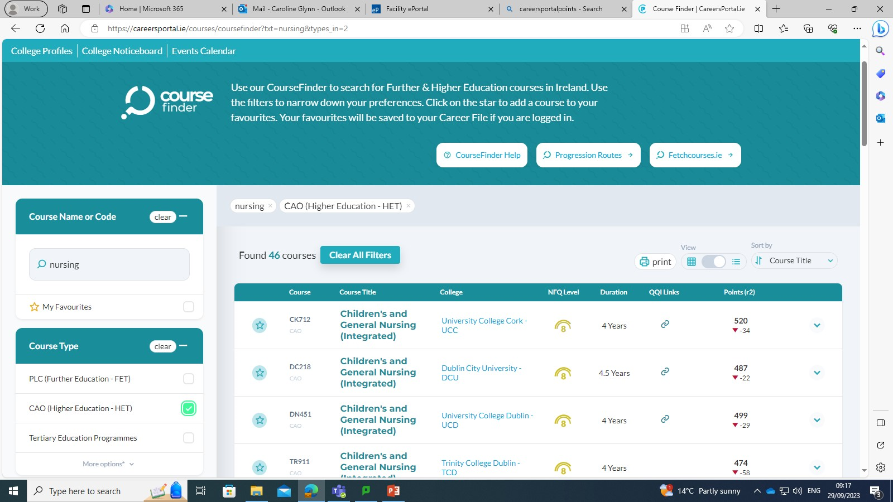
https://careersportal.ie/
QQI link: a level 5/6 PLC course offering an alternative entry route to the course
Narrows search to type of course provider
CAO Course Code
NFQ Level of Degree
CAO Points & indication of increase/ decrease from previous year

Slide 10
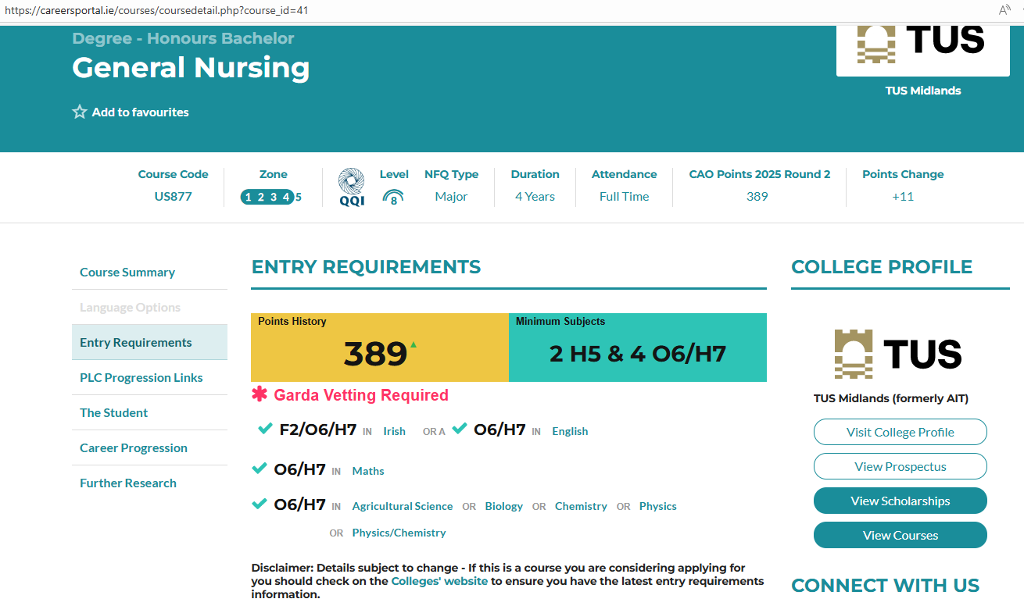
Nursing TUS Athlone L8
4 years
CAO Points Requirements
Minimum Entry Requirements
Subject Specific Requirements

Slide 11
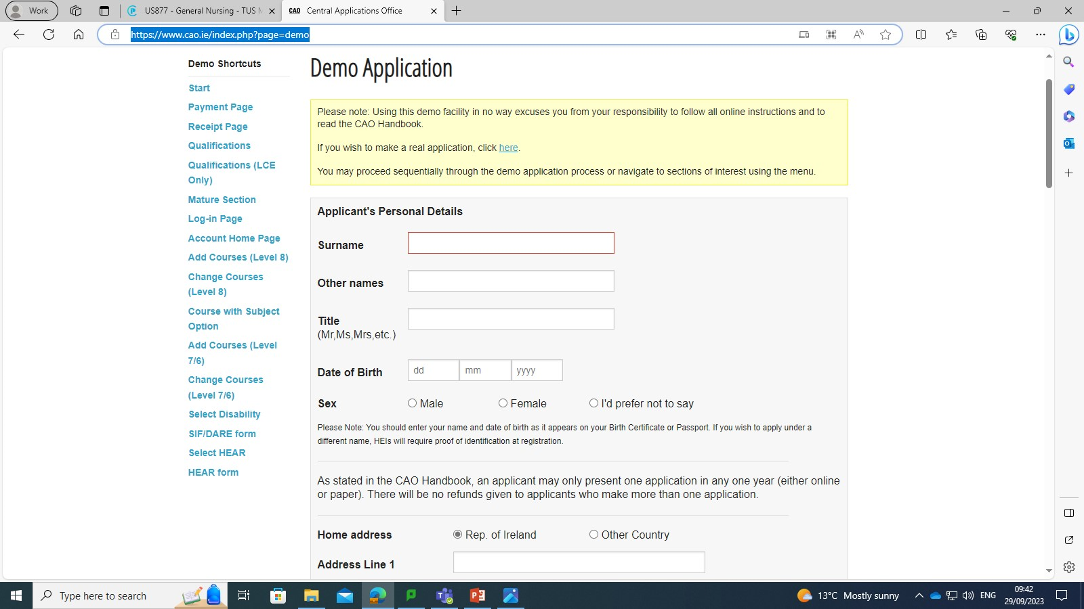
Making an Application
CAO online application facility opens on 5th November at 12:00 noon
**Spring is a busy period for LC students – mocks, orals, practical/ projects so try to get an account open before Christmas
Applications are made online via www.cao.ie
Students receive their CAO number after paying their fee.
Always keep proof of application: print screen receipt
Indicate Leaving Cert. student
Students must fill out course lists in:
Genuine Order of Preference
It is a mistake to put down courses on the basis of points predictions
A personalised CAO Handbook is available. Users can search courses & read handbook instructions & save to their phone
https://www.cao.ie/index.php?page=demo
Notes:
Online is recommended – cheaper, faster, easier and safer.
Retain proofs and record of application carefully.
Most school applicants have to fill out Part A (pages 1 and 2 of paper form) only as Standard Applicants.

Slide 12
CAO closing Date and Fees
 | Fee | Closing Date
Normal Closing Date | €50 | 1st Feb 2025 (5pm)
Discounted Application Date | €35 | 20th Jan 2025 (5pm)
Change of Mind Facility 6th May 2024 12pm | Free | 1st July 2025 (5pm)
Change the order of choices or introduce/ delete courses
** Does NOT include restricted entry
Be Responsible: Check emails sent to all applicants before end of May & confirm details
Central Applications Office (link to CAO important dates)

Slide 13
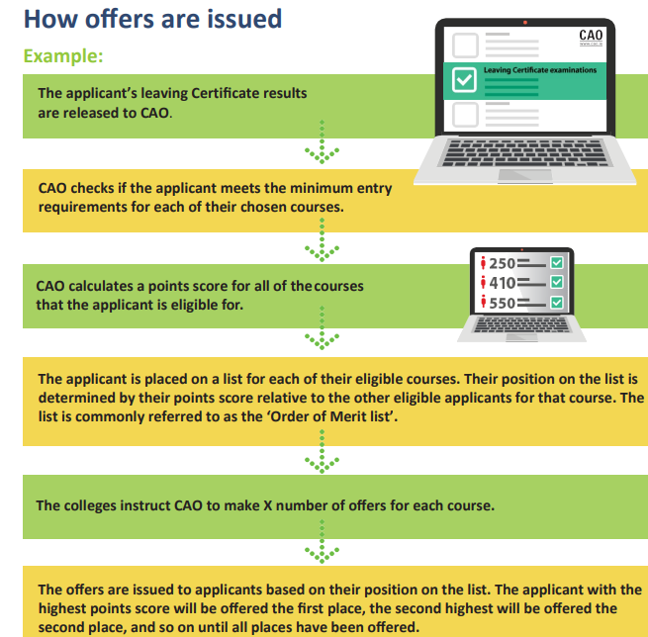
Offers
When applicants decline/ defer offers this results in subsequent places becoming available in the next round of offers in order of merit

Slide 14
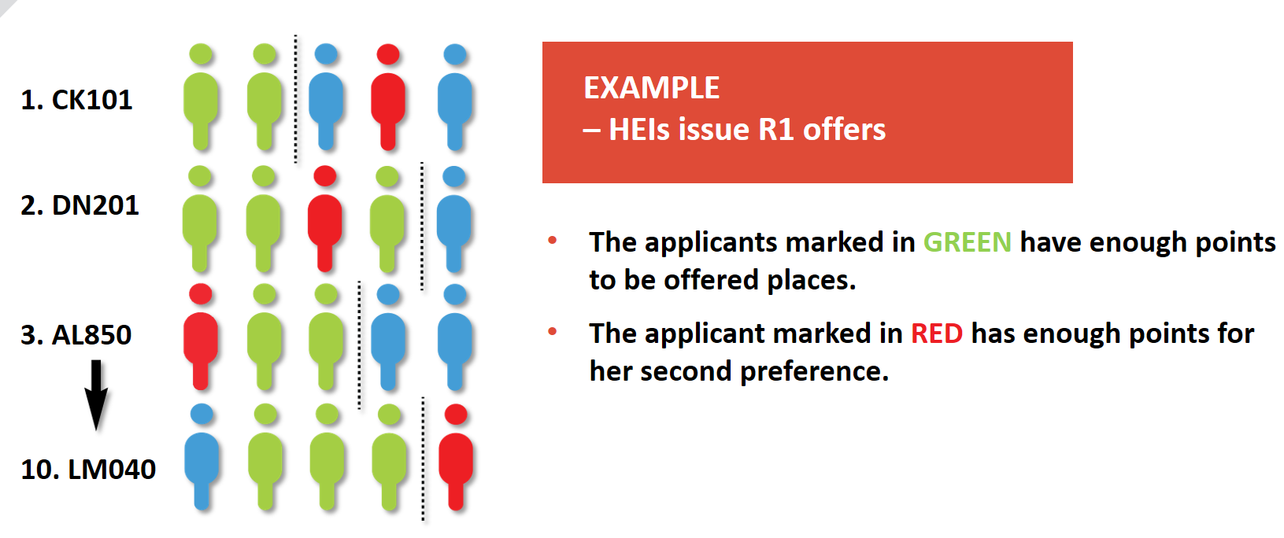
Red applicant got 486 points
Their number 1 choice CK101 was 488 points
Their number 2 choice DN201 was 470 points
Their number 3 choice AL850 was 477 points
Red applicant got offered their number 2 choice therefore they can not be offered number 3 - 10.
They MAY get offered number 1 in a later round.

Slide 15

Approximate outline of Offer Stage *Dates to be Confirmed
Round 1: Offer made 4 days following LC results
Accept Round 1 within 6 days
Round 2: Offers made 1 week later
Accept Round 2 offer within 2 days
Subsequent rounds: Aimed at filling any remaining vacancies
To accept offer, follow instructions carefully and reply within deadline
Students can defer for most courses. Do not accept offer. Contact college and follow their instructions.
NOT A GOOD TIME FOR STUDENTS TO BE AWAY ON HOLIDAYS!

Slide 16

Access Routes to Education: HEAR/DARE
HEAR (Higher Education Access Route) a college and university access scheme which offers places on reduced points to school leavers from socio-economically disadvantaged backgrounds
DARE (Disability Access Route to Education) offers reduced points places to school leavers who as a result of having a disability have experienced educational challenges in second level education
Indicate on CAO form; online forms completed by March 1st & supporting documentation posted to CAO by March 10th

Slide 17
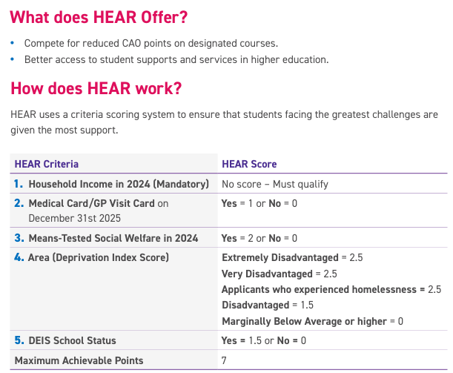
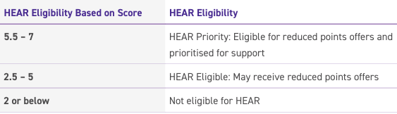
https://accesscollege.ie/hear/ HEAR Application Information Sessions will take place in January keep an eye on the website
Notes:
Low Income: Your family income falls on or below the HEAR Income Limit
Medical Card: Your family has a Medical Card or GP Visit Card
Social Welfare Payment: Your family received a means-tested payment from the Department of Social Protection for at least 26 weeks in the year previous
Socio-economic Group: You belong to a group that is under-represented in higher education based on the occupation and employment status of your parent(s) or guardian(s)
School: You completed five years in a secondary school that takes part in the Delivering Equality of Opportunity in Schools (DEIS) scheme
Area: You live in an area in which there is concentrated disadvantage and social exclusion - in other words, an area where, for example, there is high unemployment and poverty and very few facilities for the community

Slide 18

DARE: What disabilities are eligible? https://accesscollege.ie/dare/ DARE Application Information Session will take place January – keep an eye on accesscollege.ie for webinar dates
Attention Deficit Disorder (ADD)/Attention Deficit Hyperactivity Disorder (ADHD)
Autism Spectrum Disorder including/Asperger’s syndrome
Blind/Vision impaired
Deaf/Hearing impaired
Developmental Co-ordination Disorder (DCD) –Dyspraxia
Mental Health conditions
Neurological conditions (incl. Brain injury, epilepsy)
Speech and Language Communication Disorder
Significant on-going illness
Physical disability
Specific learning difficulty (incl. Dyslexia and dyscalculia)

Slide 19

DARE Eligibility
Section A: Personal Statement
experience of being in school and the challenges you faced
Section B: Educational Impact Statement completed by school
school to provide detail of how your disability has impacted on your second level experience
Section C: Evidence of Disability Form
completed by approved Medical Consultant/Specialist/GP
Notes:
Section A: This is a personal statement on how you believe your disability/learning difficulty impacts on your education
Section B: This involves getting a Second Level Academic Reference completed by your school, which helps to give an educational background to your application from staff who you’ve been involved with in secondary school.
Section C: The Evidence of Disability Form (if you have a learning difficulty, please see section below), which must be completed by a relevant and accepted medical consultant or specialist. This verifies the nature and extent of your disability, and provides an indication of what supports you may need in third level.

Slide 20
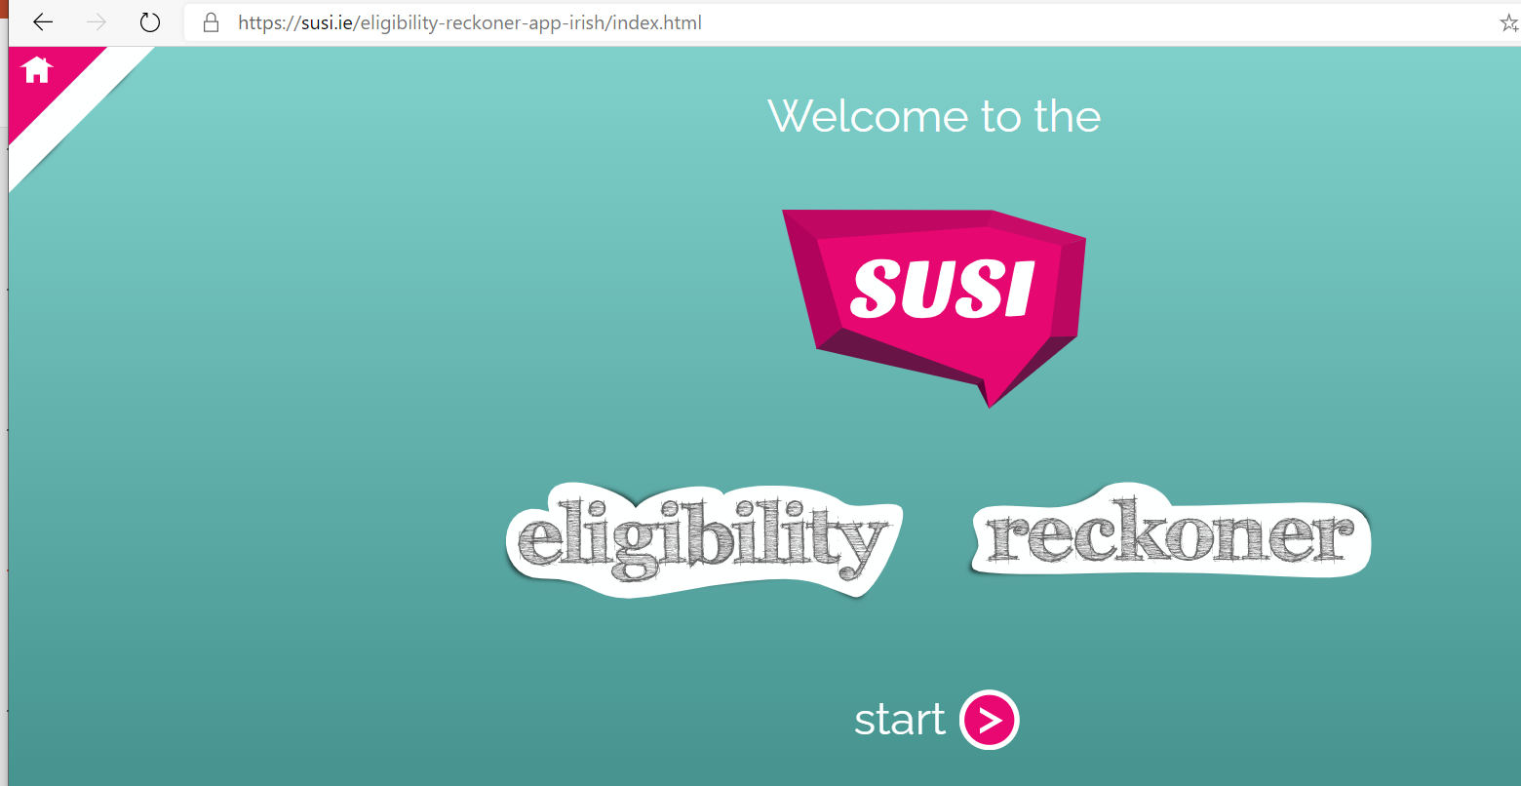
SUSI Grant
Student Universal Support Ireland (SUSI) is the single awarding authority for all grant applications www.susi.ie
Can complete Grant Eligibility Reckoner as a guide
Criteria:
Nationality
Residency
Income
Previous Education & Progression
Approved Course in Approved Institution
Generally opens in April

Slide 21
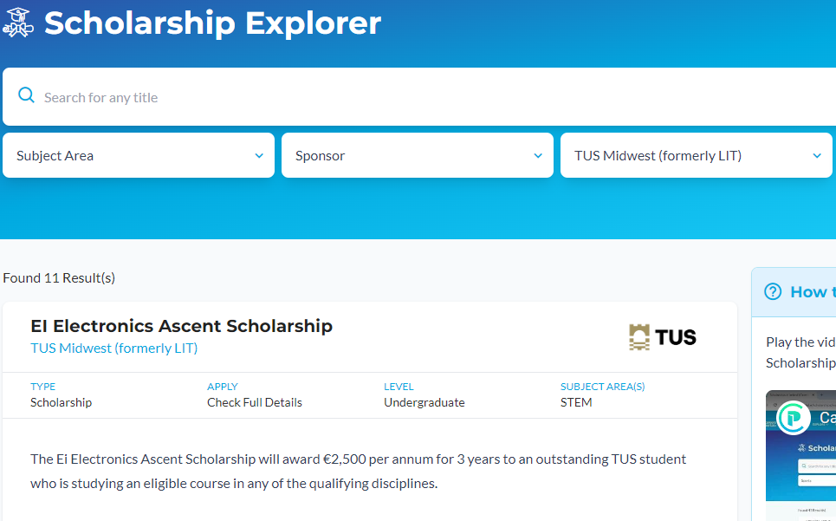
Scholarships
Enter your college of interest under the ‘Sponsor’ section to identify Scholarships and criteria
Entrance
All-Ireland
Sports
Performing/Creative Arts
Active Citizenship
Innovation & Entrepreneurship
Academic
Subject Specific : studying in a particular sector e.g. Accounting, Science, Engineering, Languages
Use careersportal to check scholarships available in colleges of interest ​
https://careersportal.ie/scholarships/index.php

Slide 22

Other Options
UCAS (Universities and Colleges Admissions Service) – colleges in the UK. Closing date 14th January 2026 (**MEDICINE, VETERINARY MEDICINE/SCIENCE, AND DENTISTRY = mid October)
EUNICAS (European Universities Central Application Support Service) – colleges in Europe (study through English).
Post Leaving Certificate, obtain FETAC (QQI) level 5/6 qualification with which student can reapply through the CAO system (alternative to repeating the Leaving Certificate). Links to Universities and TU’s. Note: Some courses require specific grades for entry purposes e.g. Nursing.
Some Universities & TU's offer a Special Maths exam
(students who missed a maths requirement)
Army, Navy, Air corps more info at: www.military.ie

Slide 23
Tertiary Courses www.NTO.ie
Tertiary Degrees are co-designed and co-delivered by the ETBs and Higher Education Institutions to provide seamless pathways from Further to Higher Education.
Each tertiary degree has different entry requirements. The entry requirements are at the bottom of each individual Course page on www.NTO.ie. Students may need to submit proof of achievement in other learning, such as certain subjects in the Leaving Certificate or LCA, to meet the entry requirements for the course. For some courses, applicants need to submit additional documentation and/or participate in an interview or submit a portfolio.
Applications for 2025/26 will be accepted through the Courses page from 5th November and will close late September 2026.
The range of courses include; Nursing, Business, Occupational Therapy & Animation, Visual Effect and Motion Design

Slide 24

Huge expansion of apprenticeships in recent years
Possible to do apprenticeships in areas such as Construction, Electrical, Engineering, Finance, Motor, IT, Accountancy and Hospitality.
Information available on www.apprenticeship.ie and www.careersportal.ie
On the job and college training (earn & learn!).

Slide 25
Further Considerations…
FEES:
Tuition Fee: Paid by the Department of Further and Higher Education, Research, Innovation and Science (will only be paid for each college year once – not for repeating a year). To qualify for free fees, you must meet criteria based on: Residence, Nationality and immigration status, Course requirements.
Student Registration fee: €2500. (if receiving the full grant students don’t pay this). If a student drops out they may be liable for fees; check cut-off dates with individual colleges.
ACCOMMODATION: Keep abreast of individual accommodation circumstances through their websites (lottery system/ online booking etc.)
Deferral: All the colleges & universities have different policies regarding deferrals and most expect a specific reason. If you received a CAO offer & decide to defer, do not accept the offer. Contact the College Admissions mark “DEFERRED ENTRY” clearly in the email. If you have successfully deferred & want to take your place, you will need to apply for the course through the CAO again the following year. You will need to put down your deferred course as your first and only choice; additional entries will forfeit your place and enter you back into the CAO lottery.

Slide 26
Thank you for listening
What is CAO?
What are CAO Requirements?
Importance of Researching Courses
CAO application, key dates & offer stage
HEAR & DARE access route to college
SUSI grant & Scholarships
Alternative Options to CAO
trudy.carroll@borrisokanecc.ie

