Slide 1

Borrisokane CC
Online Information Evening for Parents

Slide 2
5th/6th Year Parent/Guardian Information Evening
Borrisokane Community College
Ms. Paula Molloy – Principal
Ms. Caitríona Maher – Deputy Principal
Mr. Mark McGinn 5th Year Head
Mr. Tomas Maher 6th Year Head
Mr. Noel Cronin LCA Year Head
Ms. Orla Cunningham LCA Coordinator

Slide 3
Our Mission Statement & ETB Ethos
We seek to promote a caring and ​
committed school community​
which will facilitate the education of our students​
and where each individual is valued ​
as a unique human being.​
​
“Is ar scáth a chéile a mhairimid”

Slide 4
General Updates:
Enrollment for Sept 26. Admissions notice has been published and our Open Night is on Oct 16th from 5pm. Please get application forms in early or on time.
One Way System & Parking – from 8:30- 9:00 am we request that cars come to school via the athletics/tennis grounds and leave via Ballyhaden. In the evenings from 3:20 we request the same. We have extended our car park so can you please park in new car park and not on the footpath.

Slide 5
Key Dates
Pre – mock exams 6th year – 13th – 24th October
Christmas exams 5th years – 15th – 19th December
Meeting for LC Parents on CAO – 3rd November (Online)
6th year Parent, Student, Teacher Meetings – 27th November (4.15pm-6.45pm)
5th Year Parent, Student, Teacher Meetings – 22nd January (4.15-6.45pm)
Mock exams 6th years from 3rd February – 13th February 2026

Slide 6
Website
Our website is being updated and you will be able to find presentations.
We will need your input over the next few months on our Child Protection and Child Safeguarding Statement as these have to be updated in line with new circulars.

Slide 7
Board of Management
Ms.Virginia O'Dowd, Cllr Louise Morgan Walsh, Ms. Fiona Dunford ( elected to board by ETB)
Ms. Avril Murphy, Mr. Mike Fox ( Parents Rep)
Ms Ceire Hogan, Mr. Sean Ryan (PE) ( Teacher Reps)
Paula Molloy ( Secretary) Caitríona Maher ( Recording Secretary)
Thomas Clarke, Paula Sullivan. Eoin Reddan (Community Reps)

Slide 8
Parents Association
Parents Association Support
The Parents Association is seeking representatives from the following areas: Borrisokane, Nenagh, Newtown, Puckane, Toomevara, Moneygall, Shinrone, Clonlisk, Ballingarry, Carrig, Ballinderry, Cloughjordan, Lorrha, Ardcroney, and surrounding areas.
If you are interested in joining, please contact the school office by emailing info@borrisokanecc.ie.

Slide 9
School Closures
Please note that the school will be closed for students on Monday, 20th October 2025 for staff training.
Normal school hours will resume on Tuesday, 21st October.
School will also close for students on Dec 15th 2025 for staff training with normal hours resuming on Tuesday, 16th December

Slide 10

After school study
Monday to Thursday evenings.
4.00pm to 6.15pm.
€3 per evening, pay on Way2Pay – Email marie.coffey@borrisokanecc.ie
Extra study at home.
2-3 hours per school night in total as year progresses.

Slide 11
Monthly assessments / Term tests:
Regular Assessments by subject teachers recorded on Vsware.
Formative feedback with results in October and Mocks in February.

Slide 12
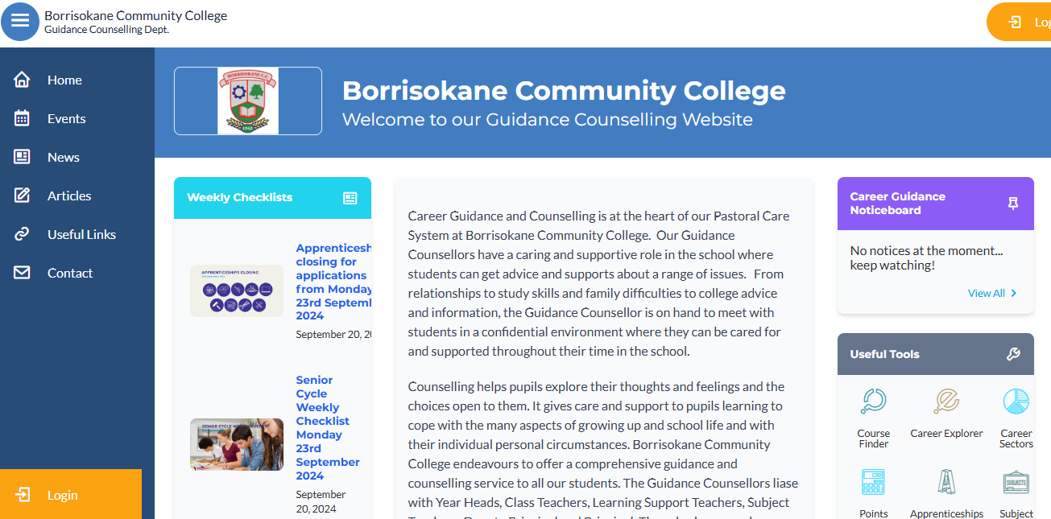
The Guidance Dept at BCC – Ms Carroll
All Junior Cycle classes have Guidance Related Learning classes.
All Senior Cycle classes have a weekly Career Guidance class and can take part in trips to Colleges and Apprenticeship centres.
Provide one-to-one personal, academic and career support.
Parents & Guardians are welcome to get in contact and can also avail of our Guidance page on the school website which has info on courses, apprenticeships, LC points and Open Days etc.

Slide 13
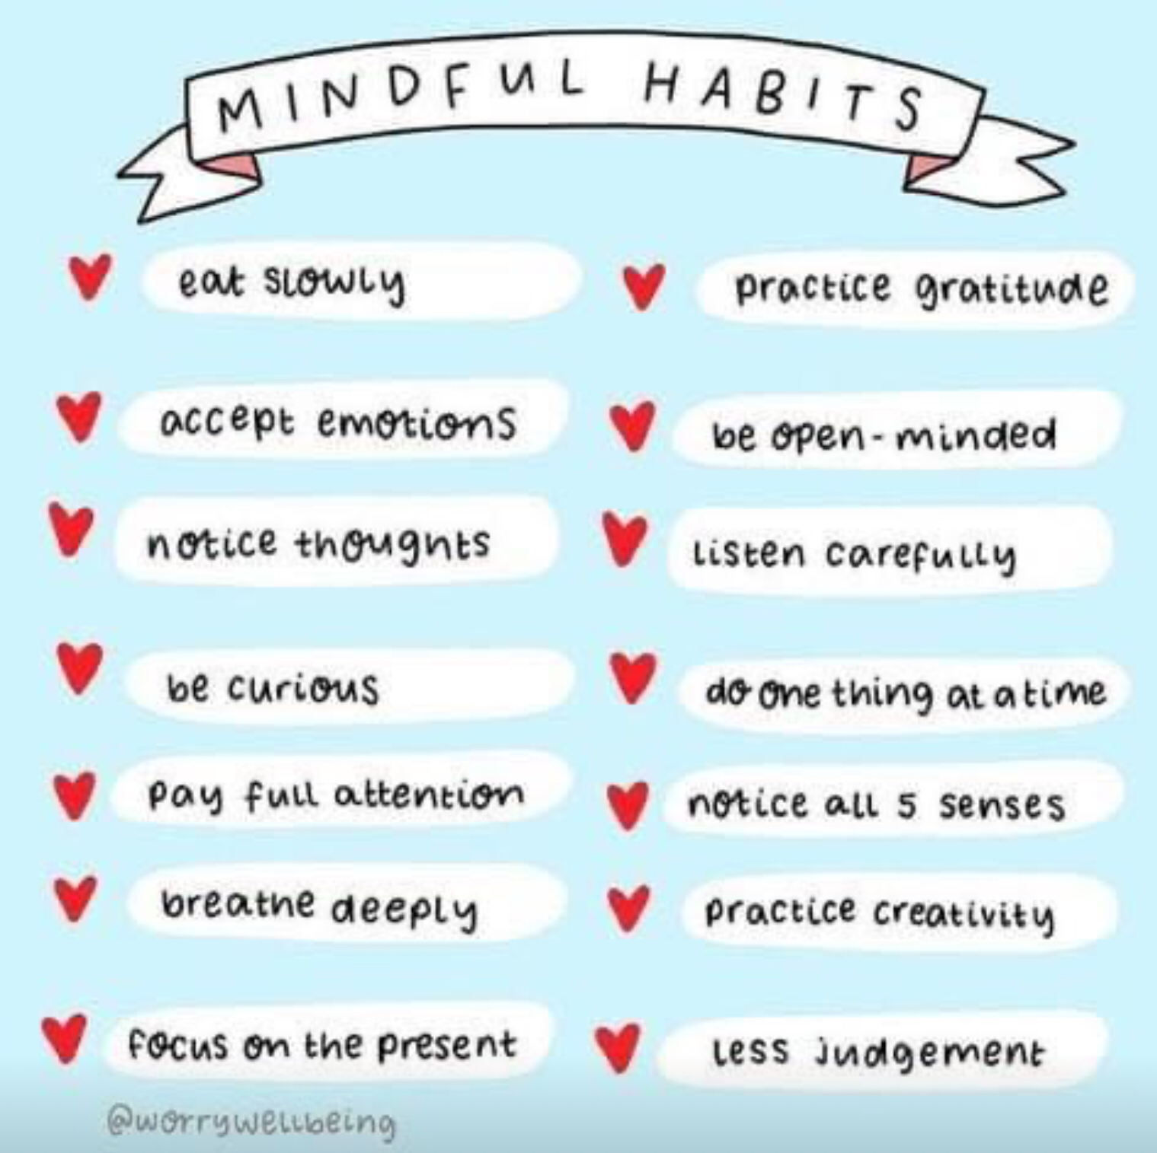

Slide 14
Leaving Cert Applied
LCA Coordinator - Ms Orla Cunningham
Year Head - Mr Noel Cronin
Programme Information and Reminders

Slide 15
Leaving Certificate Applied-Aims
Prepares you for adult and working life
Recognises your talents
Helps you to communicate better
Lets you use your knowledge and skills to solve real problems

Slide 16
LCA IS A Full Time Two Year Programme
Four sessions, 2 each year
90% Attendance is compulsory in all courses (subjects) in order to complete Key Assignments and achieve credits

Slide 17
Leaving Certificate Applied Terminology
Session
For the purpose of the Leaving Certificate Applied the school year is divided into two sessions
Session I - September to the end of January
Session II - February to June.

Slide 18
Leaving Certificate Applied Terminology
Courses
A course is an area of study made up of a number of modules e.g English and Communication is a course

Slide 19
Leaving Certificate Applied Terminology
Modules
A module is a topic within a course and will be taught in 3-4 class periods per week over one session e.g. Personal and social communications is one module in the English and Communication Course

Slide 20
Leaving Cert Applied Terminology
Seven tasks to be completed over the 2 years:
1 in Session I Year 1
2 in Session II Year I
3 in Session III Year II
Personal Reflection Task to be completed over the two years. (Two reflective statements – one at the end of Year I and one at the end of Year II)
An interview for six tasks

Slide 21
Leaving Cert Applied Terminology
Key Assignments
Key Assignments are important areas from each module.
To gain credits for each module you must
complete 4 Key Assignments usually,
and attend the course for at least 90% of the time

Slide 22
CREDITS
•Credits awarded for modules and tasks at the end of each session
Leaving Cert Applied Terminology​

Slide 23
Leaving Certificate Applied Assessment
6A ONLY
3 Types
Satisfactory completion of Modules 62 credits
7 Student tasks 70 credits
Final exams 68 credits
Total Credits 200 credits

Slide 24
5A 2025/26
Allocation of Credits
A participant may accumulate a maximum of 200 credits.
These credits are allocated on the following basis
Credits Percentages
Satisfactory Completion of Modules* 68 34%
7 Student Tasks 74 37%
Final Examinations 58 29%

Slide 25
Leaving Certificate Applied Assessment
6A ONLY
ROC-Less than 120 credits
Pass 120 credits
Merit 140 credits
Distinction 170 credits

Slide 26
Work Experience
Is a compulsory element of the LCA Programme.
Work Experience takes place EVERY WEDNESDAY of term time
Work Experience is organised by the student and their parent/guardian

Slide 27
Reminders
All students need a fully charged ipad every day in school for class
Students must bring their Student Journal to school every day
Stationery/pens/ pencil/ notes- teachers will advise in each course
VSware parent/guardian updates

Slide 28
LCA Trips
All trips are linked to a course and help students to apply their classroom learning in real life settings

Slide 29
Role of the Year Head
Leader of Teaching and Learning focusing on given year.
Support students and parents throughout the school year.
Monitoring the attendance, punctuality and engagement of each student.
Monitoring uniform (including PE uniform)
Ensuring that students adhere to the code of behavior and behave in a positive manner in line with the ethos of our school.
Active communication is very important.

Slide 30
School Journal
Allows vital communication between teachers and parents. Parents see what students need to engage with at home and can provide support.
Helps students to write down important reminders.
Provides detailed information in relation to the Code of behavior and important school policies such as, Anti Bullying Policy, Acceptable use policy, Student Rights and Responsibilities. Etc.
Parents should check the journal daily.
Sign each week preferable. Regular checks take place.
Centre Pages – Study tips, Revision Points, Setting Targets and Goals.
Notes:
Records – behaviour, attendance.

Slide 31
Attendance
Attendance is key to success in school. Please encourage this with your children.
When absent – find out what was covered in class and complete homework – Use Teams/Homework Buddy.
A note explaining absence/late must be sent in to the school via Vsware . Please be mindful of category of comment. Sign out if leaving the school during the day. Late if arriving late.
TUSLA – over 20 days absent.
Medical certificate or reason given if possible
Records of each month in Journal.

Slide 32
Punctuality
Leaving Cert - Year Head: Tomás Maher
Arrive before 9, before 8.45 on Friday
Punctual to all classes
Punctual after breaks
Appointments/Holidays if possible outside school time
Note on VSware app if late/leaving early/absent.
Full attendance vital to maximise grades

Slide 33
Uniform
Must be worn everyday with exception of PE day.
PE uniform must be worn for PE.
T- Shirts worn under uniform must be white with no collar.
Girls Trousers – Hunter Brand or similar. 63 style not uniform.
Skirts must not be shortened – worn below the knee.
Footwear – Black or brown shoes or boots. Black runners allowed – Completely Black(no visible logos).
School Jacket. This is the best option as it can be worn both inside and outside the school building.
Notes:
No runners. If looks like runners then no. No canvas footwear.

Slide 34
Journal/Teams
Fill in timetable into diary
Check homework written in and completed
Work posted on Teams – check daily, use when absent.
VSware app for absences/appointments/lates

Slide 35
Charters
In the charter section you can view the rights and responsibilities of:
Students
Staff
Parents
Everyone works together for the betterment of the student.

Slide 36
Implementing Code of Behaviour
  Listed are the steps in which negative behaviour is treated.
  Class Teacher
  Year Head
  Deputy Principal
  Principal
  Board of Management
Parents informed – Vsware Journal, Phone, Letter, Email. Please monitor Vsware to see students behaviour.

Slide 37
Positive Discipline
Praise and encourage achievement.
Positive Comments
Respect for all, fellow students, teachers, staff.
Notes:
Rewards – No homework, game in class, watch DVD, Taken on tours, given credits

Slide 38
Code of Behaviour
Detailed information on the following can be found in the student's journal or on the school website borrisokanecc.ie or by clicking HERE
Sanctions.
Suspension Policy.
Expulsion Policy.

Slide 39
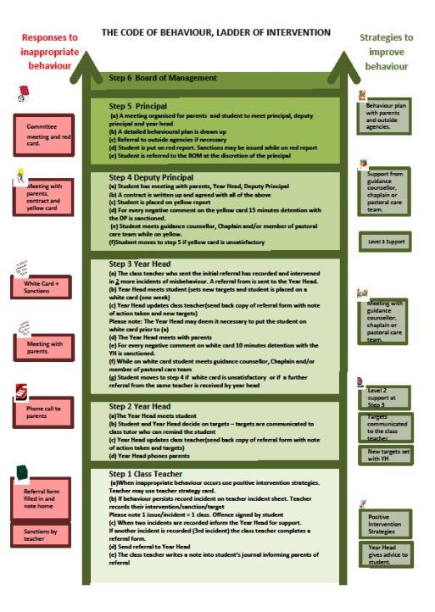
Ladder of Intervention

Slide 40
Mobile phone policy
Phones off and in bag once student arrives on school grounds
Can only be used with permission of a teacher.
Phone confiscated and recorded on VSware. Returned at end of school day.
Phones collected at start of a trip, returned at the end in line with policy
iPads to be fully charged for use in class.

Slide 41
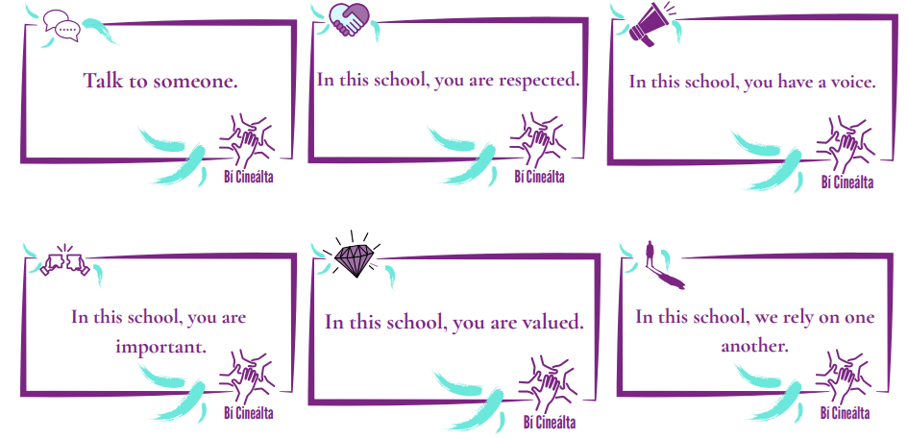

Bí Cineálta Policy (anti-bullying)
Detailed information on the following can be found in the students journal or on the school website borrisokanecc.ie or by clicking HERE
Tell someone – No innocent bystanders!
‘Morning Notes’ system – find out information Mobile phones – Social Network Sites e.g. Facebook, Snapchat, Instagram, TikTok etc. Please monitor from home.
Monitor children and talk to them. Any concerns, please contact us.
If something happens, screenshot it, don’t engage and tell someone about it.
Notes:
Mobile phones
Social networking websites – Bebo, Facebook.

Slide 42
Homework - Study
Help your child to plan their homework – place to study. Leave books at study desk, use e-books in school.
Study includes revision. We have monthly/ bi-monthly assessments.
Encourage reading. Be mindful of screen time. This can be checked on the iPad.
Time for homework/study – 1 to 1.5 hours each night.
Each night check timetable for tomorrow to ensure that all books, materials(ingredients), uniform, lunch, etc. are ready for the next day.
Ensure iPad is charged and in schoolbag each morning. Charging after homework and in bag before bed is best

Slide 43
Homework Hub
Before school 8.20-8.50
Room 114
Numbers are limited.

Slide 44
Student Supports
Subject Teacher
Year Head
Deputy Principal and Principal
Student Support Team
Student Council
SEN Department
Guidance Counsellors

Slide 45
Parent Reminders
Prepare bag and uniform with child – study area
Attendance (Child at school and parent at Parent/ Teacher Meeting) - is key to school and exam success
Read journal and sign to monitor and assist with Homework
Encourage full participation in all school activities
Never hesitate to contact the school if your child needs support
Time- support and encourage good time keeping. Give your child TIME.
Set realistic goals with your child

Slide 46
Extra Curricular Activities
Permission to take part in activities – Note in Journal to be signed pg 46.
Basketball, Hurling, Soccer, Camogie, Badminton.
Groups play hurling, soccer, basketball at lunchtime
Helmets required for hurling at all times.
Walkway used by students at breaks
Positive Behaviour is very important (trips, matches away etc)

Slide 47
3 key considerations
3 key considerations highlighted to all students, please reinforce this with them.
HIGH EXPECTATIONS: We all have high expectations of you, please mirror these expectations and do your best to achieve your potential.
RESPECT: From the time you put on your uniform each morning, please be respectful to all members of the school community.
BE KIND: Be kind in your actions each day.

Slide 48
Other
Cars
Catching up on work missed
Any issues contact school/send email
mark.mcginn@borrioskanecc.ie (5th Year Head)
tomas.maher@borrisokanecc.ie (6th year Head)
noel.cronin@borrisokanecc.ie (LCA Year Head)
Thank you

