Slide 1

Borrisokane CC
Online Information Evening for Parents
Principal: Paula Molloy
Deputy Principal: Caitríona Maher
2nd Year Head: Marianne Bergin
3rd Year Head: Eimear Lyons

Slide 2
General Updates:
Enrollment for Sept 26. Admissions notice has been published and our Open Night is on Oct 16th from 5pm. Please get application forms in early or on time.
One Way System & Parking – from 8:30- 9:00 am we request that cars come to school via the athletics/tennis grounds and leave via Ballyhaden. In the evenings from 3:20 we request the same. We have extended our car park so can you please park in new car park and not on the footpath.

Slide 3
Website
Our website is being updated and you will be able to find presentations.
We will need your input over the next few months on our Child Protection and Child Safeguarding Statement and our Code of Behaviour as these have to be updated in line with new circulars.

Slide 4
Board of Management
Ms.Virginia O'Dowd, Cllr Louise Morgan Walsh, Ms. Fiona Dunford ( elected to board by ETB)
Ms. Avril Murphy, Mr. Mike Fox ( Parents Rep)
Ms Ceire Hogan, Mr. Sean Ryan (PE) ( Teacher Reps)
Paula Molloy ( Secretary) Caitríona Maher ( Recording Secretary)
Thomas Clarke, Paula Sullivan. Eoin Reddan (Community Reps)

Slide 5
Parents Association
Parents Association Support
The Parents Association is seeking representatives from the following areas: Borrisokane, Nenagh, Newtown, Puckane, Toomevara, Moneygall, Shinrone, Clonlisk, Ballingarry, Carrig, Ballinderry, Cloughjordan, Lorrha, Ardcroney, and surrounding areas.
If you are interested in joining, please contact the school office by emailing info@borrisokanecc.ie.

Slide 6
School Closures
Please note that the school will be closed for students on Monday, 20th October 2025 for staff training.
Normal school hours will resume on Tuesday, 21st October.
School will also close for students on Dec 15th 2025 for staff training with normal hours resuming on Tuesday, 16th December

Slide 7

After school study
Monday to Thursday evenings.
4.00pm to 6.15pm.
€3 per evening, pay on Way2Pay – Email marie.coffey@borrisokanecc.ie
Extra study at home.
2-3 hours per school night in total as year progresses.

Slide 8
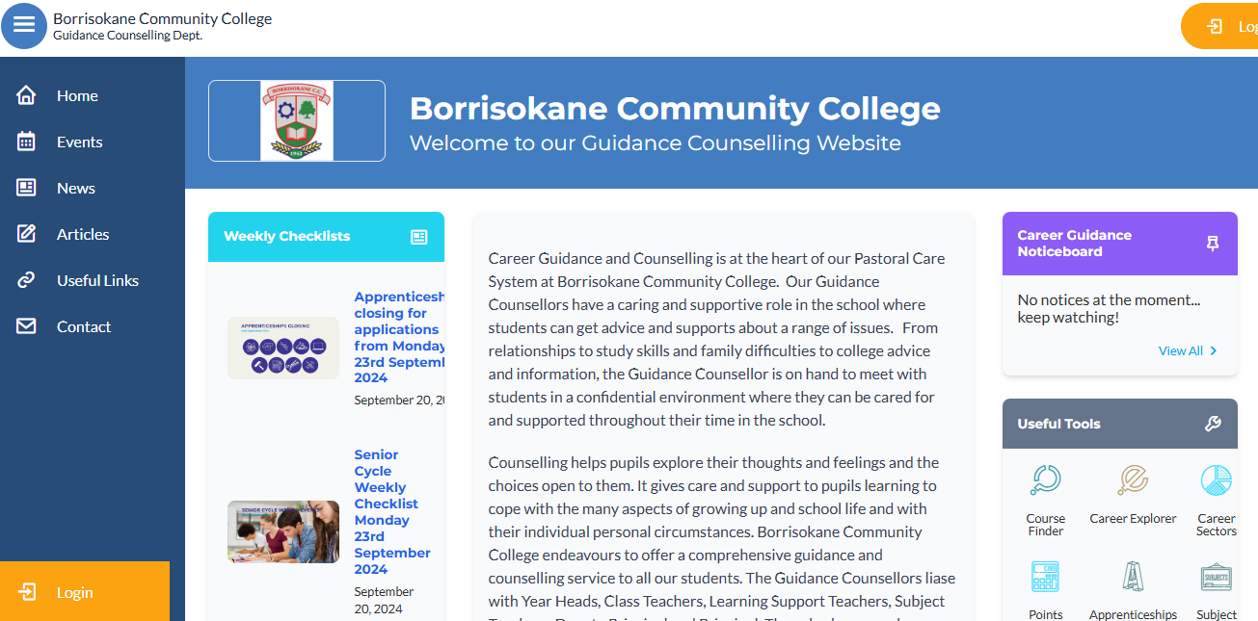
The Guidance Dept at BCC – Ms Carroll
All Junior Cycle classes have Guidance Related Learning classes.
All Senior Cycle classes have a weekly Career Guidance class and can take part in trips to Colleges and Apprenticeship centres.
Provide one-to-one personal, academic and career support.
Parents & Guardians are welcome to get in contact and can also avail of our Guidance page on the school website which has info on courses, apprenticeships, LC points and Open Days etc.

Slide 9
Year Heads: Eimear Lyons(3rd)& Marianne Bergin(2nd)
Leaders of Teaching and Learning
Support students and parents throughout the school year.
Monitoring the attendance, punctuality and engagement of each student.
Monitoring uniform (including PE uniform)
Ensuring that students adhere to the code of behavior and behave in a positive manner in line with the ethos of our school.
Active communication is very important.

Slide 10
School Journal
Allows vital communication between teachers, students and parents. Parents see what students need to engage with at home and can provide support.
Helps students to write down important reminders.
Provides detailed information in relation to the Code of behavior and important school policies such as, Anti Bullying Policy, Student Rights and Responsibilities, etc.
Parents should check the journal weekly.
Sign each week is preferable so you can keep an eye on it
Centre Pages – Study tips, Revision Points, Setting Targets and Goals.
Notes:
Records – behaviour, attendance.

Slide 11
Attendance and Punctuality
Attendance is key to success in school. Please encourage your child to attend.
When absent- when sick and on school activities – find out what was covered in class and complete classwork and homework – Use Teams. A homework buddy works well.
A note explaining absence/late must be sent on Vsware App- need to know information only please
TUSLA – over 20 days absent.
Medical certificate or reason given where possible
Records of each month are entered in Journal. Available on vsware too

Slide 12
Attendance and Punctuality
Arriving Late or Leaving Early
If a student arrives late or is signing out early, a reason must be submitted on Vsware. This will inform the Year Head and Secretary, who can update the records system.
Absent/ late/ sign out notes sent are received by the Year head who must approve them.
Please only use the sign out option if a student is missing just part of a day. Sign outs must be for a genuine reason
The “others” option can be used for absences that don’t have a preselected option
Any issues with incorrect attendance markings please email the relevant year head.

Slide 13
Parent Reminders
Prepare bag and uniform with child – study area
Attendance (Child at school and parent at Parent/ Teacher Meeting) - is key to school and exam success
Read journal and sign daily to monitor and assist with Homework
Encourage full participation in all school activities
Never hesitate to contact the school if your child needs support
Time- support and encourage good time keeping. Give your child TIME.
Set realistic goals with your child

Slide 14
Staying Well
For Wellbeing students need:
  Sleep
  Food- breakfast before school
  Hydration
  Exercise
All of these are needed before a student can succeed at school
Some good investments: an alarm clock and a keyboard for the iPad.

Slide 15
Student Supports
Year Head
Any class Teacher
Principal and Deputy Principal
Student Support Team
Student Council
Homework Club
SEN Department
Guidance Counsellors

Slide 16
4 key considerations
4 key considerations highlighted to all students, please reinforce this with them.
High expectations: We all have high expectations of students, please mirror these expectations and encourage students to achieve their potential.
RESPECT: From the time you put on your uniform each morning, please be respectful to all members of the school community, most importantly yourself.
BE KIND: Be kind in your actions each day. Kindness can go a long way.
STUDENT VOICE: we encourage students to represent themselves(when able to do so)- please encourage the same.

Slide 17
Homework - Study
Help your child to plan their homework – place to study. Leave books at study desk, use e-books in school.
A "same time, same place" routine builds structure round homework.
Study includes revision. Ongoing learning is essential to help performance in class assessments/exams.
Encourage reading. Be mindful of screen time. This can be checked on the iPad.
Time for homework/study – 2 to 3 hours each night as year progresses.
Each night check timetable to ensure that all books, materials, uniform, lunch, etc. are ready for the next day.
Ensure iPad is charged and in schoolbag each morning.

Slide 18
After School Study & Morning Study Club
Monday to Thursday 4.00pm to 6.15pm.
Cost €3 per evening – Subsidised by Parents Association.
Sign up via email sent by Marie Coffey
Morning Study Club:
before school Monday to Thursday 8.20 to 8.50 room 114
Notes:
First years are welcome to take part in study – majority of students are 3rd 5th and 6th years.

Slide 19
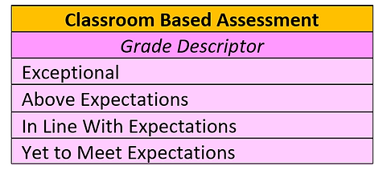
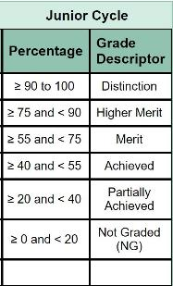
CBA – Classroom based Assessment
CBA schedule on p6 of the school journal.
Duration and completion dates to be entered into the journal in conjunction with the relevant class teacher.

Slide 20
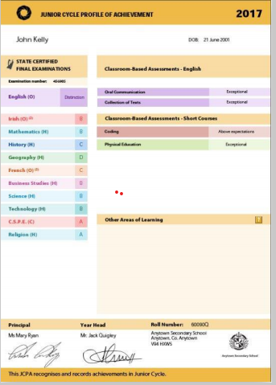
JCPA-Junior Cycle Profile of Achievement
This is an example of a JCPA – it is what you will receive after you have completed your Junior Cycle exams. It includes three key areas.
1. Results of your JC Exams
2. Results of your Classroom Based Assessments
3. Other Areas of Learning

Slide 21
What are some suitable achievements for inclusion in my OAL?
Awards you have won
Player on a sports team
Student Council
Competition – Art/ Science
Charity Fundraiser for School
School Clubs
Perfomance at school assemblies
Any other relevant area.
Prize for attitude/behaviour

Slide 22
Uniform
Must be worn everyday with exception of PE day.
PE uniform must be worn on PE day. Any runners are acceptable as long as suitable for activity.
Any layer or t-Shirt worn under the uniform must be white with no collar.
Girls Trousers – Hunter Brand or similar.
Skirts must not be shortened – worn below the knee.
Footwear – Black or brown shoes or boots. Black runners allowed – Completely black- no white logos
School Jacket. This is the best option as it can be worn both inside and outside the school building. Other jackets can not be worn on the school premises.
Notes:
No runners. If looks like runners then no. No canvas footwear.

Slide 23
Uniform
Please use Identification tags/labels. If an item of uniform is found with a clear name it will always be returned to the owner.
PE uniform is available on www.xgear.ie
Protect valuables- use the lockers/pockets.
Please supply a note if there is a uniform issue – accidents etc. – and please Keep to a minimum.

Slide 24
Code of Behaviour –Journal
In place to allow all members of the school community to fulfil their roles. Negative behaviour has an impact on Teaching and Learning and will not be tolerated.
Teaching – Learning - Respect
Charters – Highlighted in school journal pg 9. Become familiar with them.
In the charter section you can view the rights and responsibilities of:
  Students
  Staff
  Parents
Everyone works together for the betterment of the student.
Notes:
Review of Code of Behaviour two years ago - charters

Slide 25
Positive Discipline
Positive Comments are used to encourage positive behaviour.
Students start the year with 100 credits and are expected to maintain this.
Credits needed for school trips.
Teachers will try to catch students doing right
A reward for good behaviour and exceptional work.
Notes:
Rewards – No homework, game in class, watch DVD, Taken on tours, given credits

Slide 26
Implementing Code of Behaviour
  Listed are the steps in which negative behaviour is treated.
  Class Teacher
  Year Head
  Deputy Principal
  Principal
  Board of Management
Parents informed – vsware, Journal, Phone, letter/Email. Please monitor vsware to support your child
Parents are our partners in this process- your support can really help students to have a positive experience of school.

Slide 27
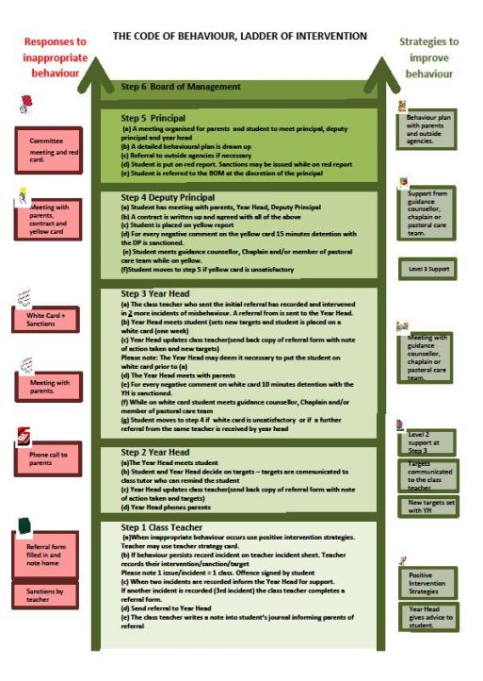
Ladder of Intervention

Slide 28
Code of Behaviour
Detailed information on the following can be found in the student's journal or on the school website borrisokanecc.ie or by clicking
Code-of-Behaviour.pdf
Sanctions.
Suspension Policy.
Expulsion Policy.

Slide 29
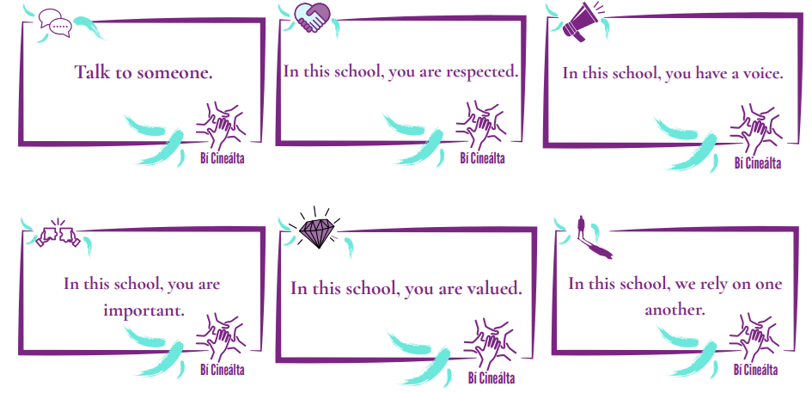

Bí Cineálta Policy
to Prevent and Address Bullying Behaviour
Detailed information on the following can be found in the student journal(pages 28 – 41) or on the school website www.borrisokanecc.ie
Tell someone – No innocent bystanders!
‘Morning Notes’ system – find out information Mobile phones – Social Network Sites e.g. Snapchat, Instagram, TikTok etc.
Please monitor from home.
Monitor children and talk to them. Any concerns, please contact us.
If something happens, screenshot it, don’t engage and tell someone about it.
Notes:
Mobile phones
Social networking websites – Bebo, Facebook.

Slide 30
Extra Curricular Activities
Permission to take part in activities – Note in Journal to be signed pg 46. Please sign
E.g. Basketball, Hurling, Soccer, Camogie, Badminton.
Groups play hurling, soccer, basketball at lunchtime
Helmets are required for hurling at all times.
Positive Behaviour is very important (trips, matches away etc). We are operating a no phones on trip policy. Contact the school in emergency situations.
Students catch up on work missed.

Slide 31
3rd Yr Assessments
Parent -Teacher meetings
Premocks 20th – 24th Oct (week before midterm break)
Results with teachers' Formative feedback on VSware in November
Study skill day 11th Dec
3rd Parent teacher meeting Thursday December 11th - 4.15 to 6.45pm
Mock exams 9th Feb –13th Feb 2026 (week before midterm break)
Results with teachers' Formative feedback on VSware
Junior cycle Wednesday 3rd June –24th June

Slide 32
2nd Yr Parent -Teacher meetings & Assessments
Study skill 26th September
First term class assessments – results posted on VSware
Christmas assessment 15th-19th December.
Parent teacher meeting Thursday Jan 22nd - 4.15 to 6.45pm
Summer exams: Week begining May 25th
Formative feedback on vsware in January, March and June. Notification sent to parents.

Slide 33
Please contact the year head for any support when needed
eimear.lyons@borrisokanecc.ie
marianne.bergin@borrisokanecc.ie
Please inform the school if your contact details change at any time or if your child's medical information changes.

