Slide 1
Coláiste Pobail Buiríos Uí Chéin
Borrisokane Community College
1st Year Parent Information Evening
Ms. Paula Molloy
Ms. Caitríona Maher
Ms. Davina Fogarty

Slide 2
General Updates:
Enrollment for Sept 26. Admissions notice has been published and our Open Night is on Oct 16th from 5pm. Please get application forms in early or on time.
One Way System & Parking – from 8:30- 9:00 am we request that cars come to school via the athletics/tennis grounds and leave via Ballyhaden. In the evenings from 3:20 we request the same. We have extended our car park so can you please park in new car park and not on the footpath.

Slide 3

Our Mission Statement & ETB Ethos
We seek to promote a caring and ​
committed school community​
which will facilitate the education of our students​
and where each individual is valued ​
as a unique human being.​
​
“Is ar scáth a chéile a mhairimid”

Slide 4
Website
Our website is being updated and you will be able to find presentations.
We will need your input over the next few months on our Child Protection and Child Safeguarding Statement and Code of Behaviour as these have to be updated in line with new circulars.

Slide 5
Board of Management
Ms.Virginia O'Dowd, Cllr Louise Morgan Walsh, Ms. Fiona Dunford ( elected to board by ETB)
Ms. Avril Murphy, Mr. Mike Fox ( Parents Rep)
Ms Ceire Hogan, Mr. Sean Ryan (PE) ( Teacher Reps)
Paula Molloy ( Secretary) Caitríona Maher ( Recording Secretary)
Thomas Clarke, Paula Sullivan. Eoin Reddan (Community Reps)

Slide 6
Parents Association
Parents Association Support
The Parents Association is seeking representatives from the following areas: Borrisokane, Nenagh, Newtown, Puckane, Toomevara, Moneygall, Shinrone, Clonlisk, Ballingarry, Carrig, Ballinderry, Cloughjordan, Lorrha, Ardcroney, and surrounding areas.
If you are interested in joining, please contact the school office by emailing info@borrisokanecc.ie.

Slide 7
School Closures
Please note that the school will be closed for students on Monday, 20th October 2025 for staff training.
Normal school hours will resume on Tuesday, 21st October.
School will also close for students on Dec 15th 2025 for staff training with normal hours resuming on Tuesday, 16th December

Slide 8

After school study
Monday to Thursday evenings.
4.00pm to 6.15pm.
€3 per evening, pay on Way2Pay – Email marie.coffey@borrisokanecc.ie
Extra study at home.
2-3 hours per school night in total as year progresses.

Slide 9
Classroom Based Assessments (CBA)
Each student must complete a minimum of one CBA in each subject and short course
Students taking the junior cycle final examinations in 2025 will not be required to complete Assessment Tasks for the relevant subjects.
The grade descriptor awarded for these subjects will be based on the examination paper only.
Exam Papers – teachers are ordering papers at the moment for JC Subjects.

Slide 10
Monthly assessments / Term tests:
Regular Assessments by subject teachers recorded on Vsware.
Formative feedback with results January, March & June

Slide 11
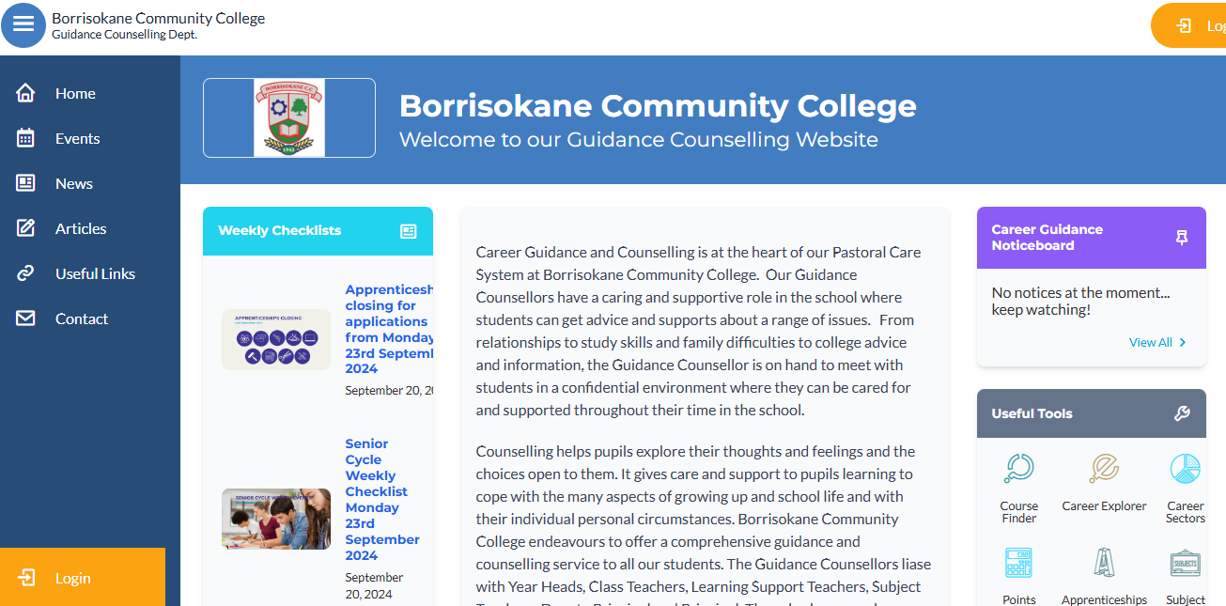
The Guidance Dept at BCC.
All Junior Cycle classes have Guidance Related Learning classes.
All Senior Cycle classes have a weekly Career Guidance class and can take part in trips to Colleges and Apprenticeship centres.
Provide one-to-one personal, academic and career support.
Parents & Guardians are welcome to get in contact and can also avail of our Guidance page on the school website which has info on courses, apprenticeships, LC points and Open Days etc.

Slide 12
Option Subjects- Rotations
Options are rotating every 3 weeks- some classes will get to experience certain subjects twice/3 times.
Next rotation – Monday 6th October.
1st Year Options online meeting Tues 6th Jan (subject options will be sent out after this meeting on VSWare – ensure you have login)
1st Year Parent/Student/Teacher Meeting Thurs 8th Jan
Select in mid January, to commence selected options in late Jan

Slide 13
Year Head: Ms. Fogarty
Leader of Teaching and Learning focusing on First Year.
Support students and parents throughout the school year.
Monitoring the attendance, punctuality and engagement of each student.
Monitoring uniform (including PE uniform)
Ensuring that students adhere to the code of behavior and behave in a positive manner in line with the ethos of our school.
Active communication is very important.

Slide 14
School Journal
Allows vital communication between teachers and parents.
Parents can see where they need to provide support for their child.
Helps students to write down important reminders.
Provides detailed information in relation to the Code of behavior and important school policies
e.g. Bí Cineálta, Acceptable Use Policy,
Student Rights and Responsibilities etc.
Parents should check the journal daily.
Sign each week so that regular checks take place.
Study tips, Revision Points, Setting Targets and Goals
Page 46 – extra curricular activities – please sign
Notes:
Records – behaviour, attendance.

Slide 15
Attendance and Punctuality
Attendance is key to success in school. Please encourage this with your children.
When absent – find out what was covered in class and complete homework – Use Teams/Homework Buddy.
A note explaining absence/late must be sent into the school via VSWare . Please be mindful of category of comment. Sign out if leaving the school during the day. Late if arriving late.
TUSLA – over 20 days absent.
Medical certificate or reason given if possible
Please do not share your VSWare password with your child.

Slide 16
Attendance and Punctuality
Arriving Late or Leaving Early
If a student arrives late or is signing out early, a reason must be submitted via VSWare. This will inform the Year Head and Secretary, who can update the records system. Please choose correct category.
Sign outs are used when students are leaving the school during the day.
Parents should have received a text as a link to VSWare. Download the app to make access easy.
Absent/ late/ sign out notes are approved at the year heads earliest convenience. VSWare updates once approved.
If you are unsure of the category to use for absence- just use other and insert reason.

Slide 17
Parents Reminders
Prepare bag and uniform with child – study area
Attendance (Child at school and parent at Parent/ Teacher Meeting) - is key to school and exam success
Read journal and sign to monitor and assist with Homework
Encourage full participation in all school activities
Never hesitate to contact the school if your child needs support
Time- support and encourage good time keeping. Give your child TIME.
Set realistic goals with your child

Slide 18
Homework - Study
Help your child to plan their homework – place to study. Leave books at study desk, use e-books in school.
Study includes revision. We have monthly/ bi-monthly assessments.
Encourage reading. Be mindful of screen time. This can be checked on the iPad.
Time for homework/study – 1 to 1.5 hours each night.
Each night check timetable for tomorrow to ensure that all books, materials(ingredients), uniform, lunch, etc. are ready for the next day.
Ensure iPad is charged and in schoolbag each morning. Charging after homework and in bag before bed is best.

Slide 19
Student Supports
Year Head
Any class Teacher
Principal and Deputy Principal
Student Support Team
Cairde
Student Council
Homework Hub
SEN Department
Guidance Counsellors

Slide 20
Homework Hub
Before school 8.20-8.50
Room 114
Numbers are limited.

Slide 21
Mobile Phone Policy
Mobile phones are not permitted from 9:00am to 3:40pm.
This applies to all areas of the school premises, including classrooms, corridors, bathrooms, and outdoor spaces.
Guidelines
Phones must be switched off or on silent mode and kept out of sight (e.g. in school bags) at all times during the school day.
Students must hand their phone to a teacher before leaving the classroom to use the bathroom. Phones will be returned upon the student’s return.
Confiscation Procedure
  If a phone is seen or used during school hours without permission, it will be confiscated immediately by a staff member.
  The phone will be placed in the school office and can be collected by the student after 3:40pm.
  The incident will be recorded on VSware as a breach of school policy.
Repeated violations may result in further disciplinary action, including parental contact and review of the student’s behaviour record.
Phones collected at start of a trip, given back at end of trip

Slide 22
Uniform
Must be worn everyday with exception of PE day.
PE uniform must be worn for PE.
T- Shirts worn under uniform must be white with no collar.
Girls Trousers – Hunter Brand or similar. 63 style not uniform.
Skirts must not be shortened – worn below the knee.
Footwear – Black or brown shoes or boots. Black runners allowed – Completely Black(no visible logos) - no Ugg boots.
School Jacket is the best option as it can be worn both inside and outside the school building.
Notes:
No runners. If looks like runners then no. No canvas footwear.

Slide 23
Uniform
Sport and PE classes – PE uniform and runners or boots for field games.
Wear PE Uniform to school on PE Day.
Label all clothing to prevent loss
Protect valuables- lockers
Please provide a note if there is an unexpected issue with uniform in the morning – keep this to a minimum.
1st Year PE Timetable:
1A and 1B – Friday
1C and 1D – Tuesday
1E – Monday

Slide 24
Code of Behaviour –Journal
In place to allow all members of the school community to fulfil their roles. Negative behaviour has an impact on Teaching and Learning and will not be tolerated.
Teaching – Learning – Respect
Charters – Highlighted in school journal. Become familiar with them.
Notes:
Review of Code of Behaviour two years ago - charters

Slide 25
Charters
In the charter section you can view the rights and responsibilities of:
Students
Staff
Parents
Everyone works together for the betterment of the student.

Slide 26
Positive Discipline
Positive Comments
Catch students doing right
Praise, Thank you.
Reward good behaviour and excellent attendance
Demonstrate respect
Notes:
Rewards – No homework, game in class, watch DVD, Taken on tours, given credits

Slide 27
Implementing Code of Behaviour
  Ladder of intervention:
  Class Teacher
  Year Head
  Deputy Principal
  Principal
  Board of Management
Parents informed – VSWare, Journal, Phone, Letter, Email.
Detailed on pages 15 to 26 in Journal
Please monitor VSWare to see students behaviour.
Parents are our partners in this process.

Slide 28
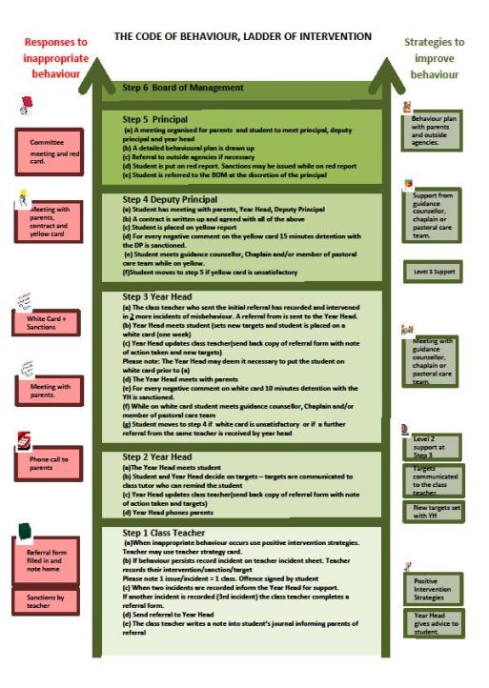
Ladder of Intervention

Slide 29
Code of Behaviour
Detailed information on the following can be found in the student's journal or on the school website www.borrisokanecc.ie
Sanctions.
Suspension Policy.
Expulsion Policy.

Slide 30
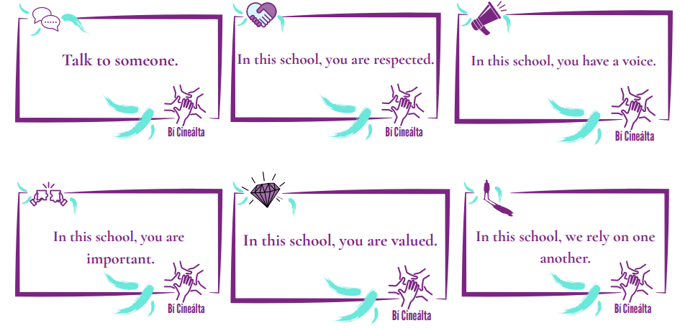

Bí Cineálta Policy
to Prevent and Address Bullying Behaviour
Detailed information on the following can be found in the student journal(pages 28 – 41) or on the school website www.borrisokanecc.ie
Tell someone – No innocent bystanders!
‘Morning Notes’ system – find out information Mobile phones – Social Network Sites e.g. Snapchat, Instagram, TikTok etc.
Please monitor from home.
Monitor children and talk to them. Any concerns, please contact us.
If something happens, screenshot it, don’t engage and tell someone about it.
Notes:
Mobile phones
Social networking websites – Bebo, Facebook.

Slide 31
Extra Curricular Activities
Permission to take part in activities – Note in Journal to be signed pg 46
Basketball, Hurling, Soccer, Camogie, Badminton, Football, Rugby
First years play basketball blitz at lunchtime
Helmets required for hurling at all times, hurling on the grass.
Walkway used by students at breaks
Positive Behaviour is very important (trips, matches away etc)

Slide 32
Details for 1st Year Sports
You do not have permission to wear PE uniform all day when training after school
Please change for training
Monday
Darts | Mr Ryan | Lunchtime Sign up now closed
Soccer (boys) | Mr Hanlon | After School every week First training 6th October
Soccer (girls) | Ms Mitchell | After school every second week Next training 13th October
Tuesday
Badminton | Ms Dillon | Each week after school Sign in sheet on arrival

Slide 33
Details for 1st Year Sports
You do not have permission to wear PE uniform all day when training after school
Please change for training
Wednesday
Camogie | Ms Flaherty and Ms Kelly | After school every Wednesday
Hurling | Mr MacLochlainn and Mr O’Connell | After school every Wednesday
Thursday
Ladies Gaelic Football | Ms Allen | After school every Thursday First training 2nd October
Friday
Rugby (boys) | Ms C Maher / Mr E Ryan | After school every second week Next training 10th October
Rugby (girls) | Ms C Maher / Mr E Ryan | After school every second week Next training 3rd October

Slide 34
4 pieces of advice of
Be here – Attendance is key to success at school.
  “no-one is…” “everyone is…”
Be on time – Go straight to classroom door and wait for your teacher. Students no permitted to use bathroom between classes.
Be ready – PE Uniform? Home Ec ingredients? Homework done? Necessary equipment?
Be nice – You don’t need to be everyone’s friend…

Slide 35

Class captains

Slide 36
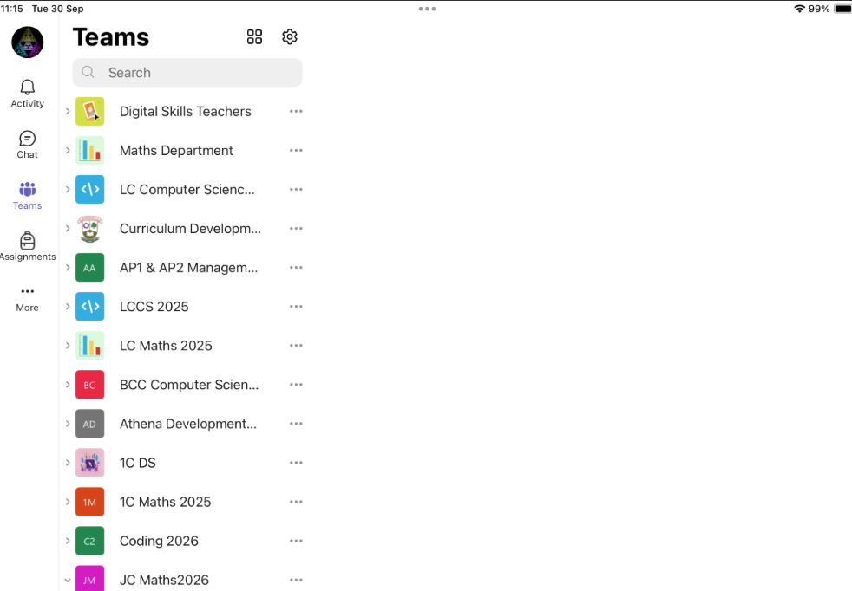
Teams
Home Screen
Here on the main screen of the iPad app you will find a list of all Teams that your child is a member of.
Please check through these to ensure that they have access to all subjects, and are not in any unnecessary Teams.

Slide 37
Teams
Activity Button: here you will find notifications for all teams – usually sports updates and homework assignments
Chat: This should be disable for all students. Please check that it is disabled on your child’s device.
Teams: The list of all Teams (from previous slide)
Assignments: If teachers have set an assignment in Teams to be completed, you will find a list of them all here

Slide 38
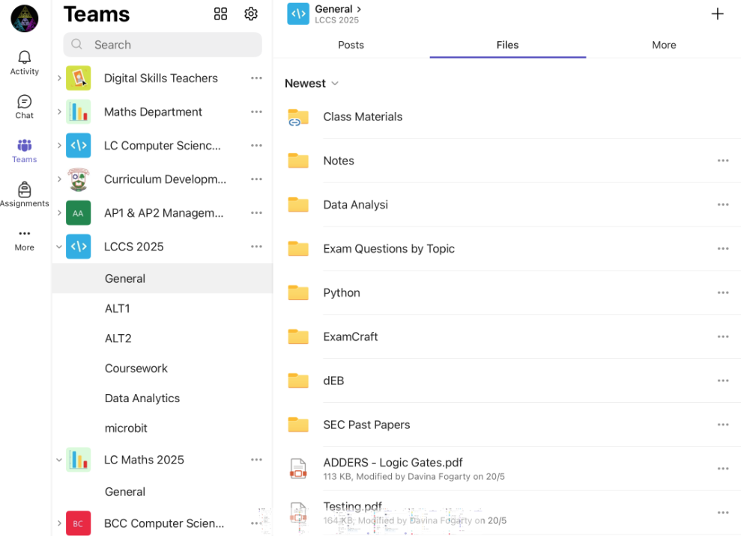
Channels
Some teachers will divide their Teams into chapters or sections.
These are called Channels
You can click on the three dots,
Select manage channels to make sure that all channels have been activated for this Team.
Sometimes, homework is posted in a dedicated homework channel.

Slide 39
Files
Files shared in class via Teams can all be found in the Files section in the General Channel.
These might include images, notes, handouts etc.

Slide 40
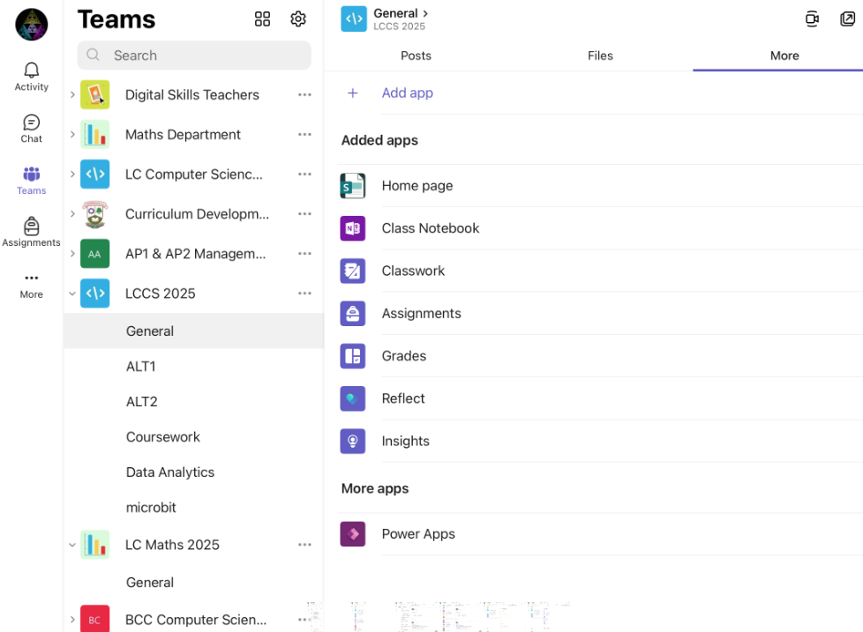
More
Here is where you will find assignments specific to that subject and other important information.
Some teachers use OneNote to deliver lessons.
The OneNote specific to that Team can be found under the “More” menu in the General Channel.

