Slide 1

Information meeting 1st Year Sept 2025
Mon 20th Jan 2025

Slide 2
Why promote Digital Learning
Use of internet for research.
All students have school email accounts.
Teachers Email notes to students.
Students can email each other.
Teachers can share resources on school online systems –Microsoft 365 – OneDrive, Teams, etc.
Getting familiar with modern technology.
Many apps can be used in class and for homework.
Students have textbooks in paper format and EBook
New Junior Cycle – Promotes use of Technology in all subjects.
Lighter School Bags.
Platform available for Distance Learning and Teaching.

Slide 3
Department of Education & Skills Policy
New Junior Cycle
Senior Cycle Reform
DES Strategy to integrate Digital Technology in Teaching and Learning

Slide 4
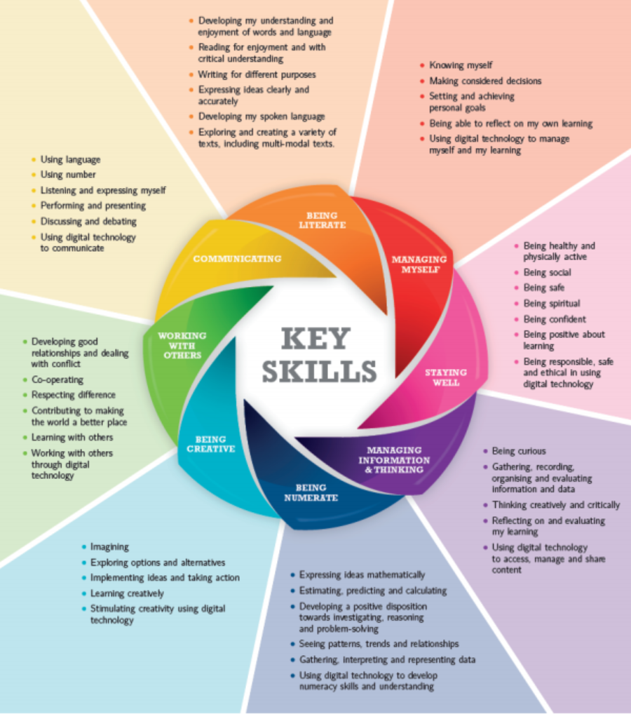

Slide 5

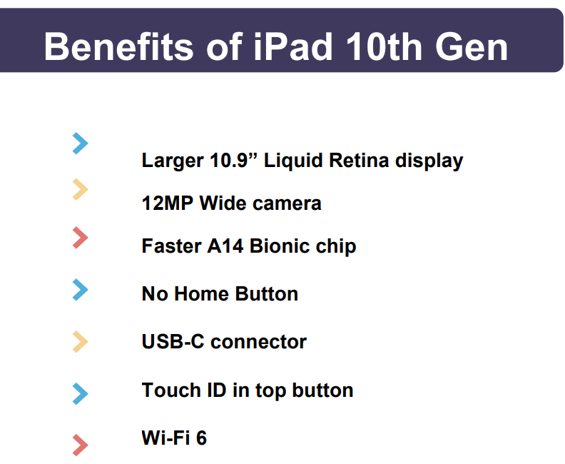
Apple 10th generation iPad
Device
Device
Private & Confidential
Notes:
Best device we have ever offered students at this price point
We envisage the device will last the full length of your child’s education. With ongoing support from Wriggle, we will ensure the device is kept fully up to date, secure and protected, and running smoothly.

Slide 6
Payable to Ipad Supply Company - Wriggle
Ipad 64GB including setup 10th Generation 10.9 inch | €419
6 Year Management | €120
Heavy Duty Case | €50
Payable to Borrisokane Community College
Personal Accident Insurance Year 1,2 ,3 | €30
Locker Year 1,2,3 | €30
Cat 4- Cognitive Ability Test | €30

Slide 7
Ipad Setup
IPad Supplier Wriggle:
  Purchase on online Store
  iPad supplied setup to your home.
  School Books ordered through school and uploaded to IPad
All new IPads are setup on a Manged System
  Controls the Setup of the iPad.
  Only School requested Apps installed
  Limit to Educational Use.
  Support available to Parents from Wriggle
  Training materials available online from Wriggle

Slide 8

Wriggle Pay
Interest-Free Payments
  Offers the option to pay over 12 months without interest, extra fees, or charges.
  Ensures the total cost remains unchanged, regardless of payment upfront or over 12 months.
Extended Payment Plans
  Provides options for extending payments over 24 or 36 months with a 9.99% interest rate.
  Includes a €20 application fee and a €2 monthly account-keeping fee.
  Allows early settlement of the balance without penalties for added flexibility.
Eligibility Criteria
  Must be over 18 years of age.
  Minimum income of €1500 per month.
  Resident in the country for more than 12 months.
  Requirement to provide ID, Proof of Address, and PPS Number.
All payment options (12, 24, or 36 months) are contingent upon meeting the HUMM minimum criteria.

Slide 9
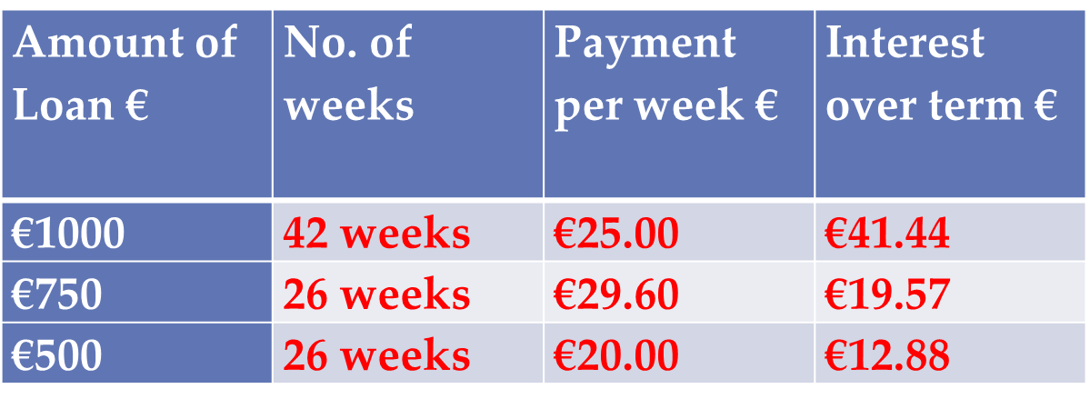
Other Finance Options
Borrisokane Credit Union Phone: 067 27455
Email: info@borrisokanecu.ie
Website: www.borrisokanecu.ie

Slide 10
Preused Ipads.
Need to be relatively new for use of current apps and software.
Storage needs to be considered.
  New iPad minimum 64GB
  Old iPads may be 16GB or 32GB
iPad will be used for six years – need to consider.

Slide 11
Relevant School Policies
Social Media Policy.
IPad Acceptable Usage Policy
ICT Acceptable Use Policy
All available on school website: www.borrisokanecc.ie

Slide 12
Payment Schedule
Purchase iPad from online store – Details will be emailed as soon as store is open.
Payment to school of:
€90 by June 30th 2025. Can be paid in instalments on electronic payment system Way2Pay

Slide 13
Access to Schools Record System for your child
Vsware
Records
  Attendance
  Exam Results and reports
  Events – behaviour and positive comments.
  Target Setting.
  Athena
You will be given username and password, web address to access this in June 2025. Access will be available from August 2025.

Slide 14
Permission for Photos
GDPR
School must have permission to use photos
Social Media – Twitter, Facebook and Instagram. Can view from school website.
On Social Media no names
Photos also used on Local Newspapers
Names used on Newspapers.

Slide 15
Next Steps - Summary
Before end of March you will get text from school – total €90, Can be paid in instalments.
When iPad Store is setup you will be sent details by email and text.
Will email in relation to dates for Cat4 testing, will let primary schools know, also up on social media.
Notified when school books and stationary are ready for collection.

Slide 16
School Uniform
The school uniform is available from Slatterys, Pearse St., Nenagh, Co. Tipperary.
School Jumper with Crest and Skirt only available from Slattery’s
Navy Uniform Trousers and white shirt can be purchased in other shops.
Footwear – Black/Brown shoes or boots. Also Decks or equivalent can be worn – navy, navy/green, black, brown. If wearing runners they must be completely black.
PE Uniform – purchase online www.xgear.ie

Slide 17
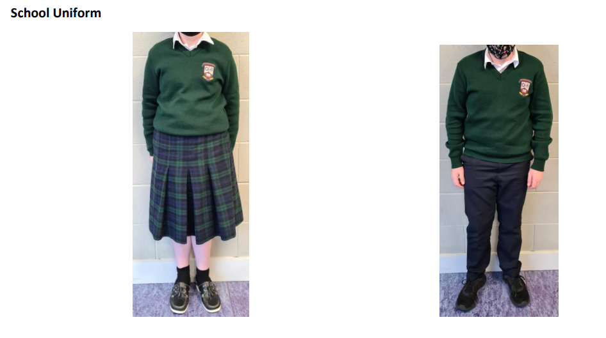
Uniform Slatterys Nenagh

Slide 18
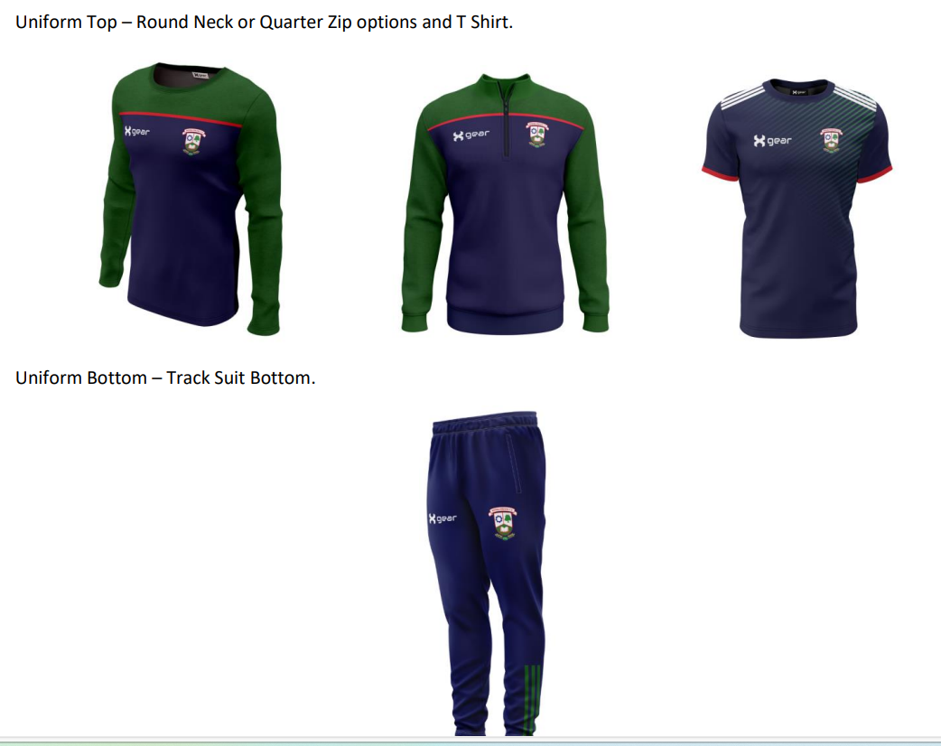
PE Uniform xgear.ie
PE Jumper €28
T-shirt €20
Bottoms €24

Slide 19

School Jacket €38-€36

Slide 20
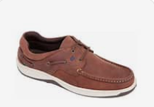
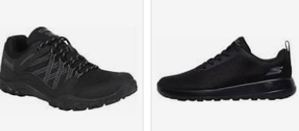
Footwear
Footwear: Black, Brown, Navy Shoes. Black, Brown, Navy and Navy/Green Decks. The only runners that can form part of the school uniform are complete black runners.
Canvas, Uggs, Vans or similar footwear are not allowed.

Slide 21
Assessment
Cat 4 Cognitive Testing/ NGRT will take place the week of 14th April.

Slide 22
Subject Options
Approx 12 weeks of taster of Option subjects (end Nov)
Presentation from Career Dept
Parent Student Teacher Meeting.
French, German, Home Ec, Wood Tech, Engineering, Geography, Graphics, Business, Music, Art.
Select 3 subjects to continue.

Slide 23
School Transport
Bus Eireann School Transport.
Apply on www.buseireann.ie and go to School Transport section.
Closing Date: Last Friday in April.
Private Transport from Nenagh direction
  Aidan Claffey 087 6531777
  Andy Kennedy 086 2664060

Slide 24
Presentation will on our website.
Leaflet from Wriggle
Useful website for parents in relation to supporting your child with technology www.webwise.ie

Slide 25
Keep up to date
Follow us on Social Media
Facebook
Twitter
Instagram
Website

