Slide 1


Borrisokane Community College
Seeking to promote a caring and committed school community
Junior Cycle Subject Choice

Slide 2
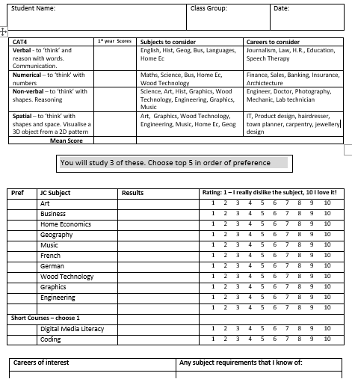

CAT4 scores
Rank your subjects in order of preference
Class test results
How much you like the subject
Career/ subject requirement

Slide 3


Subject Choice
Pathways Through BCC
1st Year
2nd Year
3rd Year
TY
LCA
LCE
At various stages students make subject or programme choices.
The first term of 1st year allows students to sample all subjects.
This facilitates an informed decision regarding subject choice for Junior Cycle

Slide 4
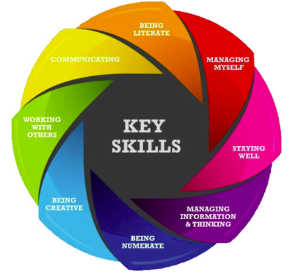
Junior Cycle Core Subjects – (compulsory)
Irish (unless exemption)
English
Maths
Science
Religion
History
PE
SPHE
CSPE
Wellbeing & Guidance
These 4 subjects make up 400 hours of WELLBEING at BCC and include learning through
Whole School Guidance:
Developing Myself
Developing My Learning
Developing My Career Path

Slide 5

3 Junior Cycle Optional Subjects – (Choice)
Art
Business
Home Economics
Geography
Music
French
German
Wood Technology
Graphics
Engineering
short courses (100 hours approx.):
Digital Media literacy or Coding
Students will study three options for Junior Cycle.
Place five subjects in order of preference.
Indicate which short course you wish to take.

Slide 6
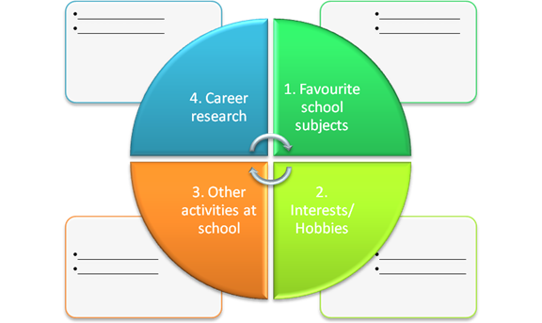
General advice when Choosing Subjects
Choose subjects you enjoy.
Choose subjects you excel in.
Be aware of College requirements (eg. Language).
Be aware you may receive your 4th/5th choice.
Talk to teachers of the subjects.
Research subjects using www.curriculumonline.ie
Ask for advice from Guidance Dept.

Slide 7
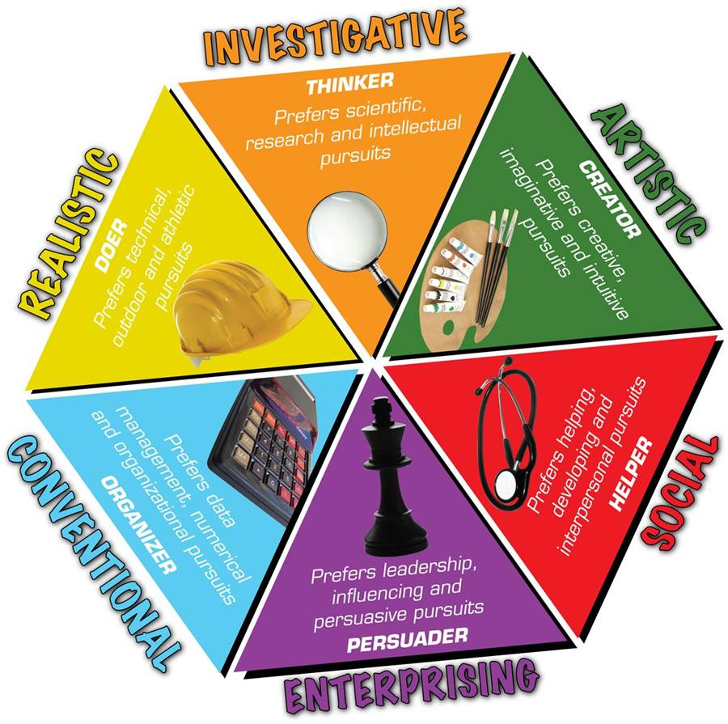
How do you like to learn?
Consider:
Do you like reading & learning factual information?
Do you prefer practical hands-on tasks?
Do you enjoy discussion and analysing information?
How are you at problem solving?
Are you creative and enjoy expressing yourself through creativity?
Do you prefer project work or assignments or performing in exams?
https://classroomguidance.ie/test/learning-styles-2/

Slide 8

Future Career & Study Path
Discussion & reflection on possible careers & further study supports decision making.
Be mindful JC subjects may have an impact on senior cycle subject choices.
Skills & knowledge learned in subjects at Junior Cycle are expanded upon in most Senior Cycle subjects.
https://classroomguidance.ie/test/musaic-psychometric-test/

Slide 9
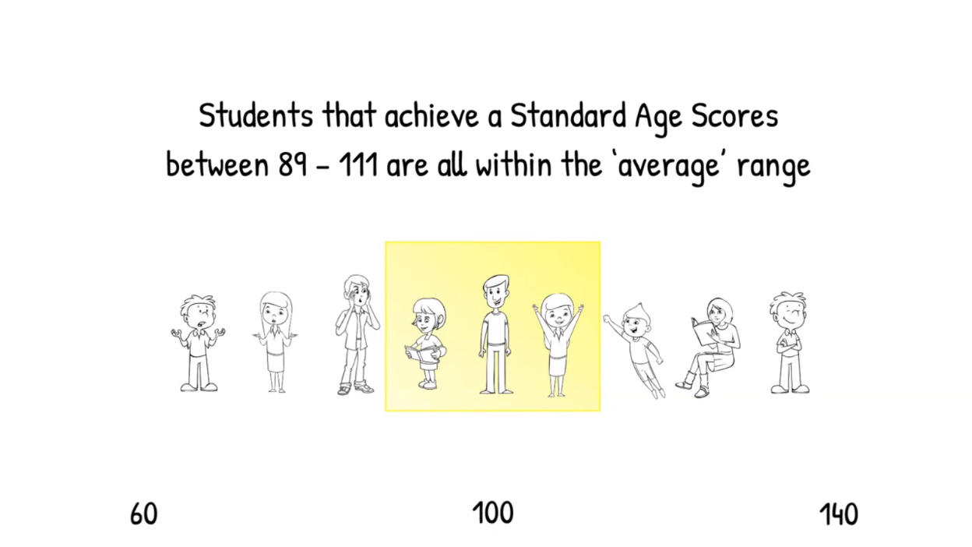
What is CAT4 used for?
CAT4: Cognitive Abilities Test Fourth Edition
Understanding how a student thinks
Identifying academic potential
Determining where further support may be necessary
Informing decision making regarding subject choice
Students that achieve a Standard Score of between 90 and 110 are within the ‘average’ range.

Slide 10
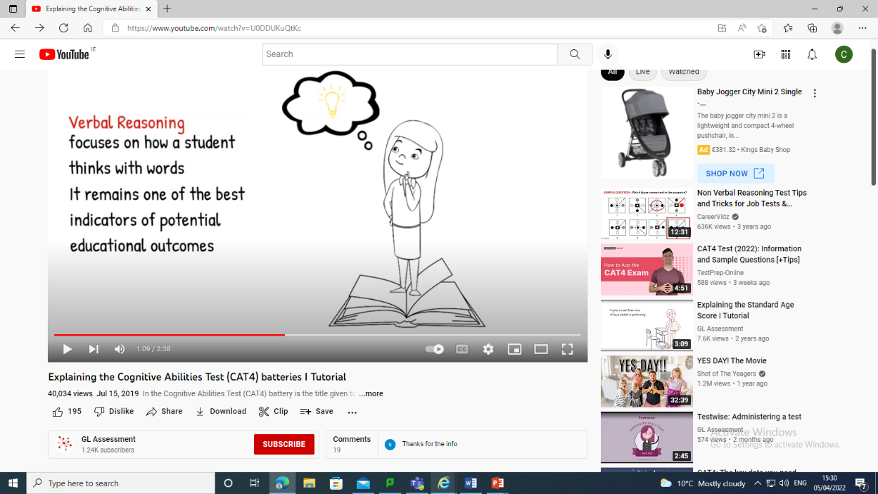
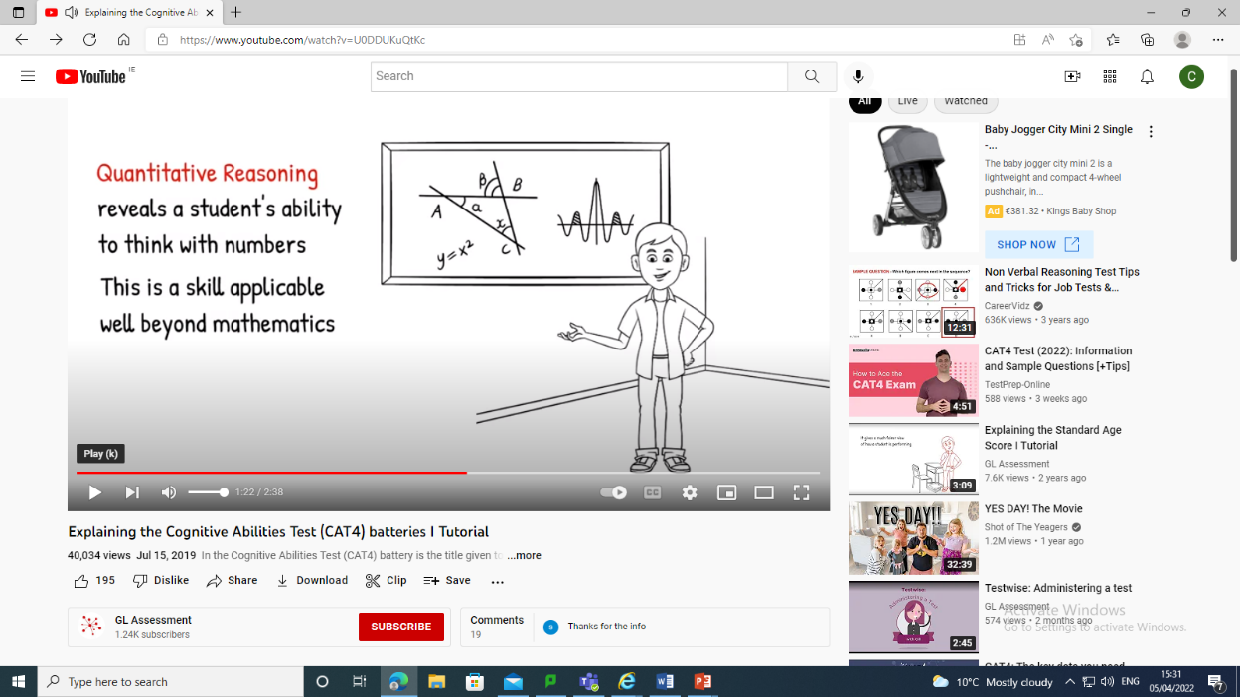
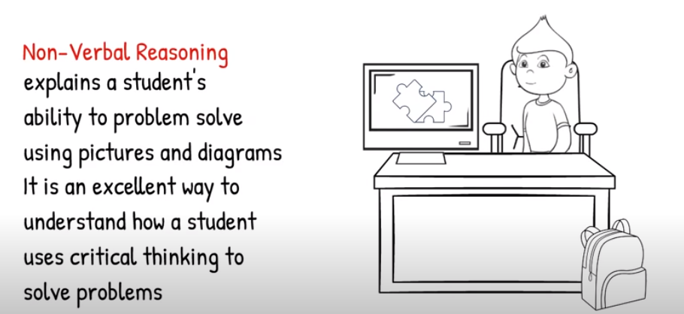
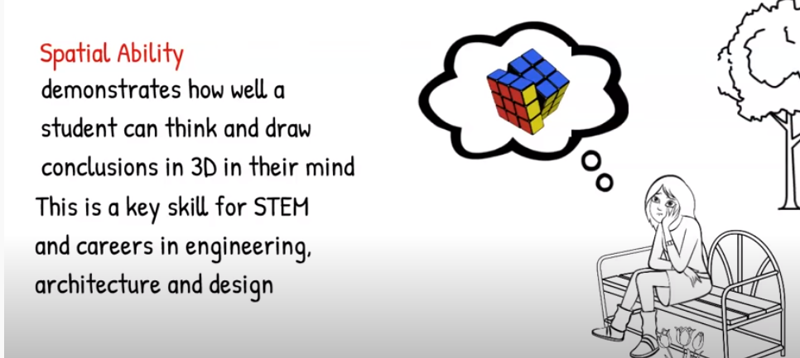
Consider their SAS (Standard Age Score) in the following Batteries:
Verbal Reasoning subjects: Languages, History, Geography, Home Economics & Business.
Quantitative Reasoning subjects: Maths, Metalwork, Graphics, Science
  Non-Verbal Reasoning subjects: Maths, Art, Graphics, Metalwork, Wood Technology, Science
Spatial Ability subjects: Art, Metalwork, Home Economics, Wood Technology, Geography & Graphics.

Slide 11
Further Information
www.curriculumonline.ie
www.jct.ie
www.examinations.ie
www.qualifax.ie
www.careersportal.ie
Choices
Interest
Ability
Motivation
Results

Slide 12
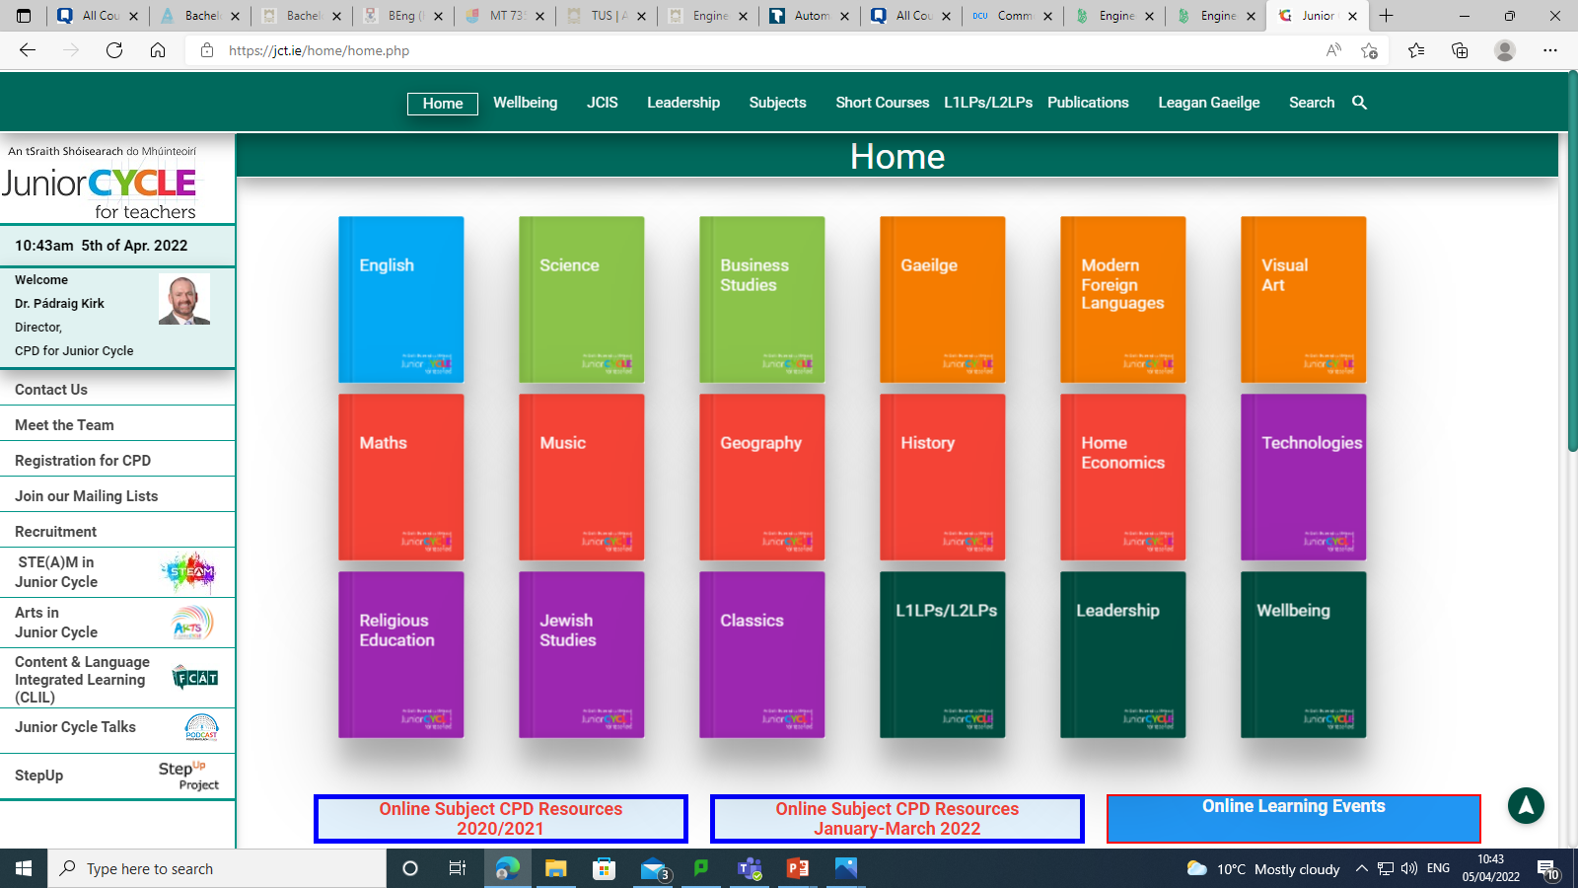
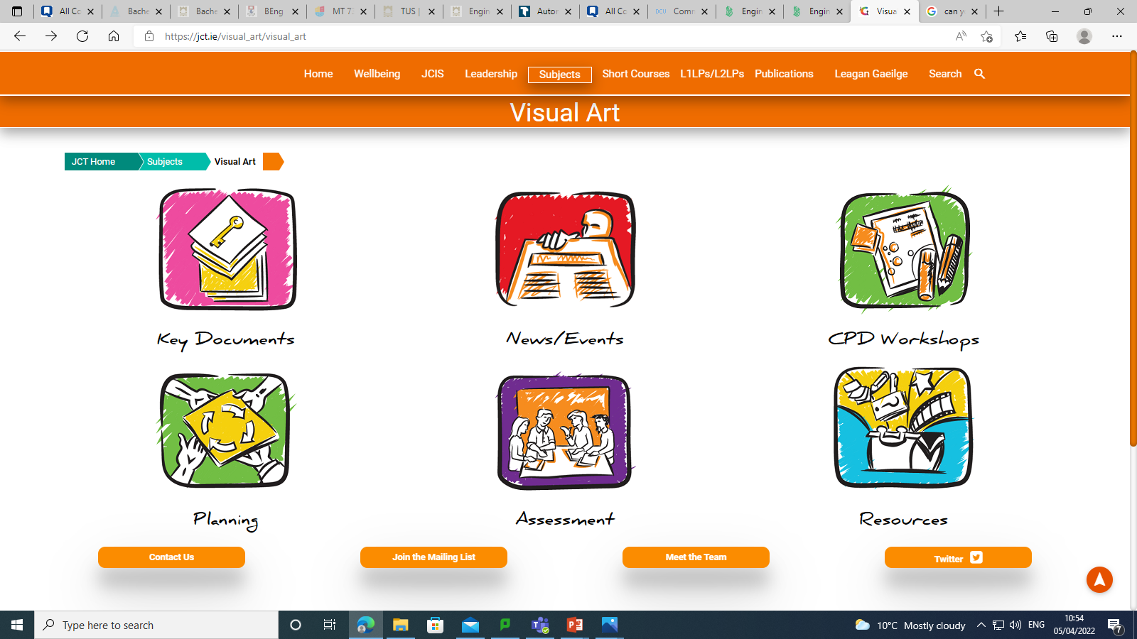
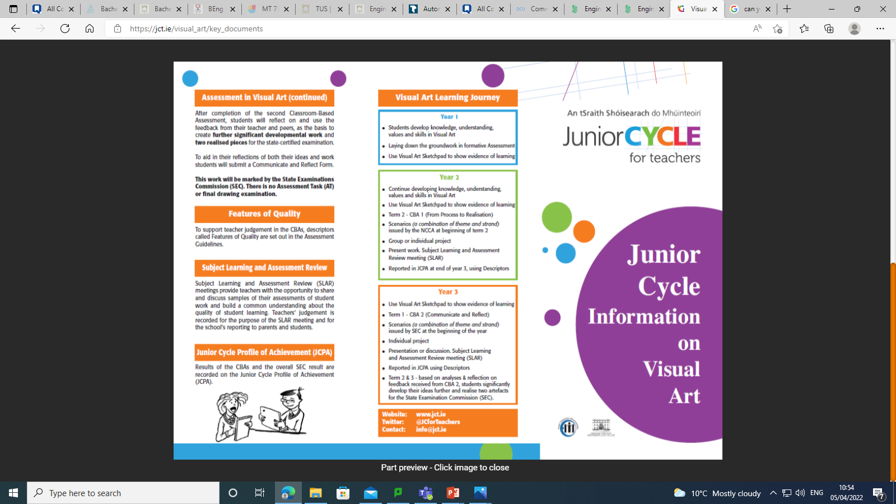
‘Information Leaflet’

Slide 13
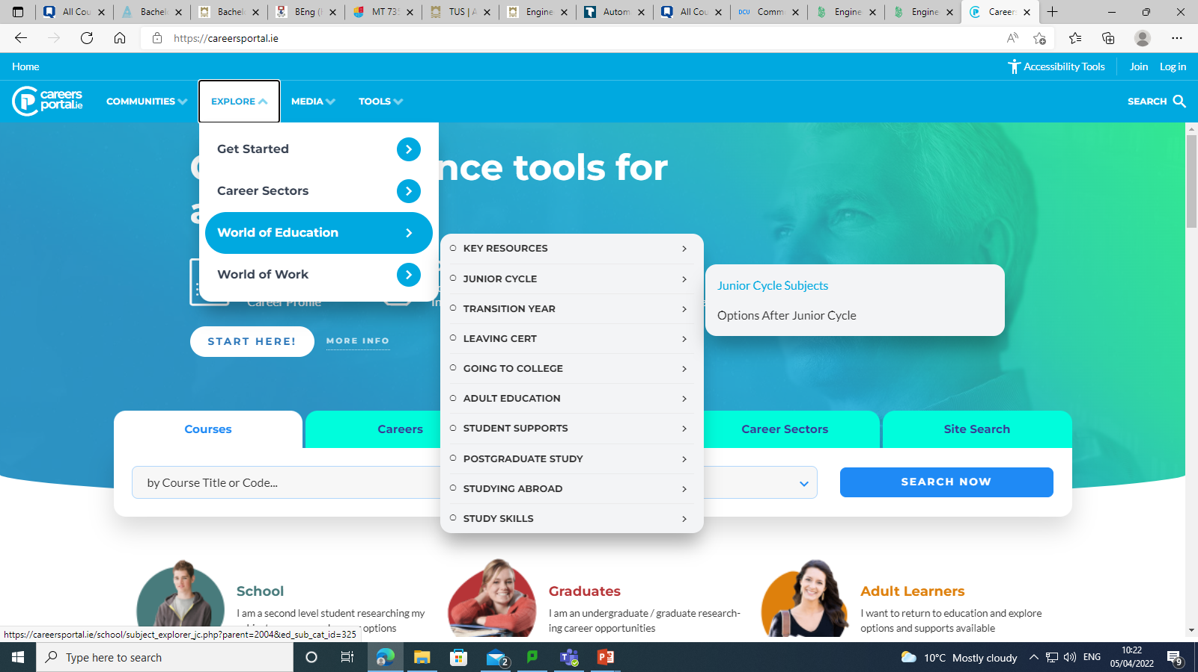
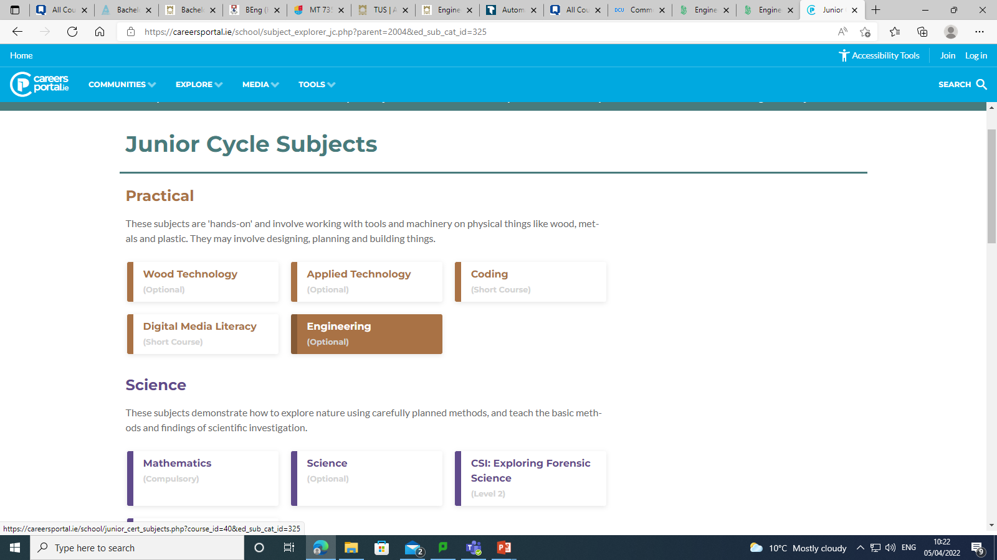
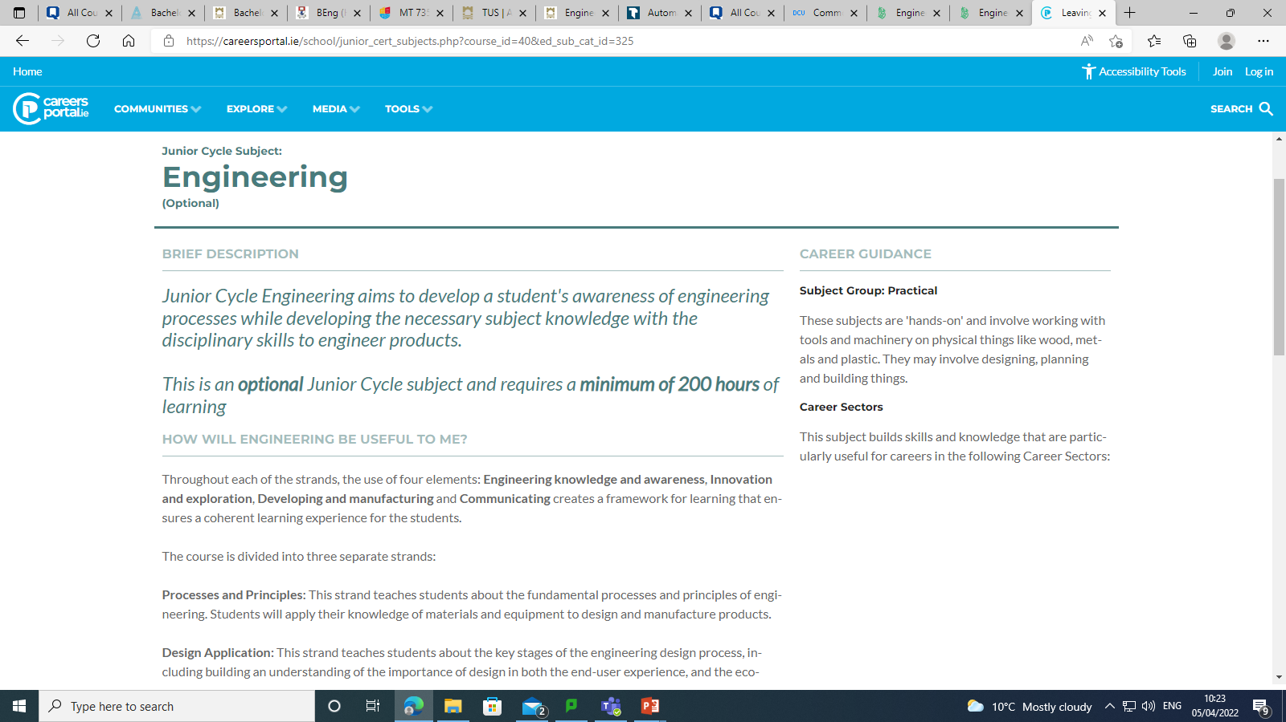
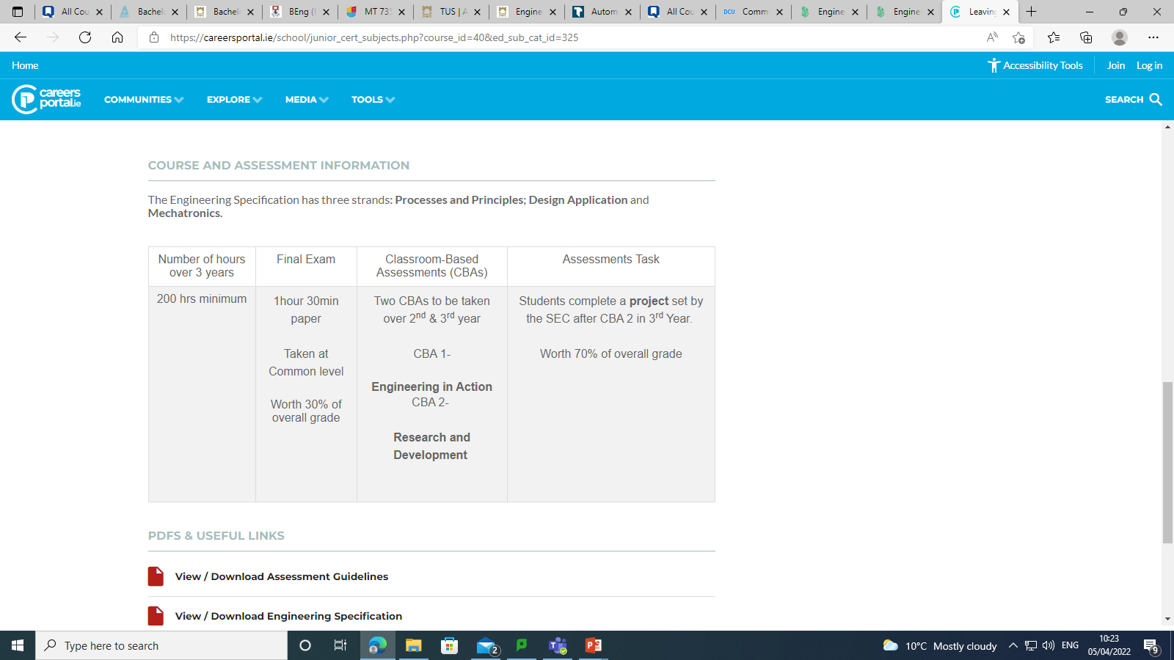
1
2
3
4
Breakdown of course

Slide 14
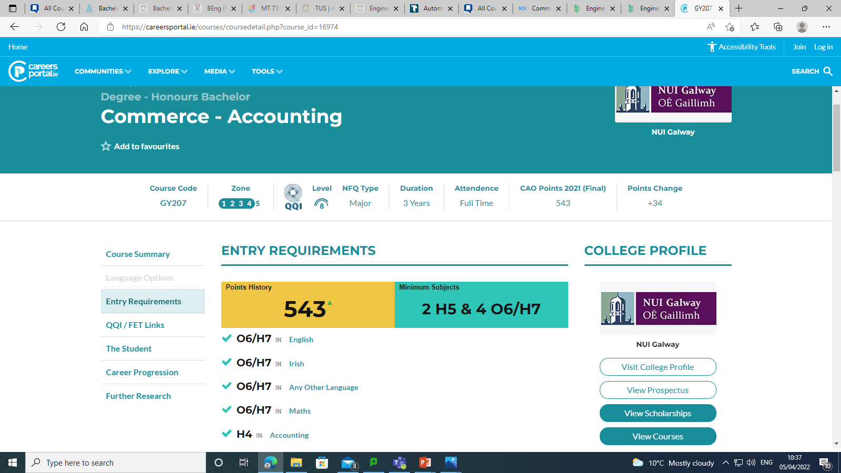
www.careersportal.ie

Slide 15
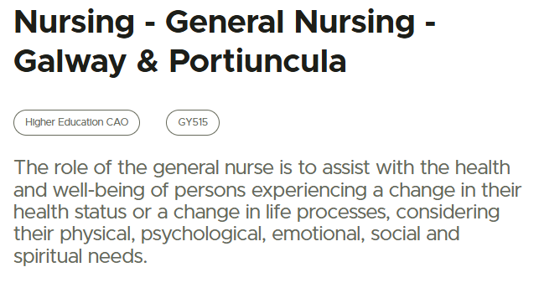
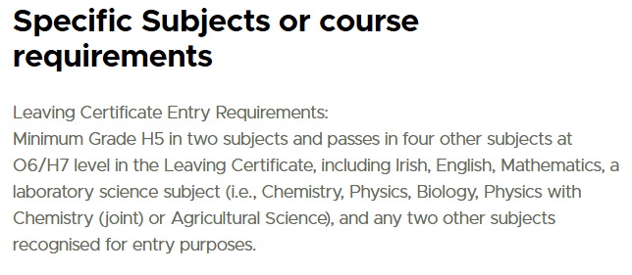
www.qualifax.ie
Specific Subject Requirement: Irish, Eng, Mat, Lab Sc O6/H7
*Irish Exemption Contact admissions office*

Slide 16
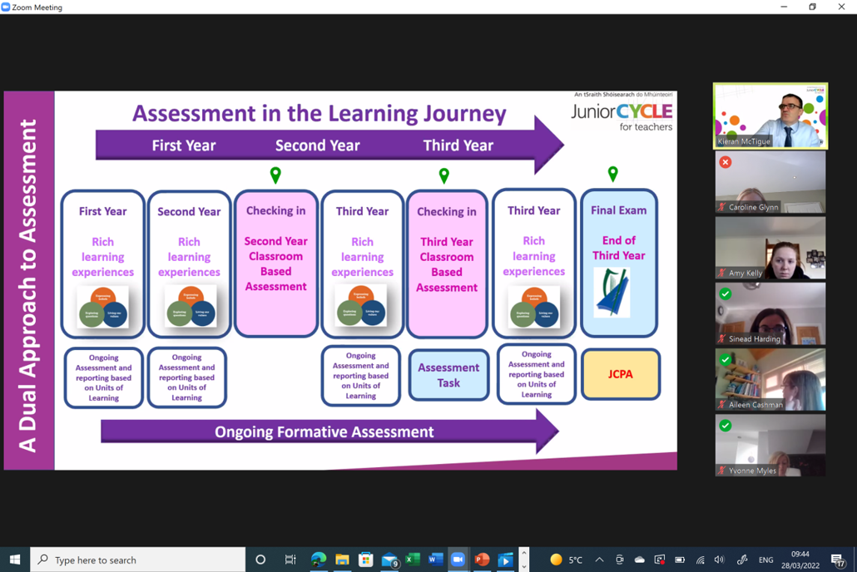
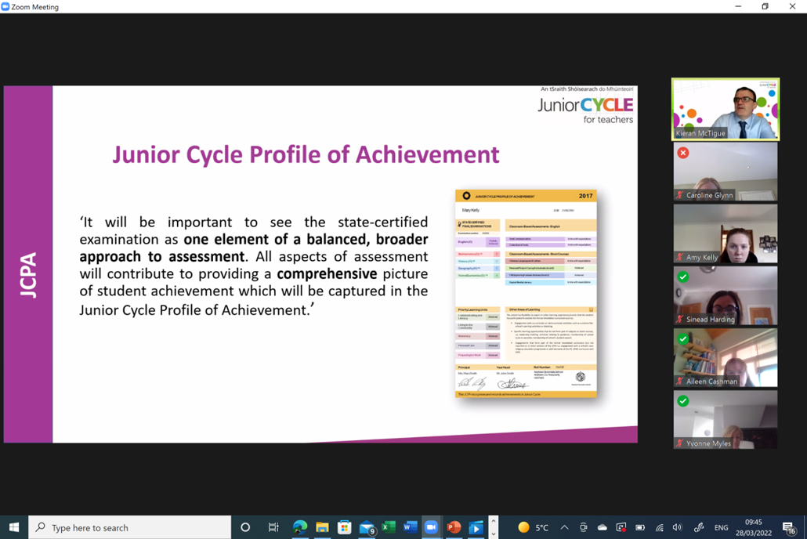
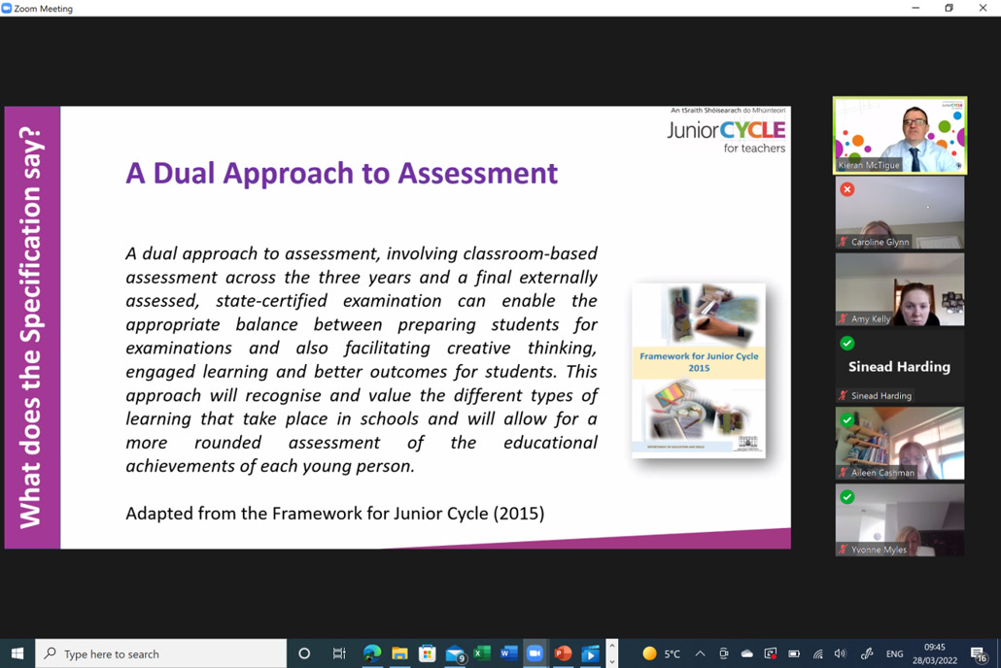
When considering the subjects you wish to take keep in mind that throughout 2nd & 3rd year there will be CBA’s (Classroom Based Assessments); with a final exam in 3rd year*

Slide 17

Modern Foreign Languages
Choice between French or German.
Modern Foreign Languages | Curriculum Online
3 Strands: Communicative Competence Language Awareness Socio-cultural Knowledge & Cultural Awareness *For 4 of the 7 universities you need a foreign language (exceptions: Science, Nursing and Engineering).
Examination: CBA 1 (2nd Year) Oral Presentation CBA 2 (3rd Year) Language Portfolio SEC Examination: 90% Final Exam (1 Common Paper). (Aural 35%) 10% Assessment Task
Careers/Courses: European Studies, Marketing, Hotel Management, Translation, EU, Teaching, Cadets, Tourism & Leisure.

Slide 18

Business
Business Studies is concerned with understanding the environment in which business operates including households. 3 Main Sections: 1)Personal Finance 2)Our Economy 3)Enterprise
Examination : CBA 1 (2nd Year) Business in Action CBA 2 (3rd Year) Presentation SEC Examination: 90% Written Test (1 Common Paper). 10% Assessment Task
Careers / Courses : Accounting, Banking, Bookkeeping, Administration, Insurance, Sales, Marketing, Customs and Excise, Taxation and Law.
https://curriculumonline.ie/Junior-cycle/Junior-Cycle-Subjects/Business-Studies/Rationale

Slide 19
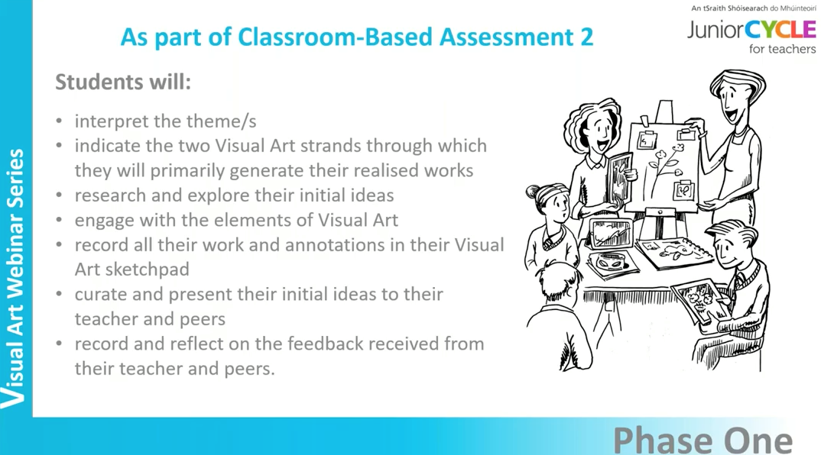
Visual Art
This course aims to develop the expressive, communicative and functional modes of art, craft and design with drawing as the central activity. Four main areas: Art (drawing: life, still life) Design (layout, composition, lettering) Crafts (pottery, puppetry, embroidery & collage etc) History & Appreciation
Examination: CBA 1 (2nd Year) From Process to Realisation CBA 2 (3rd Year) Communicate & Reflect SEC Examination: a school-based project, chosen from a list of themes completed during 3rd year
Careers/Courses: Graphic Design, Film, Animation, Teaching.
https://curriculumonline.ie/Junior-cycle/Junior-Cycle-Subjects/Visual-Art/Rationale/

Slide 20
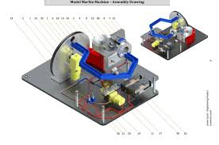
Engineering
In Engineering you will learn how to work with metal and assemble different parts. Plastics and wood are also investigated. What will you do: examine properties of metal/wood/plastics examine how things work freehand sketching joining and assembling materials learn about basic electronic components
Examination: CBA 1 (2nd Year) Engineering in Action CBA 2 (3rd Year) Research & Development SEC Examination: Project 70% & Written Examination 30%
Careers/Courses: Aircraft Technician, Fitter/Turner, Industrial Design / Operatives, Mechanics, Mechanical Production, Structural and Civil Engineer, Toolmaker and Welder.
https://curriculumonline.ie/Junior-cycle/Junior-Cycle-Subjects/Engineering/Rationale/

Slide 21
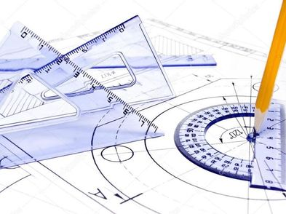
Graphics
In Technical Graphics you will learn how to represent 3-D objects on paper and on computer. What will you do: produce neat drawings of everyday items create models on the computer sketching, colouring and shading of objects make cardboard / paper cut-outs of items
Examination: CBA 1 (2nd Year) Communication through Sketching CBA 2 (3rd Year) Graphical Presentation Skills SEC Examination: Project 70% & Written Examination 30%
Careers/Courses: Civil Engineering, Mechanical Engineering, Construction Management, Architecture, Product Design, Quantity Surveyor, Draughtsman, Graphic Design and Teaching .
https://curriculumonline.ie/Junior-cycle/Junior-Cycle-Subjects/Graphics/Rationale/

Slide 22

Wood Technology
In Woodwork you will learn to design small projects and the skills required to use tools and equipment to make your designs. Main sections: Examine trees & the environment Sketching Design Project & Folder Woodwork theory
Examination: CBA 1 (2nd Year) Wood Science in our Environment CBA 2 (3rd Year) Student Self-analysis & Evaluation SEC Examination: Project 70% & Written Examination 30%
Careers/Courses: Sustainable Energy Consultant, Civil Engineering, Mechanical Engineering, Construction Management, Architecture, Quantity Surveyor, Site Foremen, Plumber, Carpenter, Joiner.
Wood Technology | Curriculum Online

Slide 23
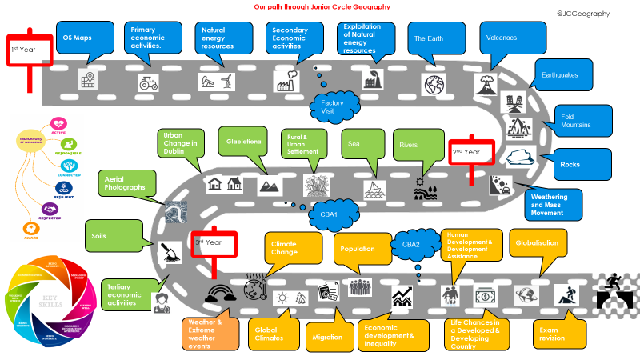
Geography
Enlarge this image so you can see all the topics covered.
Geography is the study of the Earth’s landscapes, peoples, places, and environments. The study of geography helps to explore and understand the world around you. What will you learn? The Human Habitat - Processes and Change Population, Settlement Patterns and Urbanisation Patterns in Economic Activity
Examination : 90% Written Test (1 Common Paper). 10% Assessment Task
Careers/Courses: Town planning, Teaching, Engineering, Geology.
https://curriculumonline.ie/Junior-cycle/Junior-Cycle-Subjects/Geography/

Slide 24
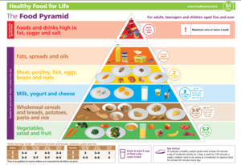
Home Economics
Junior Cycle Home Economics develops knowledge, understanding, skills and values necessary for healthy and sustainable living as an individual and as a member of families & society. 3 Strands: Food, Health & Culinary skills Responsible Family living Textiles & Craft
Examination: CBA 1 (2nd Year) Creative Textiles CBA 2 (3rd Year) Food Literacy Skills Brief SEC Examination: Cookery Exam 50% & Written Exam 50%
Careers/Courses: Hotel, Catering & Tourism, Culinary Arts, Fashion & Design, Childcare, Home Economics Teaching, Social Care, Food Science
https://curriculumonline.ie/Junior-cycle/Junior-Cycle-subjects/Home-Economics/Rationale/

Slide 25
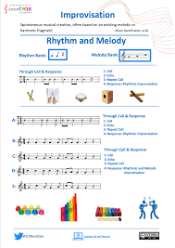
Music
In Junior Certificate Music, you will sing and possibly learn how to play an instrument. You will listen to many types of music such as pop, classical and traditional Irish music. You will also start composing. What will you do: learn about many types of music learn how to read and write music learn how to sing songs and maybe how to play an instrument.
Examination: CBA 1 (2nd Year) Composition Portfolio CBA 2 (3rd Year) Programme Note (Leads on to Practical Exam) SEC Examination: Practical Exam 30% & Written Examination 70%
Careers/Courses: Composer, Conductor, Sound Engineer, Primary School Teaching, Drama & Theatre & Communications.
Music | Curriculum Online

Slide 26
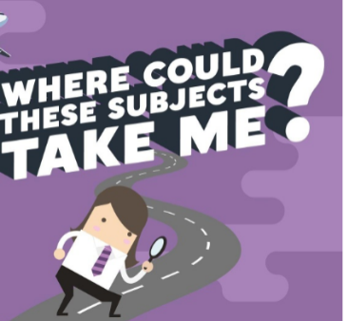
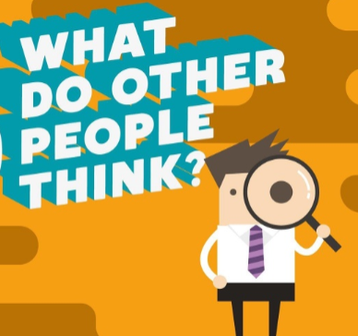

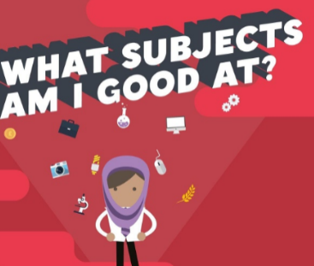
Choosing subjects
Take the time to make an informed decision
When choosing subjects you need to consider 2 main questions:
What subjects do you enjoy?
What subjects are you good at?
Please talk to your parents/guardians and also contact your teachers for advice if you are unsure
Use the hyperlinks attached to this presentation to research the subjects on offer; to assess the type of learner you are or identify possible career interests

Slide 27
Thank you for listening
trudy.carroll@borrisokanecc.ie

Slide 28
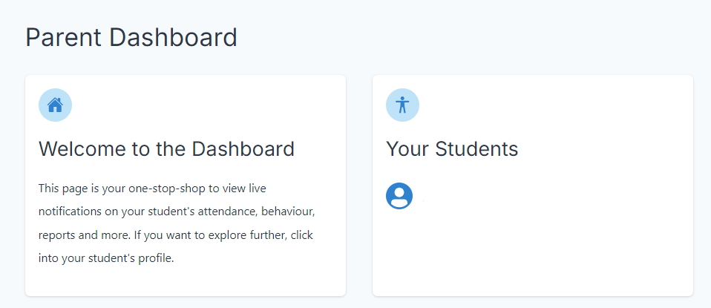
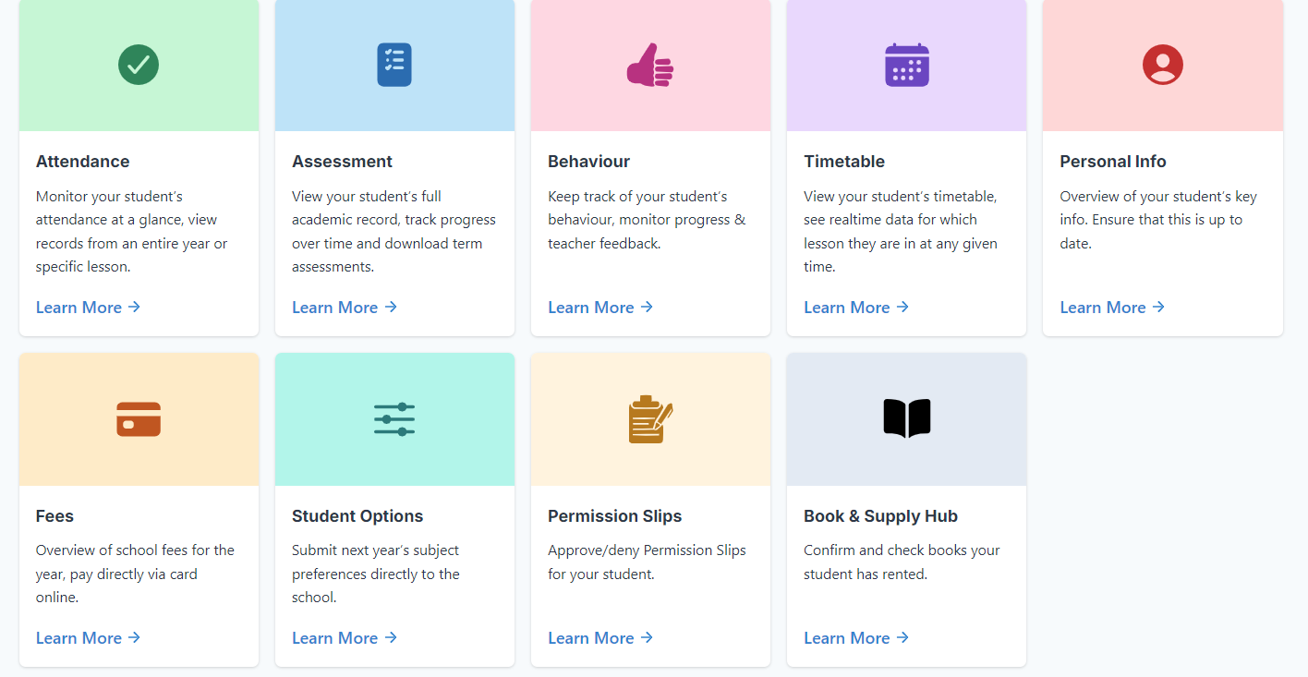
Selecting Subject Options
1. Log into VsWare and click 1st year student | 2. Click Student Options

Slide 29
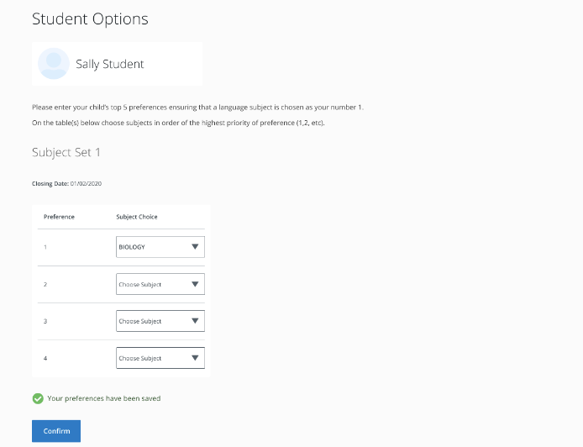
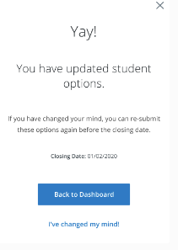
Selecting Subject Options
3. Choose five subject in order of preference | 4. Click confirm. You can change your mind on subject options on VSWare up to the closing date – 13/12/24

Slide 30
Selecting Subject Options
Please note:
Pick 5 subjects and rank in order of preference, we endeavour to give students their top three choices but with timetable constraints it is not always feasible, please ensure subject 4 and 5 are subjects the student is also happy to keep on.
Subject options will open on VSWare on 6/12/24 and remain open for one week. The closing date for subject option submission is 13/12/24.
Students will remain in their final rotation classes until 20/12/24 and new timetable will start on 6/1/25.
If you have any issues, please email info@borrisokanecc.ie

