Slide 1
6th Year Parents’ Information Evening
25th September 2024

Slide 2
6th LCA Parents
LCA Coordinator – Ms Cunningham
Programme Information and Reminders

Slide 3
Leaving Certificate Applied Aims
Prepares you for adult and working life
Recognises your talents
Helps you to communicate better and make
Lets you use your knowledge and skills to solve real problems

Slide 4
LCA IS A Full Time Two Year Programme
Four sessions, 2 each year
90% Attendance is compulsory in all courses (subjects) in order to complete Key Assignments and achieve credits

Slide 5
Leaving Cert Applied
Seven tasks to be completed over the 2 years:
1 in Session I Year I
2 in Session II Year I
3 in Session III Year II
Personal Reflection Task to be completed over the two years. (Two reflective statements – one at the end of Year I and one at the end of Year II)
An interview for six tasks

Slide 6
Leaving Cert Applied
Key Assignments
Key Assignments are important areas from each module.
To gain credits for each module you must
Complete 4 Key Assignments usually,
Attend the course for at least 90% of the time

Slide 7
Leaving Certificate Applied Assessment
3 Types
Satisfactory completion of Modules 62 credits
7 Student tasks 70 credits
Final exams 68 credits
Total Credits 200 credits

Slide 8
Leaving Certificate Applied - Overall Cert
ROC-Less than 120 credits
Pass 120 credits
Merit 140 credits
Distinction 170 credits

Slide 9
Work Experience
Is a compulsory element of the LCA Programme
Work Experience takes place EVERY WEDNESDAY of term time
Work Experience is organised by the student and their parent/guardian

Slide 10
Reminders
All students need a fully charged Ipad every day in school for class
Students must bring their Student Journal to school every day/LCA Journal to Work Exp- to get signed and to school every day
Stationery/pens/ pencil/ notes- teachers will advise in each course
VS Ware parent/guardian updates

Slide 11
Dates of upcoming LCA Events
Thursday Sept 26th- Trip to UL Activity Centre- WAY2PAY 20 Euros contribution
All trips are linked to a course and help students to apply their classroom learning in real -life setting

Slide 12
Year Head – Mr Cronin
Time management
Homework and study
Attendance & punctuality, cars
Subject projects
Uniform
Phones
Questions & Answers

Slide 13
School Uniform
Full School Uniform every day.
Full PE Uniform on PE day.
If students do not have PE uniform they must wear regular uniform and change into PE gear using dressing rooms and change back after PE class.
School Jacket – Navy school jacket with the school crest is permitted in school

Slide 14
Mobile Phones
Phones off and in bag once student arrives in school grounds
If students are caught using their phones the teacher will take the phone until the end of the school day.
Refusal to hand up the phone is a major offence
The second offence will result in detention on Fri 2-3 pm

Slide 15
Cars and Road Safety
Students are not permitted to use their cars or to sit in cars during the day.
RSA – Road Safety Education Services – 8th and 9th October

Slide 16
Importance of good attendance and punctuality
If a student is absent, late or signing out early, please let the school know by using VSware or alternatively email the Year Head.
If possible, catch up through TEAMS when absent
Students under 18 must be collected at the school.
Students over 18 - Please encourage your son/daughter to let you sign the over 18 consent form so that you can continue to provide support and receive updates from the school
Importance of routine, meeting friends, support at school, staying in school until the end of May.

Slide 17
Attendance
The majority of learning takes place in school, therefore this is the best place to be.
The LCA programme requires 90% attendance in order to gain credits – this should focus students towards achieving a minimum of 90% attendance in order to succeed.

Slide 18
Managing time well - weekdays
Get up on time, eat a good breakfast, arrive to school on time
Get to class on time
Eat a good lunch
In evenings, have a quiet place to study- try to avail of after school study
Supervised study is a great option and a great routine
After school study Mon –Thurs 4pm -6.15pm
Have a study plan, create a definite time for each subject and stick to it.
Get organised for the next day before you go to bed
Get to bed early, no screens- charge phones in room other than bedroom.
Take breaks; get fresh air and exercise in preference to sitting in front of TV or screen

Slide 19
Managing time well - weekends
Use the early finish on Fridays to complete homework
Use Saturday and Sunday for rest and recreation as well as revision
Sunday - get prepared for Monday morning
Part time jobs – best kept to a minimum and not during the week

Slide 20
Setting Subject Targets
Setting target grades are very important to help view and monitor progress.
In consultation with your teacher set a target grade for each subject. Record in Journal and Athena
Log into VSware to track progress in each subject.
Work towards reaching target in each monthly and class assessment.
Reflect on all results – did you reach your target, why/why not, what can you do to ensure you improve your grade, is target realistic, does target need to be reviewed
Study must start NOW! Best of luck!

Slide 21
Subject | % Value in Leaving cert &- details | Approximate start date
Art | 50% Project 20% Practical Day Exam | Starts in 6th yr – 10 wks approx May of 6th yr – 5 hr exam
Agricultural science | 25% Project | Started in 5th year -
Construction Studies | 25% Project and Portfolio 25% practical day exam | Starts in 6th year 4-hour exam in May of 6th year
Computer science | 30% Course Work | Preparations began in 5th year
DCG | 40% Project | Starts in September of 6th Year – Finishes in January of 6th Year
Engineering | Project; Higher level 25% Ordinary level 30% | 6th year
Geography | 20 % project | 6th year
History | Reasearch study report 20% | 5th year
Home Economics | 20% Food Studies Assignment | Started in October of 5th year
PE | Physical Activity Project 20% Performance Assess. 30 % | Start 6th year 6th year
French / German | Oral exam 25% | Preparation begins in 5th year Oral exam in March/April 6th year
Gaeilge | Oral exam 40% | Preparation begins in 5th year Oral exam in March/April 6th year
Music | Performance exam 50 % | March/ April 6th year

Slide 22
Wellbeing and support for students
We can all have off days and difficult periods.
School is full of challenges, particularly during the final year.
You will also have many happy memories over the coming months.
If you feel under pressure please let me know and I will do the best to help in any way I can
“mind yourself and mind each other”

Slide 23
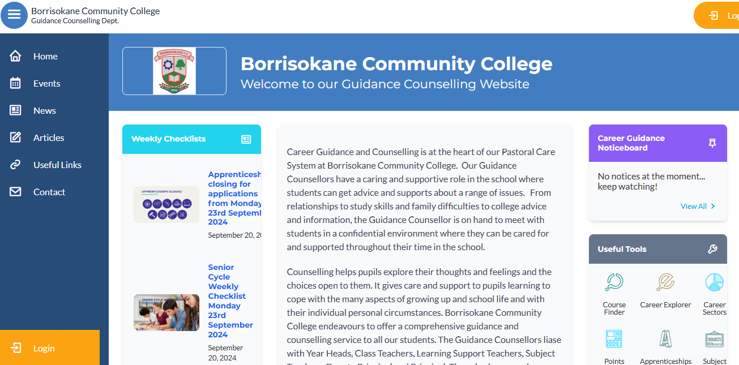
The Guidance Dept at BCC – Ms Carroll & Ms Glynn
All Junior Cycle classes have Guidance Related Learning classes.
All Senior Cycle classes have a weekly Career Guidance class and can take part in trips to Colleges and Apprenticeship centres.
Provide one-to-one personal, academic and career support.
Parents & Guardians are welcome to get in contact and can also avail of our Guidance page on the school website which has info on courses, apprenticeships, LC points and Open Days etc.

Slide 24
Key Dates - 2024
Monthly Assessments – recorded on VSware
Sixth Year Exams – October 23rd – October 25th.
Meeting for Leaving Cert Parents on the CAO system – Wednesday November 6th 8pm
Parent/Student/Teacher Meeting 6th Year – Thursday November 28th 4.15pm – 6.45pm.

Slide 25
Contact details
Telephone – (067) 27268
School email – info@borrisokanecc.ie
Principal – paula.molloy@borrisokanecc.ie
Deputy Principal – catriona.maher@borrisokanecc.ie
Year Head – noel.cronin@borrisokanecc.ie

Slide 26
General Updates:
Parents Association – looking for volunteers to join our PA from all areas. If you are interested please send an email to info@borrisokanecc.ie PA have requested a payment of €50 from each family.
One Way System & Parking – from 8:30- 9:00 am we request that cars come to school via the athletics/tennis grounds and leave via Ballyhaden. In the evenings from 3:20 we request the same. We have extended our car park so can you please park in new car park and not on the footpath.

Slide 27
General Updates:
Enrollment for Sept 25. Admissions notice has been published and our Open Night is on Oct 17th from 6pm. Please get application forms in early or on time.

Slide 28
Website
Our website is being updated and you will be able to find presentations.
Link to Survey that we would like you to complete on Reviewing Inclusive and Special Ed.
Bí Cinealta – Anti Bullying Guidelines and documents. Your input will be required to compete our new policy.
Other surveys throughout the year and parental voice is very important to us.

Slide 29
Board of Management
New Board being set up from Oct 2024-May 2029.
5 meetings per year.
Ms.Virginia O'Dowd, Cllr Louise Morgan Walsh, Ms. Fiona Dunford ( elected to board by ETB)
Ms. Avril Murphy, Mr. Mike Fox ( Parents Rep)
Ms Ceire Hogan, Mr. Sean Ryan (PE) ( Teacher Reps)
Paula Molloy ( Secretary) Caitríona Maher ( Recording Secretary)
Community Reps

Slide 30
School Closures
Mon 30th September.
Thursday 21st November
Wednesday 8th Jan.
One further half day tbc.
Teachers emails available on the website we request where possible that you keep emails to working hours 8am-4:00pm.

Slide 31

Survey to look at how students are supported in school.
We are interested in finding out about how you think your child is progressing in school and want to understand what we can do to make learning easier for your child. We would be grateful if could complete this anonymous survey, which should take about 10 minutes.
https://forms.office.com/e/v96H0zykjN

