Slide 1
5th Year Parent/Guardian Information Evening
Borrisokane Community College

Slide 2

Welcome

Slide 3
5th LCA Parents
LCA Coordinator – Ms Cunningham
Programme Information and Reminders

Slide 4
Leaving Certificate Applied Aims
Prepares you for adult and working life
Recognises your talents
Helps you to communicate better and make
Lets you use your knowledge and skills to solve real problems

Slide 5
LCA IS A Full Time Two Year Programme
Four sessions, 2 each year
90% Attendance is compulsory in all courses (subjects) in order to complete Key Assignments and achieve credits

Slide 6
Leaving Certificate Applied Terminology
Session
For the purpose of the Leaving Certificate Applied the school year is divided into two sessions
Session I - September to the end of January
Session II - February to June.
The full two- year programme has four sessions altogether

Slide 7
Leaving Certificate Applied Terminology
Courses
A course is an area of study made up of a number of modules e.g English and Communication is a course

Slide 8
Leaving Certificate Applied Terminology
Modules
A module is a topic within a course and will be taught in 3-4 class periods per week over one session e.g Personal and social communications is one module in the English and Communication Course

Slide 9
Leaving Cert Applied Terminology
Seven tasks to be completed over the 2 years:
1 in Session I Year 1
2 in Session II Year I
3 in Session III Year II
Personal Reflection Task to be completed over the two years. (Two reflective statements – one at the end of Year I and one at the end of Year II)
An interview for six tasks

Slide 10
Leaving Cert Applied Terminology
Key Assignments
Key Assignments are important areas from each module.
To gain credits for each module you must
complete 4 Key Assignments usually,
and attend the course for at least 90% of the time

Slide 11
CREDITS
•Credits awarded for modules and tasks at the end of each session
Leaving Cert Applied Terminology​

Slide 12
Leaving Certificate Applied Assessment
3 Types
Satisfactory completion of Modules 62 credits
7 Student tasks 70 credits
Final exams 68 credits
Total Credits 200 credits

Slide 13
Leaving Certificate Applied - Overall Cert
ROC-Less than 120 credits
Pass 120 credits
Merit 140 credits
Distinction 170 credits

Slide 14
Work Experience
Is a compulsory element of the LCA Programme
Work Experience takes place EVERY WEDNESDAY of term time
Work Experience is organised by the student and their parent/guardian

Slide 15
Reminders
All students need a fully charged Ipad every day in school for class
Students must bring their Student Journal to school every day
Stationery/pens/ pencil/ notes- teachers will advise in each course
VSware parent/guardian updates

Slide 16
Dates of upcoming LCA Events
Thursday Sept 26th- Trip to UL Activity Centre- WAY2PAY 20 Euros contribution
All trips are linked to a course and help students to apply their classroom learning in real -life setting

Slide 17
Attendance/Punctuality
Year Head: Tomás Maher
Arrive before 9, before 8.45 on Friday
Punctual to all classes
Punctual after breaks
Appointments/Holidays if possible outside school time
Note on VSware app if late/leaving early/absent.
Full attendance vital to maximise grades

Slide 18
Uniform
Full school uniform every day
Full PE uniform on PE day
PE uniform for games/trips
Have uniform ready night before

Slide 19
Journal/Teams
Fill in timetable into diary
Check homework written in and completed
Work posted on Teams – check daily, use when absent.
VSware app for absences/appointments/lates

Slide 20
Positive Discipline
Praise and encourage achievement.
Positive Comments
Respect for all, fellow students, teachers, staff.
Notes:
Rewards – No homework, game in class, watch DVD, Taken on tours, given credits

Slide 21
Implementing Code of Behaviour
  Listed are the steps in which negative behaviour is treated.
  Class Teacher
  Year Head
  Deputy Principal
  Principal
  Board of Management
Parents informed – Vsware Journal, Phone, Letter, Email. Please monitor Vsware to see students behaviour.

Slide 22
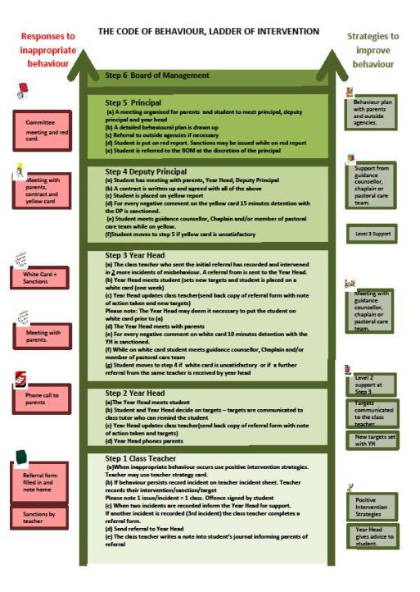
Ladder of Intervention

Slide 23
After school study
Monday to Thursday evenings
4.00 to 6.15
Extra study at home
3 hours in total as year progresses

Slide 24
Mobile phone policy
Phones off and in bag once student arrives on school grounds
Can only be used with permission of a teacher
Phone confiscated and recorded on VSware. Returned at end of school day.
Ipads to be fully charged for use in class.

Slide 25
Regular assessments/Term tests
Regular Assessments by subject teacher recorded on VSware
Feedback with results at Christmas and Summer on VSWare
Parent teacher meeting Thursday January 23rd - 4.15 to 6.45

Slide 26
Student Supports
Subject Teacher
Year Head
Deputy Principal and Principal
Student Support Team
Student Council
SEN Department
Guidance Counsellors

Slide 27


Slide 28

Survey to look at how students are supported in school.
We are interested in finding out about how you think your child is progressing in school and want to understand what we can do to make learning easier for your child. We would be grateful if could complete this anonymous survey, which should take about 10 minutes.
https://forms.office.com/e/v96H0zykjN

Slide 29


Slide 30


Slide 31
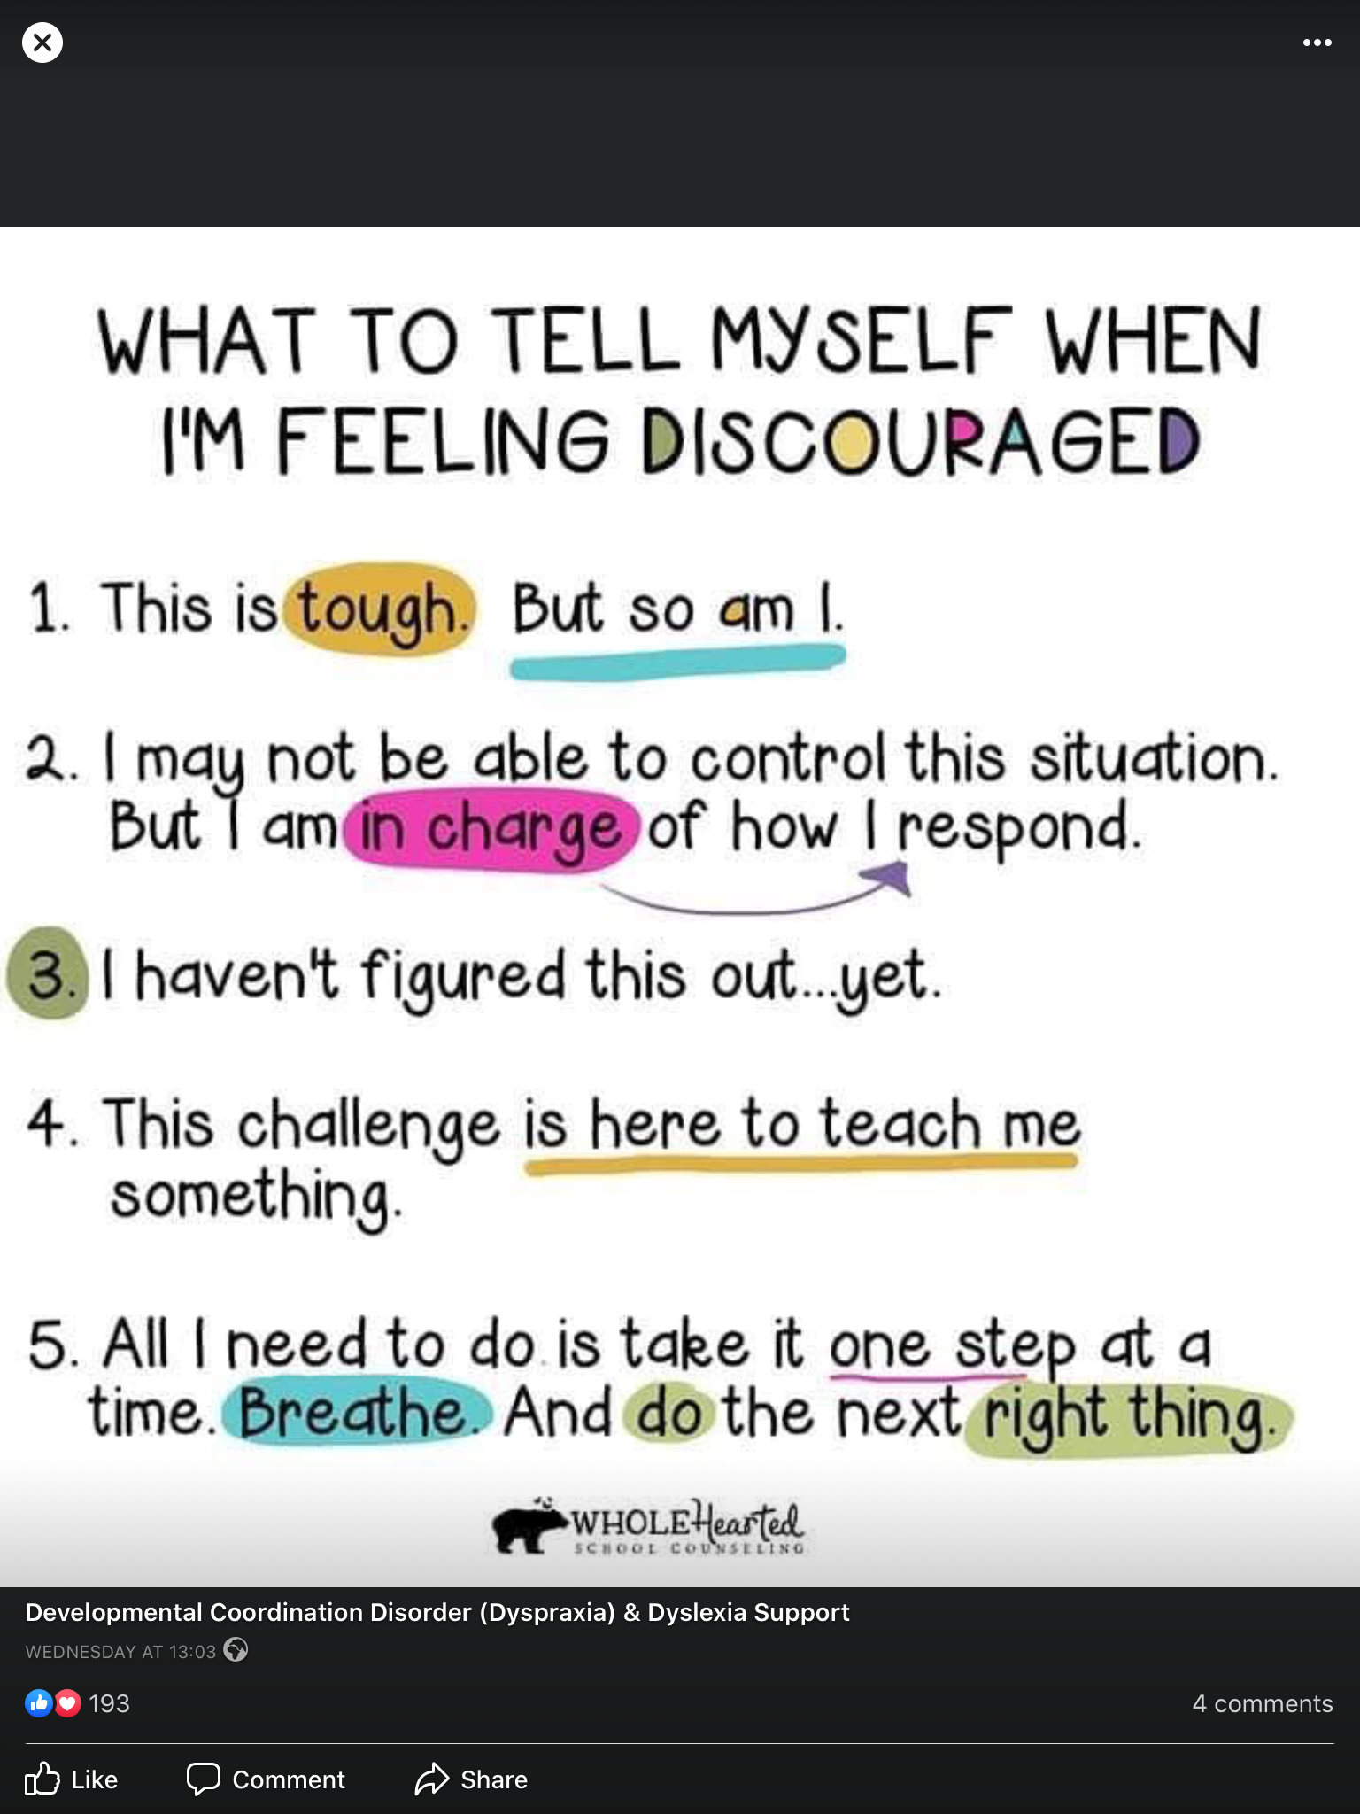

Slide 32
Other
Cars
Catching up on work missed
Any issues contact school/send email tomas.maher@borrisokanecc.ie
Thank you

Slide 33
General Updates:
Parents Association – looking for volunteers to join our PA from all areas. If you are interested please send an email to info@borrisokanecc.ie PA have requested a payment of €50 from each family.
One Way System & Parking – from 8:30- 9:00 am we request that cars come to school via the athletics/tennis grounds and leave via Ballyhaden. In the evenings from 3:20 we request the same. We have extended our car park so can you please park in new car park and not on the footpath.

Slide 34
General Updates:
Enrollment for Sept 25. Admissions notice has been published and our Open Night is on Oct 17th from 6pm. Please get application forms in early or on time.

Slide 35
Website
Our website is being updated and you will be able to find presentations.
Link to Survey that we would like you to complete on Reviewing Inclusive and Special Ed.
Bí Cinealta – Anti Bullying Guidelines and documents. Your input will be required to complete our new policy.
Other surveys throughout the year and parental voice is very important to us.

Slide 36
Board of Management
New Board being set up from Oct 2024-May 2029.
5 meetings per year.
Ms.Virginia O'Dowd, Cllr Louise Morgan Walsh, Ms. Fiona Dunford ( elected to board by ETB)
Ms. Avril Murphy, Mr. Mike Fox ( Parents Rep)
Ms Ceire Hogan, Mr. Sean Ryan (PE) ( Teacher Reps)
Paula Molloy ( Secretary) Caitríona Maher ( Recording Secretary)
Community Reps

Slide 37
School Closures
Mon 30th September.
Thursday 21st November
Wednesday 8th Jan.
One further half day tbc.
Teachers emails available on the website, we request where possible that you keep emails to working hours 8am-4:00pm.

