Slide 1

Borrisokane CC
2nd Year Information Evening for Parents Tuesday 24th September 2024

Slide 2
Our Mission Statement & ETB Ethos
We seek to promote a caring and ​
committed school community​
which will facilitate the education of our students​
and where each individual is valued ​
as a unique human being.​
​
“Is ar scáth a chéile a mhairimid”

Slide 3
General Updates:
Parents Association – looking for volunteers to join our PA from all areas. If you are interested please send an email to info@borrisokanecc.ie PA have requested a payment of €50 from each family.
Ipads & Ebooks- some issues with logging onto our network. This will be resolved next week.
One Way System & Parking – from 8:30- 9:00 am we request that cars come to school via the athletics/tennis grounds and leave via Ballyhaden. In the evenings from 3:20 we request the same. We have extended our car park so can you please park in new car park and not on the footpath.

Slide 4
General Updates:
Enrollment for Sept 25. Admissions notice has been published and our Open Night is on Oct 17th from 6pm. Please get application forms in early or on time.
Class Assessments will be taking place over the next few weeks please keep an eye on Vsware.
Club na nÓg- activities through Gaeilge
LGBTIQ+ Café
Lunch time: library, friendship café, games room, blitzes etc

Slide 5
Website
Our website is being updated and you will be able to find presentations.
Link to Survey that we would like you to complete on Reviewing Inclusive and Special Ed.
Bí Cinealta – Anti Bullying Guidelines and documents. Your input will be required to compete our new policy.
Other surveys throughout the year and parental voice is very important to us.

Slide 6
Board of Management
New Board being set up from Oct 2024-May 2029.
5 meetings per year.
Ms.Virginia O'Dowd, Cllr Louise Morgan Walsh, Ms. Fiona Dunford ( elected to board by ETB)
Ms. Avril Murphy, Mr. Mike Fox ( Parents Rep)
Ms Ceire Hogan, Mr. Sean Ryan (PE) ( Teacher Reps)
Paula Molloy ( Secretary) Caitríona Maher ( Recording Secretary)
Community Reps

Slide 7
School Closures
Mon 30th September.
Thursday 21st November
Wednesday 8th Jan.
One further half day tbc.
Teachers emails available on the website we request where possible that you keep emails to working hours 8am-4:00pm.

Slide 8

Attendance/Punctuality
Ms Lyons – Year Head 2nd Year
Full attendance vital to maximise grades.
Arrive before 9am, before 8.45am on Friday.
Punctual to all classes.
Punctual after breaks.
Appointments if possible outside school time.
Note on VSware if late/leaving early/absent.
If a student arrives late or is signing out early, a reason must be submitted via VSware. This will inform the Year Head, who can update the records system.

Slide 9
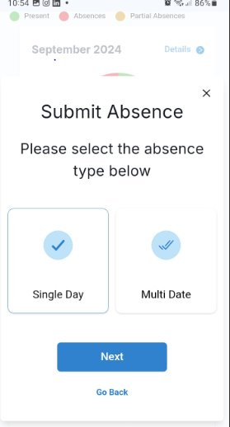
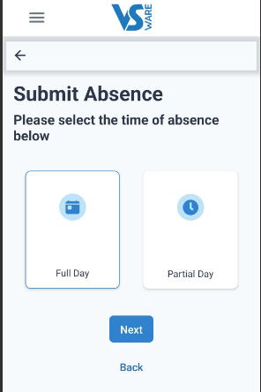
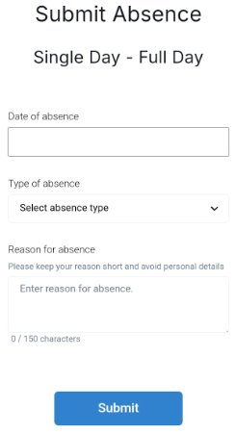
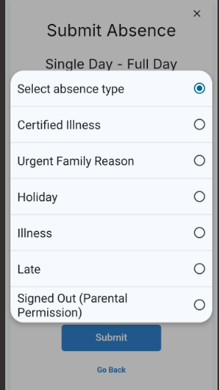
Absent notes on VSware

Slide 10
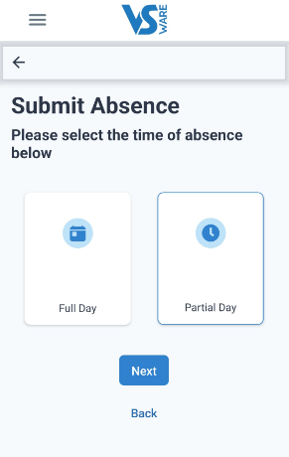
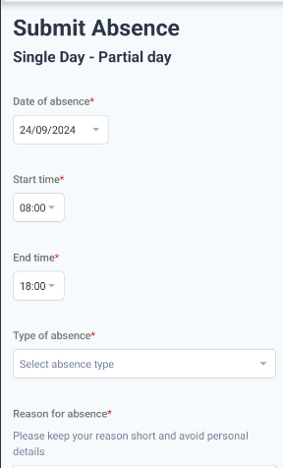
Sign in late / sign out early

Slide 11
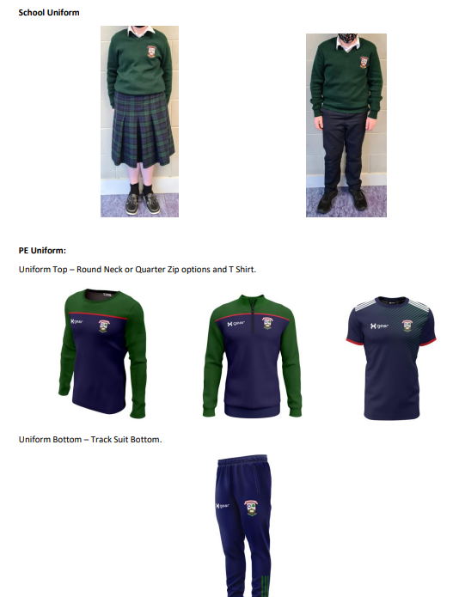
Uniform
Full school uniform every day.
Skirts must be worn below the knee and please do not have the skirt shortened.
Full PE uniform on PE day.
PE uniform for games/trips.
Not allowed to class if uniform incorrect, parents phoned at 9.10am.
Have uniform ready night before.

Slide 12
Journal
Fill/Stick timetable into diary.
Check homework written in and completed.
If absent ask a friend for homework, check teams.
The school journal helps students to write down important reminders.
Provides detailed information in relation to the Code of behavior and important school policies such as, Anti Bullying Policy, Acceptable use policy, Mobile Phone Policy, Student Rights and Responsibilities. Etc.
Parents should check the journal daily.

Slide 13
Positive Discipline
Positive Comments.
Praise, Thank you.
Reward good behaviour.
Respect is a core value in BCC.
Notes:
Rewards – No homework, game in class, watch DVD, Taken on tours, given credits

Slide 14
Implementing Code of Behaviour
  Listed are the steps in which negative behaviour is treated.
  Class Teacher
  Year Head
  Deputy Principal
  Principal
  Board of Management
Parents informed – VSware, Journal, Phone, Letter, Email. Please monitor Vsware to see students’ behaviour.
Parents are our partners in this process.

Slide 15
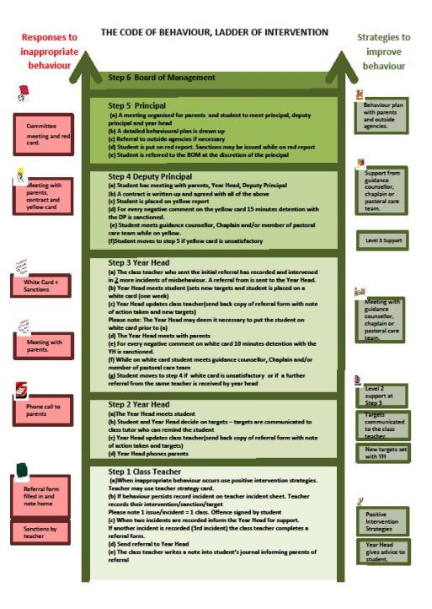

Ladder of Intervention

Slide 16
Homework & Study
Help your child to plan their homework – place to study. Leave books at study desk, use e-books in school. ​
Study includes revision. We have monthly/ bi-monthly assessments. ​
Encourage reading. Be mindful of screen time. This can be checked on the iPad. ​
Time for homework/study – 1.5 to 2 hours each night. ​
Each night check timetable for tomorrow to ensure that all books, materials(ingredients), uniform, lunch, etc. are ready for the next day. ​
Ensure iPad is charged and in schoolbag each morning. Charging after homework and in bag before bed is best

Slide 17
After school study
Monday to Thursday evenings.
4.00pm to 6.15pm.
€3 per evening, pay on Way2Pay – Email marie.darcy@borrisokanecc.ie
Extra study at home.
2-3 hours per school night in total as year progresses.

Slide 18
Monthly assessments / Term tests:
Regular Assessments by subject teachers recorded on Vsware.
Formative feedback with results in October and December
Parent teacher meeting Thursday January 23rd - 4.15 to 6.45.

Slide 19
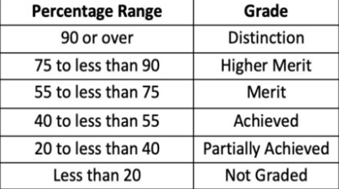
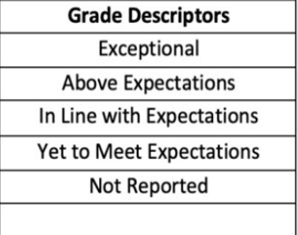
Classroom Based Assessments (CBA)
Each student will complete one CBA in each subject in 2nd year. Timetable will be given to students in due course
Junior Cycle Final Exam Grades
Junior Cycle CBA Descriptors

Slide 20
Parent Reminders
Prepare bag and uniform with child – study area​
Attendance (Child at school and parent at Parent/ Teacher Meeting) - is key to school and exam success​
Read journal and sign to monitor and assist with Homework​
Encourage full participation in all school activities​
Never hesitate to contact the school if your child needs support​
Time- support and encourage good time keeping. Give your child TIME.​
Set realistic goals with your child

Slide 21
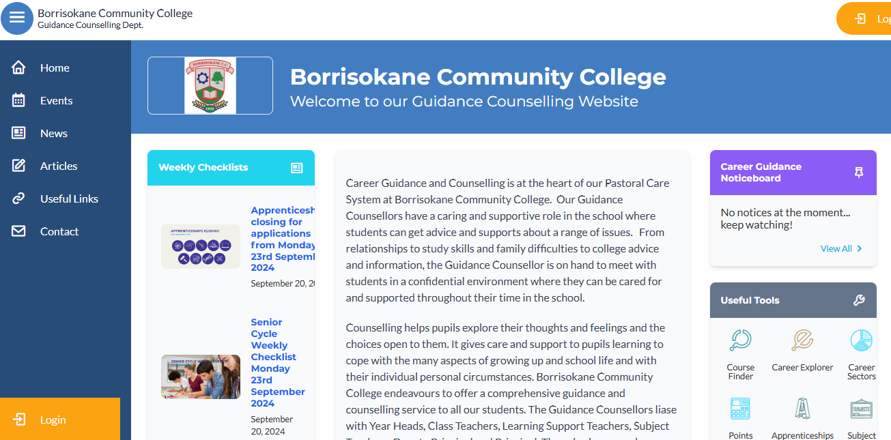
The Guidance Dept at BCC – Ms Carroll & Ms Glynn
All Junior Cycle classes have Guidance Related Learning classes.
All Senior Cycle classes have a weekly Career Guidance class and can take part in trips to Colleges and Apprenticeship centres.
Provide one-to-one personal, academic and career support.
Parents & Guardians are welcome to get in contact and can also avail of our Guidance page on the school website which has info on courses, apprenticeships, LC points and Open Days etc.

Slide 22
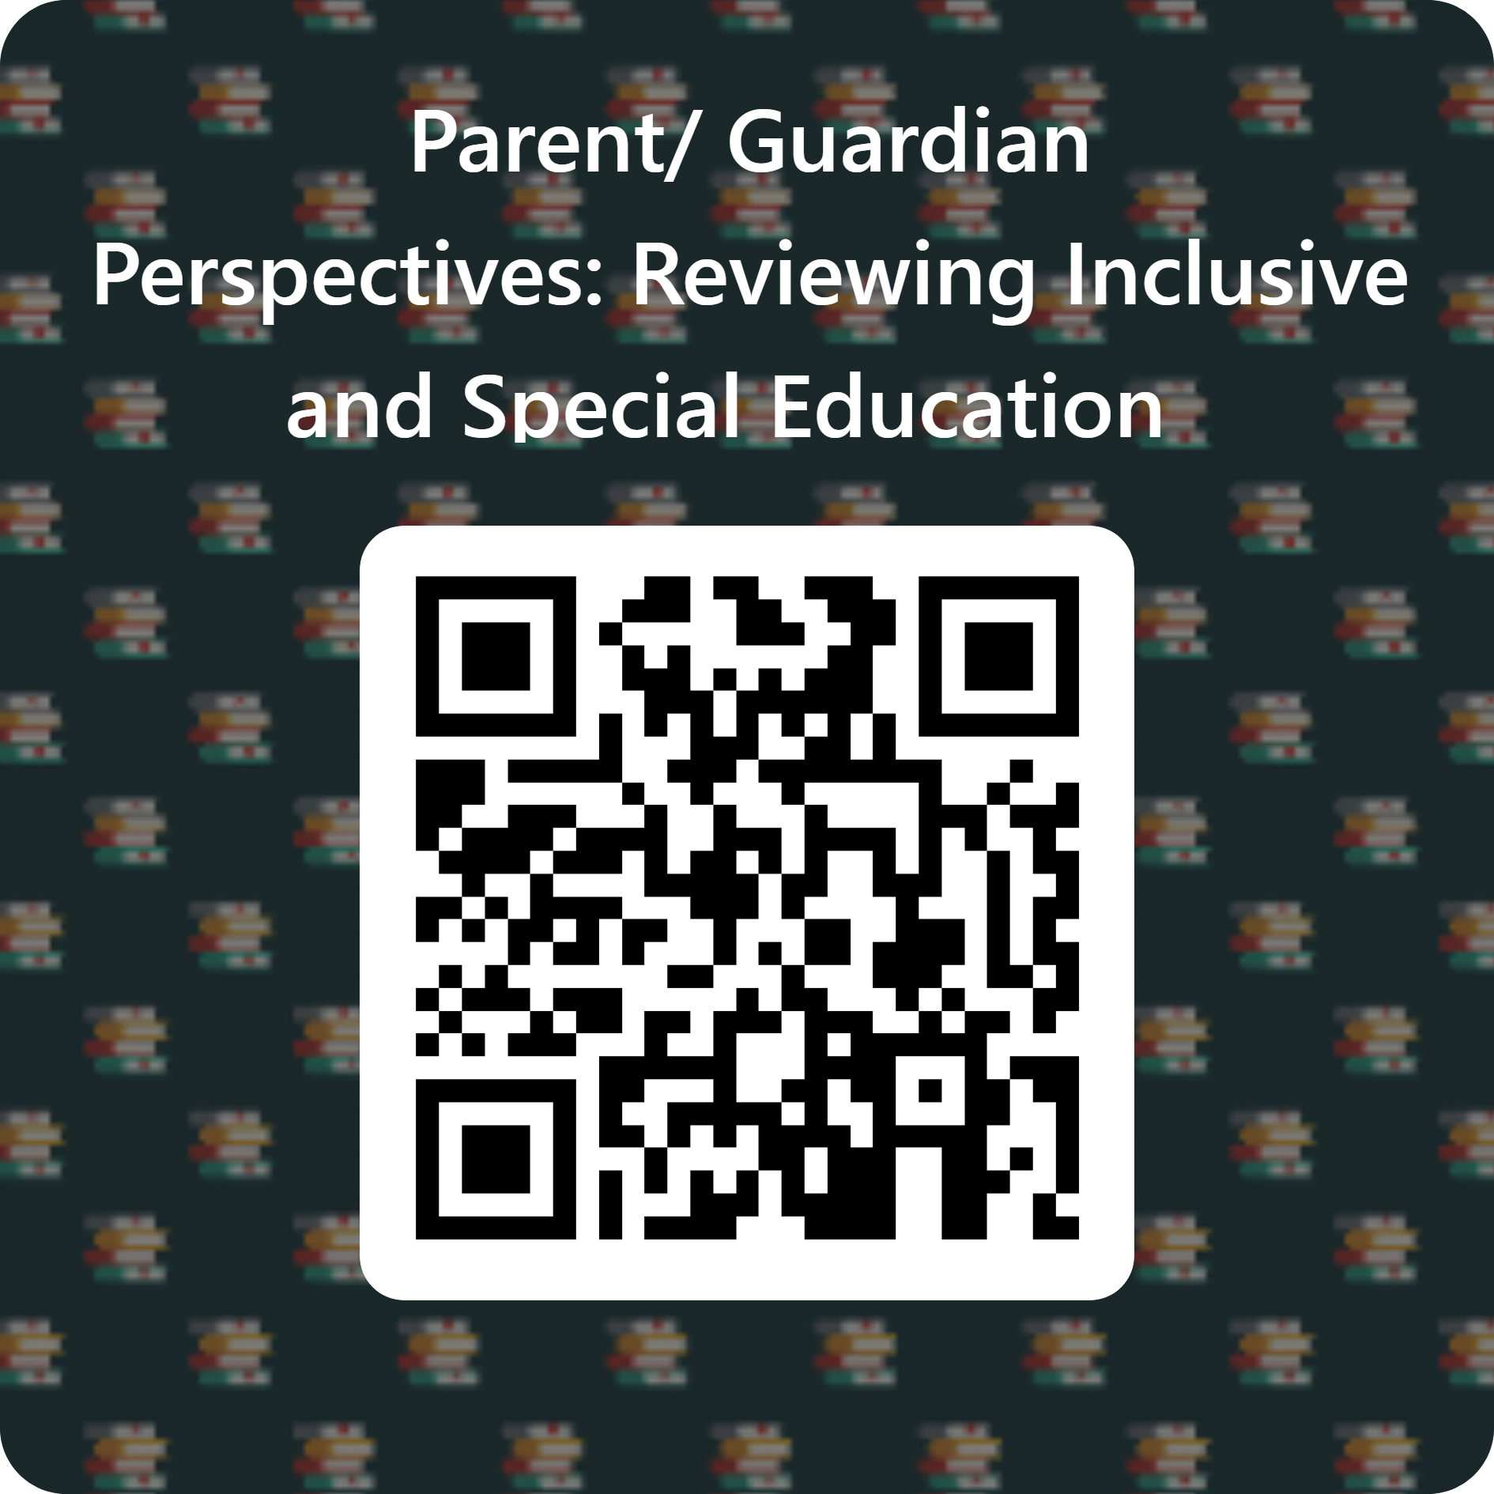
Survey to look at how students are supported in school:
We are interested in finding out about how you think your child is progressing in school and want to understand what we can do to make learning easier for your child. We would be grateful if could complete this anonymous survey, which should take about 10 minutes.
https://forms.office.com/e/v96H0zykjN

Slide 23

Questions
If you have any questions, please type them into the chat box

Slide 24
Borrisokane CC
3rd Year Information Evening for Parents Tuesday 24th September 2024

Slide 25
Our Mission Statement & ETB Ethos
We seek to promote a caring and ​
committed school community​
which will facilitate the education of our students​
and where each individual is valued ​
as a unique human being.​
​
“Is ar scáth a chéile a mhairimid”

Slide 26
General Updates:
Parents Association – looking for volunteers to join our PA from all areas. If you are interested please send an email to info@borrisokanecc.ie PA have requested a payment of €50 from each family.
Ipads & Ebooks- some issues with logging onto our network. This will be resolved next week.
One Way System & Parking – from 8:30- 9:00 am we request that cars come to school via the athletics/tennis grounds and leave via Ballyhaden. In the evenings from 3:20 we request the same. We have extended our car park so can you please park in new car park and not on the footpath.

Slide 27
General Updates:
Enrollment for Sept 25. Admissions notice has been published and our Open Night is on Oct 17th from 6pm. Please get application forms in early or on time.
Class Assessments will be taking place over the next few weeks please keep an eye on Vsware.
Club na nÓg- activities through Gaeilge
LGBTIQ+ Cafe

Slide 28
Website
Our website is being updated and you will be able to find presentations.
Link to Survey that we would like you to complete on Reviewing Inclusive and Special Ed.
Bí Cinealta – Anti Bullying Guidelines and documents. Your input will be required to compete our new policy.
Other surveys throughout the year and parental voice is very important to us.

Slide 29
Board of Management
New Board being set up from Oct 2024-May 2029.
5 meetings per year.
Ms.Virginia O'Dowd, Cllr Louise Morgan Walsh, Ms. Fiona Dunford ( elected to board by ETB)
Ms. Avril Murphy, Mr. Mike Fox ( Parents Rep)
Ms Ceire Hogan, Mr. Sean Ryan (PE) ( Teacher Reps)
Paula Molloy ( Secretary) Caitríona Maher ( Recording Secretary)
Community Reps

Slide 30
School Closures
Mon 30th September.
Thursday 21st November
Wednesday 8th Jan.
One further half day tbc.
Teachers emails available on the website we request where possible that you keep emails to working hours 8am-4:00pm.

Slide 31
Attendance/Punctuality
Ms Forde – Year Head 3rd Year
Arrive before 9am, before 8.45am on Friday.
Punctual to all classes.
Punctual after breaks.
Appointments if possible outside school time.
Note on VSware if late/leaving early/absent.
If a student arrives late or is signing out early, a reason must be submitted via VSware. This will inform the Year Head, who can update the records system.
Full attendance vital to maximise grades.

Slide 32
Uniform
Full school uniform every day.
Full PE uniform on PE day.
PE uniform for games/trips.
Not allowed to class if uniform incorrect, parents phoned at 9.10am.
Have uniform ready night before.

Slide 33
Journal
Fill/Stick timetable into diary.
Check homework written in and completed.
If absent ask a friend for homework, check teams.
The school journal helps students to write down important reminders.
Provides detailed information in relation to the Code of behavior and important school policies such as, Anti Bullying Policy, Acceptable use policy, Mobile Phone Policy, Student Rights and Responsibilities. Etc.
Parents should check the journal daily.

Slide 34
Positive Discipline
Positive Comments.
Praise, Thank you.
Reward good behaviour.
Respect is a core value in BCC.
Notes:
Rewards – No homework, game in class, watch DVD, Taken on tours, given credits

Slide 35
Implementing Code of Behaviour
  Listed are the steps in which negative behaviour is treated.
  Class Teacher
  Year Head
  Deputy Principal
  Principal
  Board of Management
Parents informed – VSware, Journal, Phone, Letter, Email. Please monitor Vsware to see students’ behaviour.
Parents are our partners in this process.

Slide 36
Ladder of Intervention

Slide 37
After school study
Monday to Thursday evenings.
4.00pm to 6.15pm.
€3 per evening, pay on Way2Pay – Email marie.darcy@borrisokanecc.ie
Extra study at home.
2-3 hours per school night in total as year progresses.

Slide 38
Classroom Based Assessments (CBA)
Each student must complete a minimum of one CBA in each subject and short course
Students taking the junior cycle final examinations in 2025 will not be required to complete Assessment Tasks for the relevant subjects.
The grade descriptor awarded for these subjects will be based on the examination paper only.
Exam Papers – teachers are ordering papers at the moment for JC Subjects.

Slide 39
Monthly assessments / Term tests:
Regular Assessments by subject teachers recorded on Vsware.
Formative feedback with results in October and Mocks.
Parent teacher meeting Thursday November 28th - 4.15 to 6.45.

Slide 40
The Guidance Dept at BCC – Ms Carroll & Ms Glynn
All Junior Cycle classes have Guidance Related Learning classes.
All Senior Cycle classes have a weekly Career Guidance class and can take part in trips to Colleges and Apprenticeship centres.
Provide one-to-one personal, academic and career support.
Parents & Guardians are welcome to get in contact and can also avail of our Guidance page on the school website which has info on courses, apprenticeships, LC points and Open Days etc.

Slide 41
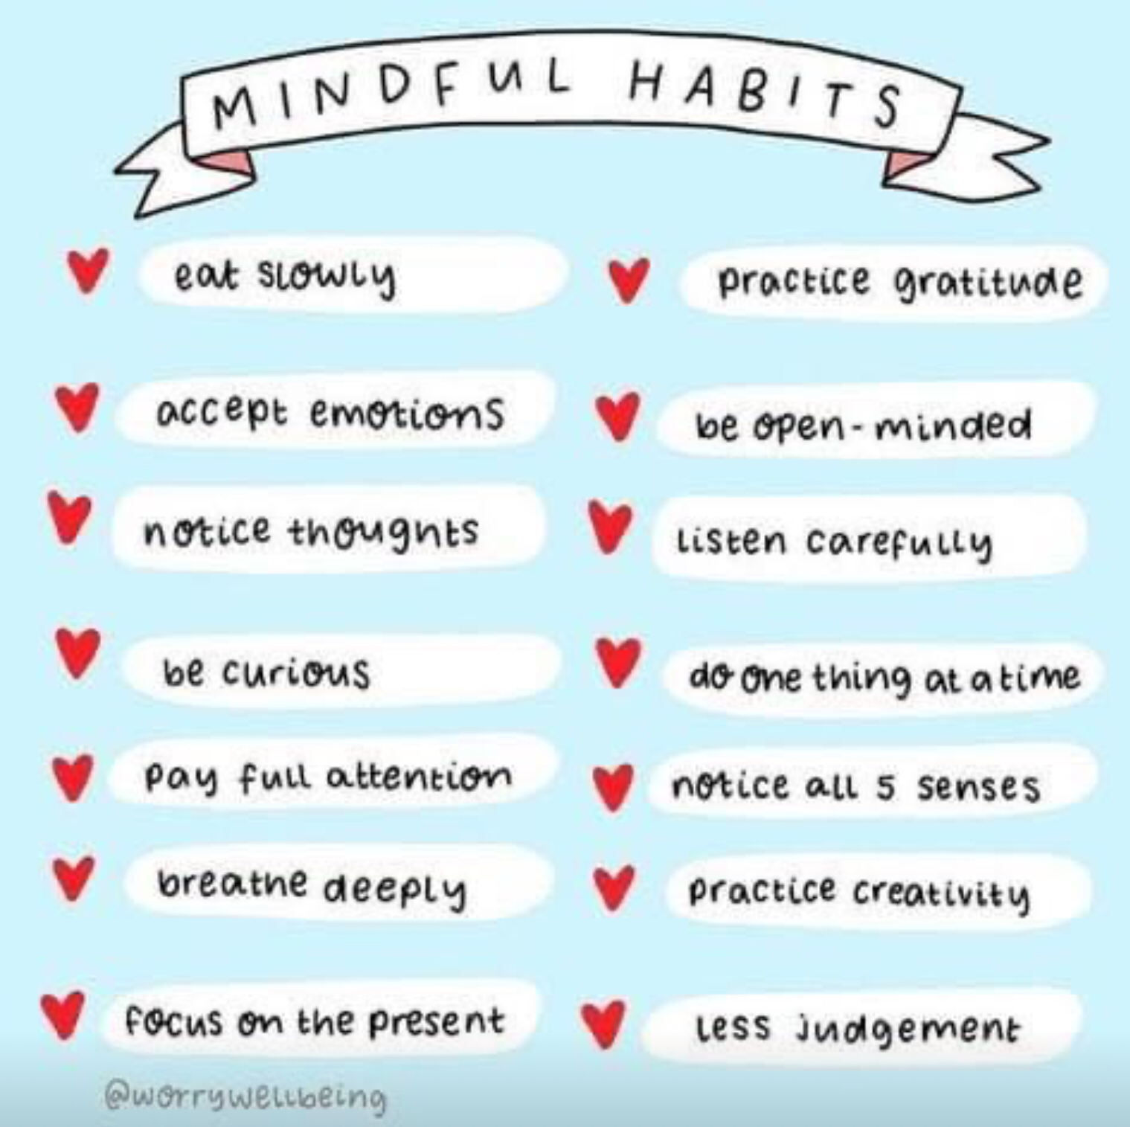

Slide 42
5 key considerations
5 key considerations highlighted to all students, please reinforce this with them.
High expectations: We all have high expectations of you, please mirror these expectations and do your best to achieve your potential.
RESPECT: From the time you put on your uniform each morning, please be respectful to all members of the school community, most important yourself.
BE KIND: Be kind in your actions each day. Kindness can go a long way.
MOBILE PHONES: Some students spend anything from 4-7 hours on their phones every day, check screen time, encourage your child to put their phone away when studying. Charge phones in another room.
SLEEP: 8-10 hours is recommended overuse of mobile phones can greatly interrupt this.

Slide 43
Survey to look at how students are supported in school:
We are interested in finding out about how you think your child is progressing in school and want to understand what we can do to make learning easier for your child. We would be grateful if could complete this anonymous survey, which should take about 10 minutes.
https://forms.office.com/e/v96H0zykjN

Slide 44
Questions
If you have any questions, please type them into the chat box

