Slide 1

1st Year Parents Information Evening 2024

Slide 2
Our Mission Statement & ETB Ethos
We seek to promote a caring and ​
committed school community​
which will facilitate the education of our students​
and where each individual is valued ​
as a unique human being.​
​
“Is ar scáth a chéile a mhairimid”

Slide 3
General Updates:
Parents Association – looking for volunteers to join our PA from all areas. If you are interested please send an email to info@borrisokanecc.ie PA have requested a payment of €50 from each family.
Ipads & Ebooks- some issues with logging onto our network. This will be resolved next week.
One Way System & Parking – from 8:30- 9:00 am we request that cars come to school via the athletics/tennis grounds and leave via Ballyhaden. In the evenings from 3:20 we request the same. We have extended our car park so can you please park in new car park and not on the footpath.

Slide 4
General Updates:
Enrollment for Sept 25. Admissions notice has been published and our Open Night is on Oct 17th from 6pm. Please get application forms in early or on time.
Class Assessments will be taking place over the next few weeks please keep an eye on Vsware. Students will complete NGRT this week and next.
Sporting Activities- Badminton, Hurling, Soccer , Camogie, Rugby.
Homework Hub before school
Club na nÓg- activities through Gaeilge
LGBTIQ+ Cafe

Slide 5
Website
Our website is being updated and you will be able to find presentations.
Link to Survey that we would like you to complete on Reviewing Inclusive and Special Ed.
Bí Cinealta – Anti Bullying Guidelines and documents. Your input will be required to compete our new policy.
Other surveys throughout the year and parental voice is very important to us.

Slide 6
Board of Management
New Board being set up from Oct 2024-May 2029.
5 meetings per year.
Ms.Virginia O'Dowd, Cllr Louise Morgan Walsh, Ms. Fiona Dunford ( elected to board by ETB)
Ms. Avril Murphy, Mr. Mike Fox ( Parents Rep)
Ms Ceire Hogan, Mr. Sean Ryan (PE) ( Teacher Reps)
Paula Molloy ( Secretary) Caitríona Maher ( Recording Secretary)
Community Reps

Slide 7
Option Subjects- Rotations
Options are rotating every 3 weeks- some classes will get to experience certain subjects twice.
12th November Online Meeting re Subject Options.
14th November Parent Student Teacher Meeting from 4:15- 6:45 ( school finished at 3:25)
Select in December, to commence selected options in Jan.

Slide 8
School Closures
Mon 30th September.
Thursday 21st November
Wednesday 8th Jan.
One further half day tbc.
Teachers emails available on the website we request where possible that you keep emails to working hours 8am-4:00pm.

Slide 9
Year Head: Ms. Bergin
Leader of Teaching and Learning focusing on First Year.
Support students and parents throughout the school year.
Monitoring the attendance, punctuality and engagement of each student.
Monitoring uniform (including PE uniform)
Ensuring that students adhere to the code of behavior and behave in a positive manner in line with the ethos of our school.
Active communication is very important.

Slide 10
Class Mentors
Class Mentors teach their specific class group. As a result, they become very familiar with their students. They provide a link between students and the Year Head and constantly provide additional support and guidance to students.
1A - Sean Ryan(WW), Therese Dooley
1B – ClaireO'Brien, Gearoid Larkin
1C - Angela Butler, Siobhan Darby
1D - Eileen Kenny, Eimear Cahalan
1E – MacDara MacLochlainn, Audrey Mitchell
All staff email addresses can be found on the school website.

Slide 11
School Journal
Allows vital communication between teachers and parents. Parents see what students need to engage with at home and can provide support.
Helps students to write down important reminders.
Provides detailed information in relation to the Code of behavior and important school policies such as, Anti Bullying Policy, Acceptable use policy, Student Rights and Responsibilities. Etc.
Parents should check the journal daily.
Sign each week preferable. Regular checks take place.
Centre Pages – Study tips, Revision Points, Setting Targets and Goals.
Notes:
Records – behaviour, attendance.

Slide 12
Attendance and Punctuality
Attendance is key to success in school. Please encourage this with your children.
When absent – find out what was covered in class and complete homework – Use Teams/Homework Buddy.
A note explaining absence/late must be sent in to the school via Vsware . Please be mindful of category of comment. Sign out if leaving the school during the day. Late if arriving late.
TUSLA – over 20 days absent.
Medical certificate or reason given if possible

Slide 13
Attendance and Punctuality
Arriving Late or Leaving Early
If a student arrives late or is signing out early, a reason must be submitted via Vsware. This will inform the Year Head and Secretary, who can update the records system. Please choose correct category.
Sign outs are used when students are leaving the school during the day.
Parents should have received a text as a link to Vsware. Download the app to make access easy.
Absent/ late/ sign out notes are approved at the year heads earliest convenience. Vsware updates once approved.
If you are unsure of the category to use for absence- just use other and insert reason.

Slide 14
Parent Reminders
Prepare bag and uniform with child – study area
Attendance (Child at school and parent at Parent/ Teacher Meeting) - is key to school and exam success
Read journal and sign to monitor and assist with Homework
Encourage full participation in all school activities
Never hesitate to contact the school if your child needs support
Time- support and encourage good time keeping. Give your child TIME.
Set realistic goals with your child

Slide 15
Homework - Study
Help your child to plan their homework – place to study. Leave books at study desk, use e-books in school.
Study includes revision. We have monthly/ bi-monthly assessments.
Encourage reading. Be mindful of screen time. This can be checked on the iPad.
Time for homework/study – 1 to 1.5 hours each night.
Each night check timetable for tomorrow to ensure that all books, materials(ingredients), uniform, lunch, etc. are ready for the next day.
Ensure iPad is charged and in schoolbag each morning. Charging after homework and in bag before bed is best

Slide 16
After School Study
Monday to Thursday 4.00pm to 6.15pm.
Cost €3 per evening – Subsidised by Parents Association.
Notes:
First years are welcome to take part in study – majority of students are 3rd 5th and 6th years.

Slide 17
Student Supports
Year Head
Mentor
Any class Teacher
Principal and Deputy Principal
Student Support Team
Cairde
Student Council
Homework Club
SEN Department
Guidance Counsellors

Slide 18
Homework Hub
Before school 8.20-8.50
Room 121
Letter and sign up slip given to students.
Numbers are limited.

Slide 19
Uniform
Must be worn everyday with exception of PE day.
PE uniform must be worn for PE.
T- Shirts worn under uniform must be white with no collar.
Girls Trousers – Hunter Brand or similar. 63 style not uniform.
Skirts must not be shortened – worn below the knee.
Footwear – Black or brown shoes or boots. Black runners allowed – Completely Black(no visible logos).
School Jacket. This is the best option as it can be worn both inside and outside the school building.
Notes:
No runners. If looks like runners then no. No canvas footwear.

Slide 20
Uniform
Sport and PE classes – PE uniform and runners or boots for field games.
Wear PE Uniform to school on PE Day.
Identification tags.
Protect valuables- lockers
Note if issue – accidents etc. – Keep to minimum.

Slide 21
Code of Behaviour –Journal
In place to allow all members of the school community to fulfil their roles. Negative behaviour has an impact on Teaching and Learning and will not be tolerated.
Teaching – Learning - Respect
Charters – Highlighted in school journal. Become familiar with them.
Notes:
Review of Code of Behaviour two years ago - charters

Slide 22
Charters
In the charter section you can view the rights and responsibilities of:
Students
Staff
Parents
Everyone works together for the betterment of the student.

Slide 23
Positive Discipline
Positive Comments
Catch students doing right
Praise, Thank you.
Reward good behaviour- words + positive comments.
Respect is a two way process.
Notes:
Rewards – No homework, game in class, watch DVD, Taken on tours, given credits

Slide 24
Implementing Code of Behaviour
  Listed are the steps in which negative behaviour is treated.
  Class Teacher
  Year Head
  Deputy Principal
  Principal
  Board of Management
Parents informed – VSware, Journal, Phone, Letter, Email. See page 39(a) of journal
Please monitor VSware to see students behaviour.
Parents are our partners in this process.

Slide 25
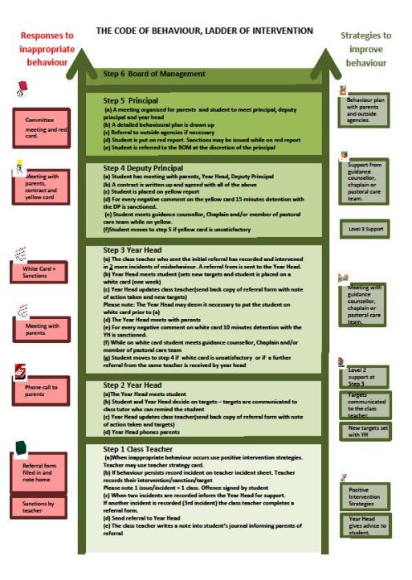
Ladder of Intervention

Slide 26
Code of Behaviour
Detailed information on the following can be found in the student's journal or on the school website borrisokanecc.ie or by clicking HERE
Sanctions.
Suspension Policy.
Expulsion Policy.

Slide 27
Anti – Bullying Policy
Detailed information on the following can be found in the students journal or on the school website borrisokanecc.ie or by clicking HERE
Tell someone – No innocent bystanders!
‘Morning Notes’ system – find out information Mobile phones – Social Network Sites e.g. Facebook, Snapchat, Instagram, TikTok etc. Please monitor from home.
Monitor children and talk to them. Any concerns, please contact us.
If something happens, screenshot it, don’t engage and tell someone about it.
Notes:
Mobile phones
Social networking websites – Bebo, Facebook.

Slide 28
Extra Curricular Activities
Permission to take part in activities – Note in Journal to be signed pg 34a.
Basketball, Hurling, Soccer, Camogie, Badminton.
Groups play hurling, soccer, basketball at lunchtime
Helmets required for hurling at all times, hurling on the grass.
Walkway used by students at breaks
Positive Behaviour is very important (trips, matches away etc)

Slide 29
3 key considerations
3 key considerations highlighted to all students, please reinforce this with them.
High expectations: We all have high expectations of you, please mirror these expectations and do your best to achieve your potential.
RESPECT: From the time you put on your uniform each morning, please be respectful to all members of the school community, most important yourself.
BE KIND: Be kind in your actions each day. Kindness can go a long way.

Slide 30


Slide 31
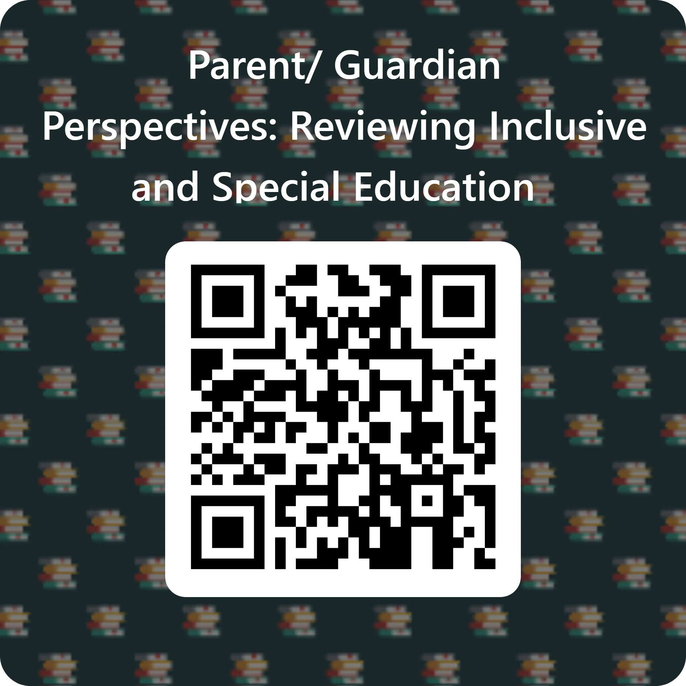
Survey to look at how students are supported in school.
We are interested in finding out about how you think your child is progressing in school and want to understand what we can do to make learning easier for your child. We would be grateful if could complete this anonymous survey, which should take about 10 minutes.
https://forms.office.com/e/v96H0zykjN

Slide 32

Questions
If you have any questions, please type them into the chat box

Slide 33
TY Parents Information Evening 2024

Slide 34
Purpose of TY Programme
TY Coordinator – Ms Cunningham
To promote maturity
Maturity in studies by making students more self-directed learners through the development of general, technical and academic skills
Maturity in relation to work and careers by developing work-related skills

Slide 35
Purpose of TY Programme
To promote maturity
Personal maturity by providing opportunities to develop communication skills, self-confidence and a sense of responsibility
Social maturity by developing greater ‘people’ skills and more awareness of the world outside school
Maturity that will help the student make a more informed choice of subject for their Leaving Certificate studies

Slide 36

TY-Aims to help students with:
Personal development
Social Competence
Transferable skills
Gain working and adult life experience

Slide 37

TY Programme –4 layers
Core Subjects- Subjects studied throughout Senior Cycle
Subject Sampling- Subjects available within the school for Senior Cycle
TY Specific Subjects available based on expertise, resources, location
Significant Learning Days and Experiences Dependent on budget, location, resources,

Slide 38

TY Programme in BCC- 4 Layers examples
Core Subjects- English, Maths, Irish, MFL, PE, DS, SPHE,CG
Subject Sampling- Geog,Hist, HEC, Bus, Acc, Ag Sc, Phys, Biol, Chem, WTec, Engi, DCG, Art, Music
TY Specific Subjects- Active Schools, Future Leaders, Junk Kouture, Erasmus, OGS, YSI, Sustainability, CS, Drama
Specific Learning Days/ Experiences- Segway, School Show Zumba, World Skills, Gaisce, Work Experience, Adventure Centre Trip, Coaching , Borris Bugle, Barista, Inspireland Workshop,Paired Reading to name but a few

Slide 39
TY Opportunities - Contribution
Other opportunities for learning, for skill and personal development that may arise and have an additional cost for example:
TY Driving School
FL-Skyline and Museum in Croke Park
Karting/Paintball/ Pureskill

Slide 40
TY Opportunities- outside of school
Outside agencies, colleges, universities, the defence forces, law society, RCSI …...
Offer TY students the opportunity to sample their courses, investigate careers …..
Information the school gets is passed to students in Coord class, also via email and to parents on VSWare

Slide 41
Equipment
Every TY Student every school day:
TY Journal,
Fully Charged IPAD,Pens, pencils,
A4 refil pad
relevant materials for class, advised by subject teacher

Slide 42
TY Work Experience
TY Work Experience is compulsory and an integral component of TY and takes place during designated school calendar dates
TY Work Experience is organized by parent/guardian/student
TY Work Experience is divided into 2 blocks
Block 1- One week duration- Oct 21st-25th
Block 2- Two weeks duration- May 19th-May 30th

Slide 43
Work Experience - Essentials prior to Work Experience:
Placement details and work placement supervisor signature on hard copy returned to Ms.Cunningham as part of the TY Application Process
Online copy- closer to Work Experience Blocks an online form with placement details, work placement supervisor to be completed by Parent/guardian and student link will be emailed to students

Slide 44
Work Experience - Essentials prior to Work Experience
Once online form completed your child will collect documentation from Ms.Cunningham to give to Work Experience Supervisor
Garda Vetting- If your child is working with children or vulnerable adults, they must be Garda Vetted. Your child must be over 16 to be Garda Vetted.

Slide 45
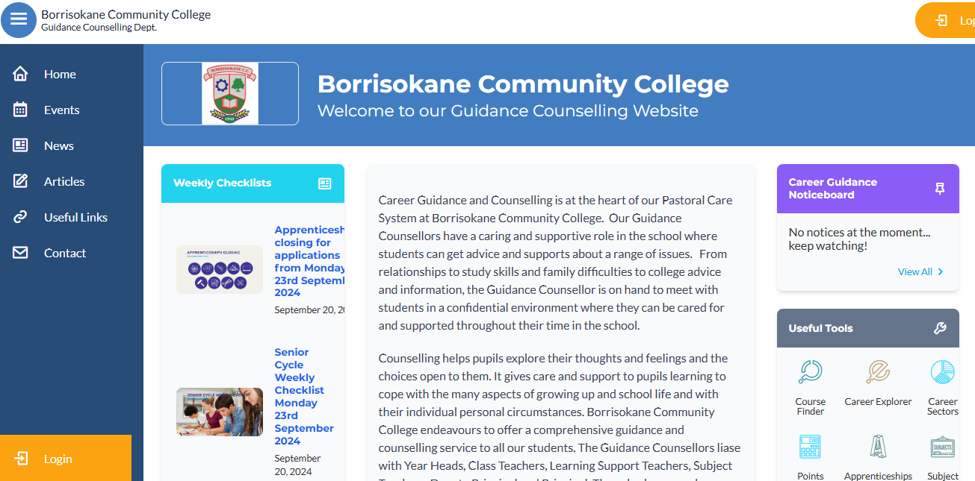
The Guidance Dept at BCC – Ms Carroll & Ms Glynn
All Junior Cycle classes have Guidance Related Learning classes.
All Senior Cycle classes have a weekly Career Guidance class and can take part in trips to Colleges and Apprenticeship centres.
Provide one-to-one personal, academic and career support.
Parents & Guardians are welcome to get in contact and can also avail of our Guidance page on the school website which has info on courses, apprenticeships, LC points and Open Days etc.

Slide 46
TY Year Head: Mr. McGinn
Leader of Teaching and Learning focusing on Transition Year.
Support students and parents throughout the school year.
Monitoring the attendance, punctuality and engagement of each student.
Monitoring uniform (including PE uniform)
Ensuring that students adhere to the code of behavior and behave in a positive manner in line with the ethos of our school.
Active communication is very important.

Slide 47
Class Mentors
Class Mentors teach their specific class group. As a result, they become very familiar with their students. They provide a link between students and the Year Head and constantly provide additional support and guidance to students.
4A Ms. Marie D’Arcy, Ms. Hannah Costello
4B Ms. Mairead Maxwell, Mr. Peter Dillon
4C Mr. Darren O Connell, Ms. Laura Allen
4D Ms. Trudy Carroll, Ms. Laura Mahoney
All staff email addresses can be found on the school website – we request where possible to keep emails to working hours 8am – 4pm.

Slide 48
Attendance and Punctuality
Attendance is key to success in school. Please encourage this with your children.
When absent – find out what was covered in class and complete – Use Teams/Homework Buddy.
A note explaining absence/late must be sent in to the school via Vsware . Please be mindful of category of comment. Sign out if leaving the school during the day. Late if arriving late.
TUSLA – over 20 days absent.
Medical certificate or reason given if possible
Records of each month in Journal

Slide 49
Attendance and Punctuality
Arriving Late or Leaving Early
If a student arrives late or is signing out early, a reason must be submitted via Vsware. This will inform the Year Head and Secretary, who can update the records system.
The School App
Parents should have received a text as a link to Vsware. Download the app to make access easy.
Absent/ late/ sign out notes are approved at the year heads earliest convenience.
Vsware updates once approved.

Slide 50
Student Supports
Year Head
Mentor
Any class Teacher
Principal and Deputy Principal
Student Support Team
Cairde
Student Council
Homework Club
SEN Department
Guidance Counsellors

Slide 51
Uniform
Must be worn everyday with exception of PE day.
PE uniform must be worn for PE.
T- Shirts worn under uniform must be white with no collar.
Girls Trousers – Hunter Brand or similar. 63 style not uniform.
Skirts must not be shortened – worn below the knee.
Footwear – Black or brown shoes or boots. Black runners allowed – Completely Black(no visible logos).
School Jacket. This is the best option as it can be worn both inside and outside the school building.
Notes:
No runners. If looks like runners then no. No canvas footwear.

Slide 52
Code of Behaviour –Journal
In place to allow all members of the school community to fulfil their roles. Negative behaviour has an impact on Teaching and Learning and will not be tolerated.
Teaching – Learning - Respect
Charters – Highlighted in school journal. Become familiar with them.
Notes:
Review of Code of Behaviour two years ago - charters

Slide 53
Charters
In the charter section you can view the rights and responsibilities of:
Students
Staff
Parents
Everyone works together for the betterment of the student.

Slide 54
Positive Discipline
Positive Comments
Catch students doing right
Praise, Thank you.
Reward good behaviour- words + positive comments.
Respect is a two way process.
Notes:
Rewards – No homework, game in class, watch DVD, Taken on tours, given credits

Slide 55
Implementing Code of Behaviour
  Listed are the steps in which negative behaviour is treated.
  Class Teacher
  Year Head
  Deputy Principal
  Principal
  Board of Management
Parents informed – VSware, Journal, Phone, Letter, Email. See page 39(a) of journal
Please monitor VSware to see students behaviour.
Parents are our partners in this process.

Slide 56
Anti – Bullying Policy
Detailed information on the following can be found in the students journal or on the school website www.borrisokanecc.ie
Tell someone – No innocent bystanders!
‘Morning Notes’ system – find out information Mobile phones – Social Network Sites e.g. Facebook, Snapchat, Instagram, TikTok etc. Please monitor from home.
Monitor children and talk to them. Any concerns, please contact us.
If something happens, screenshot it, don’t engage and tell someone about it.
Notes:
Mobile phones
Social networking websites – Bebo, Facebook.

Slide 57
Extra Curricular Activities
Permission to take part in activities – Note in Journal to be signed pg 32a.
Basketball, Hurling, Soccer, Camogie, Badminton.
Groups play hurling, soccer, basketball at lunchtime
Helmets required for hurling at all times.
Walkway used by students at breaks
Positive Behaviour is very important (trips, matches away etc)

Slide 58
3 key considerations
3 key considerations highlighted to all students, please reinforce this with them.
High expectations: We all have high expectations of you, please mirror these expectations and do your best to achieve your potential.
RESPECT: From the time you put on your uniform each morning, please be respectful to all members of the school community, most important yourself.
BE KIND: Be kind in your actions each day. Kindness can go a long way.

Slide 59
TY Trip Salou Barcelona
Wednesday 9th April 2025
Depart Dublin 09:40 Arrive Barcelona 13:10
Saturday 12th April 2025
Depart Barcelona 10:35 Arrive Dublin 12:20
Outstanding Payments – if applicable
€100 outstanding balance June 2024
€400 final payment due in Jan 2025

Slide 60
Survey to look at how students are supported in school.
We are interested in finding out about how you think your child is progressing in school and want to understand what we can do to make learning easier for your child. We would be grateful if could complete this anonymous survey, which should take about 10 minutes.
https://forms.office.com/e/v96H0zykjN

Slide 61
Questions
If you have any questions, please type them into the chat box

