Slide 1
Welcome to Borrisokane Community College

Slide 2
Agenda
Transition Year.
Leaving Certificate Applied Programme.
iPads
5th year Book Scheme.
School App
Procedure for allocating students to subjects.
Career Guidance.
Leaving Certificate Vocational Programme.
CAT4 Testing
Academic Tracking - Athena

Slide 3
Transition Year and Leaving Certificate Applied Programme
Ms Orla Cunningham

Slide 4
iPads
Transition Year & Fifth Year Students will need to have an iPad
Communication with Teachers
Microsoft TEAMS now used by all teachers for
Sharing Learning Material
Completing and submitting assignments
Competing Projects.
5th year students can have books on iPad but will mean purchasing new books.

Slide 5
iPads
Wriggle Managed Service
Initially 3 years
3 further years €31
Wriggle Store to order and make payment

Slide 6
Wriggle Managed Service
Possible consequences of licences and support expiring: It can be hugely disruptive if the licence on a device is allowed to expire. In the event that it does expire, some or all of the following can happen: 1. All Apps will de-activate and data/content will delete 2. Restrictions (e.g. blocking of App Store access) will deactivate 3. eBooks will disappear along with Publisher Apps deactivating 4. School Wi-Fi Codes will delete, requiring manual input by teachers, or sharing of codes with students 5. A full reset of iPads will be required, either by parents or at school 6. Wriggle unable to push Apps to iPads 7. Wriggle unable to support any iPad technical issues

Slide 7
Book Scheme
€200 to cover Fifth and Sixth year
Payable by 30th June 2023
Covers all text books only
Plays and Novels not included.
All books to be returned at the end of 6th year.
Inc. Journal and Personal Accident School Insurance, €35 approx. Careers Profile Test €25.
If not in Book Scheme payment of €60

Slide 8
School App
Calendar of School Events
School News
Messages
Download App - iclasscms
Verification code: RT@7T4
Setup your details
Add Students and put into year groups

Slide 9
Option Subjects
French
German
Business
Accounting
Home Economics
Physics
Ag. Science
Biology
Chemistry
Design & Communication Graphics
Art
Engineering
Const. Studies
History
Geography
Music
Physical Education
Computer Science

Slide 10
Student Preference
Students will receive link to Microsoft Form.
List subjects in preference order
_______________
_______________
_______________
_______________
_______________
_______________
Parents to check Form before it is submitted.

Slide 11
Student Preferences
Analysed by computer to form a set of bands which satisfy the majority of students.

Slide 12
Example of Band Set
Biology Geography Ag. Science Physics
Biology Const. St. Geography Art Comp Sc.
Home Ec. Engineering French Music LCPE
German Design & Com Gr. Chemistry Business
Notes:
All Science Line 1
French available on two lines – French and Art Possible and French and Music

Slide 13
Choices
Students choose one subject from each line

Slide 14
Constraints on achieving Options
Number of pupils opting for a subject
Class size
Maximum 24, 30
Minimum 10 approx
2. Two required subjects on one line when making choices

Slide 15
Constraints on achieving Options (contd)
3. Availability of Teaching Staff
e.g. 32 students ask for subject X
class size maximum 24
no teacher available to form a second class
Result: Eight students will be placed in another class on that option line based on Preference 5 and 6

Slide 16
Career Guidance Information
Ms Trudy Carroll

Slide 17
LCVP
Ms Deirdre Kyne

Slide 18
CAT Tests

Slide 19
Cognitive Abilities Test
Tendency/ Inclination
Personal strengths and weaknesses
Measurement of potential
90 - 110 – Average Score

Slide 20
What did we measure?
Verbal Classification
Verbal Analogies
Number Analogies
Number Series
Figure Classification
Figure Matrices
Figure Analysis
Figure Recognition

Slide 21
Verbal Bias
A strong verbal bias shows an ability to reason with words and to think logically Important for work involving communicating ideas or understanding written material Highly important for academic courses
Sample Careers/ Courses: Law, Journalism, Social Work, Arts, Media, P.R. Advertising, Education
Sample Subjects: English, History, Geography, Business

Slide 22
Numerical Bias
A strong numerical bias shows the ability to reason with numbers and to deal with quantitative measures.
Sample Careers/ Courses: Finance, Accounting, Sales, Banking, Architecture, Engineering, Carpentry etc.
Sample subjects: Maths, Accounting, Physics, Chemistry, Applied Maths, Economics

Slide 23
Non-Verbal Bias
Non-Verbal/ Non-Numerical measure of reasoning power. It assesses how well one can reason with geometric figures or designs
Sample Careers/ Courses: Engineer, Doctor, Scientist, Software Design, Teacher etc.
Sample Subjects: Physics, Chemistry, Biology, History, Art

Slide 24
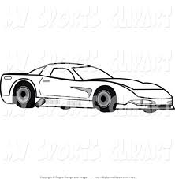
Spatial Bias
Shows the ability to visualise a three- dimensional object from a two-dimensional pattern and envisage how this object would look if rotated in space
Sample Careers/ Courses: Software Design, Architecture, Engineering, Carpentry, Product Design, Photography, Fashion Design, Management etc.
Sample Subjects: DCG, Art, Construction, Maths

Slide 25
Remember
We use the CAT to give us an insight into our STRENGTHS
They do not measure Creativity, Musical ability, Sporting ability, Social ability etc
It is just one tool to finding strengths -there are many others e.g. mock results, hobbies and interests, interest tests etc

Slide 26
Reports to Parents
Reports sent to parents in First Year
Transition Year Report sent to Students by Email.
Students shown how to setup a storage are on OneDrive for storing CAT4 and other Reports.

Slide 27
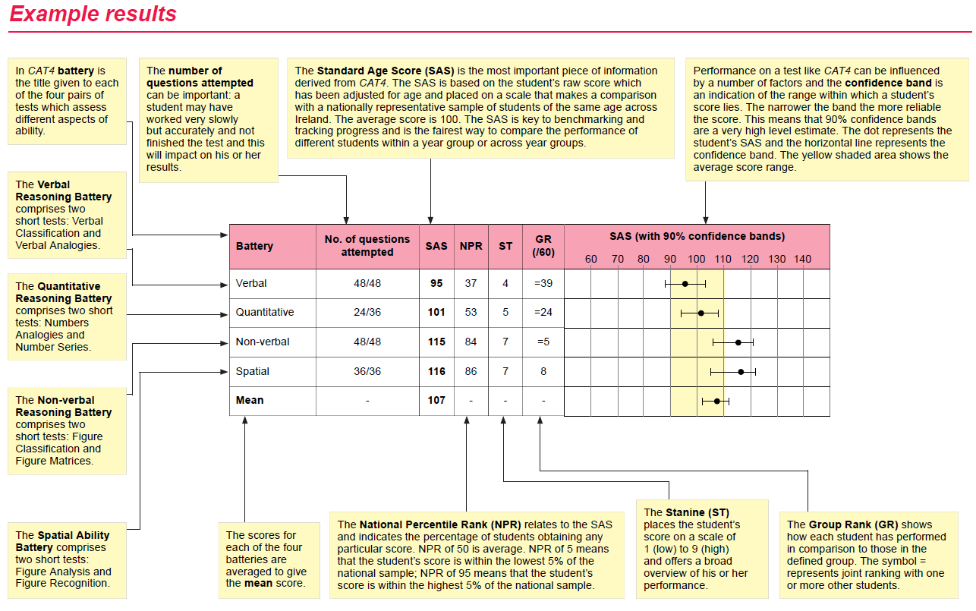
CAT 4 – Transition Year

Slide 28
Guide to Examination Results

Slide 29
Academic Tracking - Athena

Slide 30
Most recent results and CAT4

Slide 31
Graphs for each Subject

Slide 32
Supporting your Child
Discuss how to access the reports on OneDrive.
Review Athena Report following examinations
Set achievable targets for the next examinations
Time for study – setup a timetable and area for study.

