Slide 1
Parents Evening Helping your child achieve their best
5th year

Slide 2
13th September 2022
Career Guidance
Study Skills and Tips
Other Information
Questions & Answers
Ms Bergin – Year Head
Ms Molloy – Deputy Principal
Mr. Carr - Principal

Slide 3
The Guidance Department
Caroline Glynn & Trudy Carroll

Slide 4
The role of the Guidance Counsellor: * Weekly Careers Class * Individual Guidance Appointment
Educational
(Subject & Level considerations, study skills & motivation)
Vocational
(Progression routes & entry requirements)
Personal
(Supporting emotional wellbeing)

Slide 5
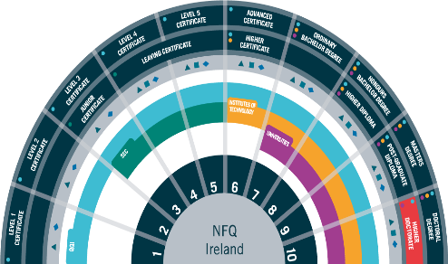
Progression Routes
National Qualifications Framework
Apprenticeship (level 5+)
PLC (Level 5 & 6)
IT (Level 7 & 8, some 6)
University (Level 7 & 8)
Work
Gap Year
Defence forces
Study abroad (UK, Europe)

Slide 6
Progression Routes (Practical/ Hands on Options)
PLC www.fetchcourses.ie
Apprenticeship www.apprenticeship.ie
Post Leaving cert course (1-2 years full time) held in community education centre/ schools/ colleges
Work Experience
Nationally recognised
Opportunity to try out a course
Step towards L.7/L.8 through CAO
Apply directly to the college
Applicant must be employed by an approved employer (SOLAS) –apprenticeship job vacancies.
At least 16 years
Entry requirements/ educational qualifications depend on the programme (apprenticeship directory)

Slide 7
Apprenticeships & Tipperary ETB
Tipperary ETB is one of 16 ETB’s that support employers and apprentices throughout apprenticeship training.
50+ apprenticeship options supported by 300+ employers across the Tipperary region.
Range from Electrical, Engineering, Motor, Construction, Finance, Hospitality, ICT, and Logistics.
Tipperary ETB Training Centre is located in Archerstown Business Park, Thurles (Phase - “off-the-job” training)

Slide 8
CAO (National database for students’ college applications) – Feb. of 6th year
3 Criteria
3 x Criteria to meet
Minimum Entry Requirements
Uni/IT L8: 2 x H5 & 4 x H7/O6
*NUI’s generally require a 3rd lang.
*UL does not req. 3rd lang (course choice*)
*TCD eng, mat &Ir/3rd lang.
L7 5xH7/O6
Subject Specific Requirements
Primary teaching Irish H4; Journalism & Digital Communications UL Eng H4; Mathematical Science NUIG mat H5/O1
NB CHECK REQUIREMENTS
NB CHECK REQUIREMENTS
Points Requirement
Totalling students’ best six subjects (*bonus maths) – specific number of places – students with highest overall points
NB Research is crucial (rash decisions re subjects/ levels can be costly)

Slide 9
Location | Ireland | UK | Europe
System of Application | CAO www.cao.ie | UCAS www.ucas.com | Eunicas www.eunicas.ie
Number of colleges | 44 | >300 | >160
Number of courses | 1793 | >18,000 | >4,200
Deadline Dates | *early application: 5pm 20th Jan. = €30 Normal applicate date: 5pm 1st Feb. = €45 | 15th Oct. (restricted Courses) 15th Jan (all other courses) | 15th Jan (conditional/limited offers) Jan. + all other offer up to Aug.
Entry Requirements | Points, 5/6 subjects General + specific subject Requirements + | Specific Grades, tariff points, interview | 2H4 + 4O6 for majority Specific requirements
Fees | The amount of the contribution varies from one institution to another. The maximum rate of the student contribution for the academic year 2022-2023 is €3,000. | UK (Eng, Scot, Wales) Ranges from location/ university/ college €9,000+ NI €4,500+ | Fees vary significantly, depending on country/ university & degree programme (no fees-state-sector universities Denmark, Sweden or Finland BUT cost of living ≥800). Germany & Austria - no Tuition fees but 'semester fees', - €500-600 per year.(Medical Schools in Italy are low (650 – 4000 pa,- linked to family income), fees for Health Sciences in most other countries are high( €9,000 +)

Slide 11
Marianne Bergin– Year Head
Time management
Homework and study
Attendance & punctuality
Uniform

Slide 12
Managing time well
Weekdays:
Get up on time, eat a good breakfast, arrive to school on time
Get to class on time
Eat a good lunch & hydrate
In evenings, have a quiet place to study
Get organised for the next day before you go to bed- books, uniform/PE, lunch, drink, charge ipad (use ipad charger)
Get to bed early, no screens- charge phones in kitchen
Take breaks; get fresh air and exercise in preference to sitting in front of TV or screen
Weekends:
Use the early finish on Fridays to complete homework
Use Saturday for rest and recreation and revise on Sunday and get prepared for Monday morning
Part time jobs are not a good idea when trying to manage school study and hobbies
“Free classes” = work classes- please don’t sign out

Slide 13
Homework and Study
Quiet Space- same time, same place every evening
No distractions
Supervised study is a great option and a great routine
After school study Mon –Thurs 4pm -6.15pm
€3 pay per session
Welcome to join at 5 if taking part in after school activity
Phone in another room
Organise in advance- books ready
Have a plan- include all subjects that day, check timetable
Learning a necessary part of homework
Tick work completed
Pack bag when finished

Slide 14
Wellbeing
Stay Active
Stay Connected
Surround yourself with positive people
Have a plan
Look after physical health (sleep, hydration & food, exercise)
Ask for help

Slide 16
Setting subject targets
Setting target grades are very important, otherwise its difficult to see progress.
Log into eportal regularly
Write target grade for each subject into journal – page 29a(reflect on Junior Cycle results when setting targets)
If target is not set, discuss with teacher and set
Write class exam result for each subject in journal
Reflect on all results – did you reach your target, why/why not, what can you do to ensure you improve your grade, is target realistic, does target need to be reviewed
Put a study plan in place
Work towards reaching target in each monthly and class assessment
Study must start NOW!

Slide 17
Attendance
Importance of Attendance/Punctuality
If student absent, late or signing out early, please let the school know by using the school iclass app. or alternatively email as soon as possible to let me know reason, for Eportal updating
Marianne.bergin@borrisokanecc.ie
Follow through TEAMS or homework buddy if absent, important to catch up if well enough

Slide 18
Signing Out
Students under 18 must be collected at the school
Please send a note through the App/back of journal
Students get a sign out slip
Students hand in the sign out slip at the office as they leave
Cars- Students are not permitted use their car or to sit in cars during the day.

Slide 19
School Uniform New PE uniform The PE Uniform is available to order online at the following website: www.xgear.ie/collections/borrisokanecommunity-college

Slide 20
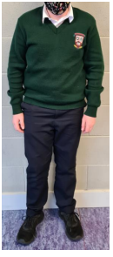
Uniform
Blackwatch tartan skirt (Skirt must not be altered in length and worn below the knee)
Navy uniform trousers – For girls the Hunter brand or equivalent uniform trousers. For boys plain navy school uniform trousers. Fashion navy trousers will not be acceptable. (Further details available by checking the sample at the school).
Bottle green v-neck jumper with college crest. White shirt (2).
Navy School Jacket with Crest.
Footwear: Black, Brown, Navy Shoes. Black, Brown, Navy and Navy/Green Decks. The only runners that can form part of the school uniform are complete black runners. Canvas, Uggs, Vans or similar footwear are not allowed.

Slide 21
Uniform
Students wear the school uniform at all times.
PE uniform on PE days only- school leggings must have the school crest
If students have no PE uniform or it’s dirty- wear uniform and change into sports gear for PE
School jackets only on school premises.

Slide 22
Anything we should know?
Feel free to contact us at any time.

Slide 24
Eportal
School System to record student information
Timetable
Attendance
Calendar of School Activities/Events
Positive Comments
Behaviour Record
Examination Results
Monthly assessments on Eportal. Teacher and student set target and compare achievement to target each month.
Log on details sent to parents - username and password. If log in details lost contact school and we can email them to you.
Log on from school website – www.borrisokanecc.ie
Link to Eportal at top of Home Page.

Slide 25
Assessments
Assessment Policy on School website.
Monthly Assessment – on EPortal. Result and Grade
September
October
December
January/February
March/April
Targets set at beginning of year and can be adjusted as year moves on.

Slide 26
Assessments
5th House Exams
December – Results and Formative Comment on EPortal
May/June - Results and Formative Comment on EPortal
Report uploaded to EPortal.

Slide 27
Subject | % Value in Leaving cert &- details | Approximate start date
Art | 50% Project 20% Practical Day Exam | Starts in 6th yr – 10 wks approx May of 6th yr – 5 hr exam
Agricultural Science | 25% Project | Portfolio across the two years
Construction Studies | 25% Project and Portfolio 25% practical day exam | Starts in 6th year 4-hour exam in May of 6th year
Computer Science | 30% Course Work | Preparations begin in 5th year
DCG | 40% Project | Starts in September of 6th Year – Finishes in January of 6th Year
Engineering | Project; Higher level 25% Ordinary level 30% | 6th year
Geography | 20 % project | 6th year
History | Reasearch study report 20% | October 2022
Home Economics | 20% Food Studies Assignment | Starts in October of 5th year
PE | Physical Activity Project 20% Performance Assess. 30 % | Start 6th year 6th year
French / German | Oral exam 25% | Preparation begins in 5th year Oral exam in March/April 6th year
Gaeilge | Oral exam 40% | Preparation begins in 5th year Oral exam in March/April 6th year
More info. In assesment policy on website | link to assessment policy on website

Slide 28
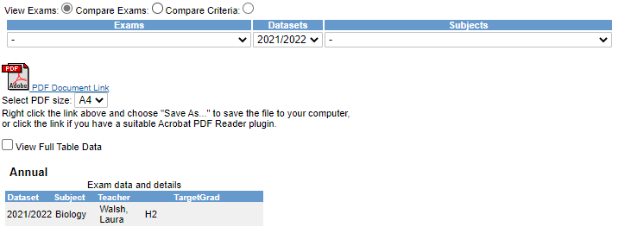
EPortal
Click More
Select Year from Datasets dropdown menu

Slide 29
EPortal – Reports

Slide 30
Data Protection
Eportal – Personal Data.
Reports to Student – over 18 parents have no access to Eportal unless with students permission.
Forms for permission on school website – Click Here.

Slide 31
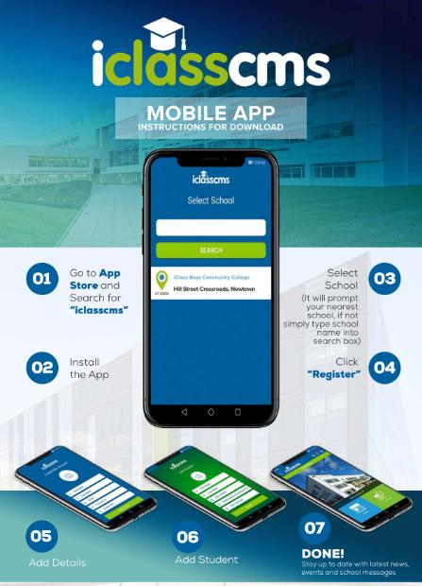
School App
iClass App
Verification Code
RT@7T4
News
Events
Send Notes to School – Absence/Lates/Leave early

Slide 32
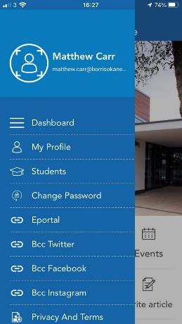
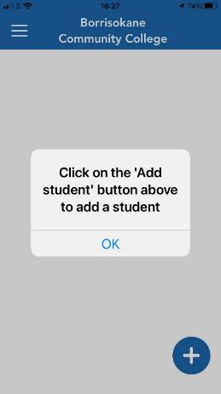
Add a Student

Slide 34
If student ill then do not send student to school
If students out of school follow class work/homework on TEAMS or use a homework buddy.
Follow a structure using timetable- if working from home.
Any queries email subject teachers.

Slide 35
Parent Teacher Meetings
If you need to speak to an individual teacher please contact the teacher or school office – 067 27268 or email info@borrisokanecc.ie or email the teacher.
Parent/Student/Teacher Meeting 5th Year - Thursday January 26th 4.15 pm to 6.45pm
Contact Year Head, Principal and Deputy Principal.

Slide 36
Parents Committee
Huge support to the school over the years
Encourage parents to join the committee
Voice of parents in the school
Parents Association AGM on Monday October 3rd at 7.30pm. Talk from Stella O’Malley Psychotherapist on How to Support your Child through the Teenage Years
€50 Parents Association Family Levy

Slide 37
Final Word what can you do to help?
Allow/ Encourage the dream
Facilitate Schoolwork/Homework/Research/Independence
Inform yourself
Support and Encourage
Praise
Encourage short study breaks to improve concentration
Leaving Cert is similar to a marathon very important that the student is at their peak in June 2024.
Ultimately decisions are student’s own, allow them to take responsibility.
Help your child set short term goals and build on them.
Follow progress on Eportal

Slide 38
Slides available on school website in next few days.
Questions?

