Slide 1
Parents Evening
Helping your child achieve their best
5th year

Slide 2
13th September 2022
Career Guidance
Study Skills and Tips
Other Information
Questions & Answers
Ms Bergin – Year Head 5th year
Ms Cunningham – LCA Coordinator
Ms Molloy – Deputy Principal
Mr. Carr - Principal

Slide 3

The Guidance Department
Caroline Glynn & Trudy Carroll

Slide 4

The role of the Guidance Counsellor:
* Weekly Careers Class
* Individual Guidance Appointment
Educational
(Subject & Level considerations, study skills & motivation)
Vocational
(Progression routes & entry requirements)
Personal
(Supporting emotional wellbeing)

Slide 5
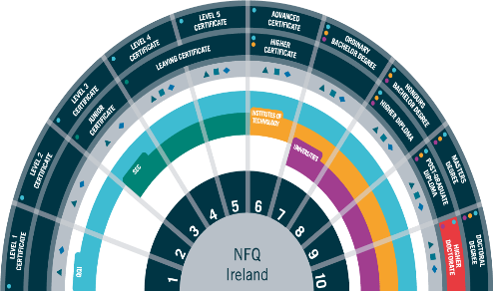
Progression Routes
National Qualifications Framework
Apprenticeship (level 5+)
PLC (Level 5 & 6)
IT (Level 7 & 8, some 6)
University (Level 7 & 8)
Work
Gap Year
Defence forces
Study abroad (UK, Europe)

Slide 6


Progression Routes (Practical/ Hands on Options)
PLC www.fetchcourses.ie
Apprenticeship www.apprenticeship.ie
Post Leaving cert course (1-2 years full time) held in community education centre/ schools/ colleges
Work Experience
Nationally recognised
Opportunity to try out a course
Step towards L.7/L.8 through CAO
Apply directly to the college
Applicant must be employed by an approved employer (SOLAS) –apprenticeship job vacancies.
At least 16 years
Entry requirements/ educational qualifications depend on the programme (apprenticeship directory)

Slide 7


Apprenticeships & Tipperary ETB
Tipperary ETB is one of 16 ETB’s that support employers and apprentices throughout apprenticeship training.
50+ apprenticeship options supported by 300+ employers across the Tipperary region.
Range from Electrical, Engineering, Motor, Construction, Finance, Hospitality, ICT, and Logistics.
Tipperary ETB Training Centre is located in Archerstown Business Park, Thurles (Phase - “off-the-job” training)

Slide 8
LCA Parents
Programme Information and Reminders

Slide 9
Leaving Certificate Applied Aims
•Prepares you for adult and working life
•Recognises your talents
•Helps you to communicate better and make
•Lets you use your knowledge and skills to solve real problems

Slide 10
➤ LCA IS A Full two year programme
•➤ Four sessions, 2 each year
90% Attendance is compulsory in all courses (subjects) in order to complete Key Assignments and achieve credits

Slide 11
Leaving Certificate Applied Terminology
Session
For the purpose of the Leaving Certificate Applied the school year is divided into two sessions
Session I - September to the end of January
Session II - February to June.
The full two- year programme has four sessions altogether

Slide 12
Leaving Certificate Applied Terminology
Courses
A course is an area of study made up of a number of modules e.g English and Communication is a course

Slide 13
Leaving Certificate Applied Terminology
Modules
A module is a topic within a course and will be taught in 3-4 class periods per week over one session e.g Personal and social communications is one module in the English and Communication Course

Slide 14
Leaving Cert Applied Terminology-
Tasks
Seven tasks to be completed over the 2 years:
1 in Session I Year 1
2 in Session II Year I
3 in Session III Year II
Personal Reflection Task to be completed over the two years. (Two reflective statements – one at the end of Year I and one at the end of Year II)
An interview for six tasks

Slide 15
Leaving Cert Applied Terminology
Key Assignments
Key Assignments are important areas from each module.
To gain credits for each module you must
complete 4 Key Assignments usually, except in COVID
and attend the course for at least 90% of the time

Slide 16
CREDITS
•Credits awarded for modules and tasks at the end of each session
Leaving Cert Applied Terminology​

Slide 17
Leaving Certificate Applied Assessment
3 Types
Satisfactory completion of Modules 62 credits
7 Student tasks 70 credits
Final examinations 68 credits

Slide 18
Leaving Certificate Applied- Overall Cert
•Pass 120 credits
•Merit 140 credits
•Distinction 170 credits

Slide 19
Work Experience
Is a compulsory element of the LCA Programme
Work Experience takes place EVERY WEDNESDAY of term time
Work Experience is organised by the student and their parent/guardian

Slide 20
Reminders
All students need a fully charged Ipad every day in school for class
Students must bring their Student Journal to school every day
Stationery/pens/ pencil/ notes- teachers will advise in each course
School App- please register if you have not done so already

Slide 21
Dates of upcoming LCA Events
Trip to World Skills Event- Thursday 15th Sept- Career Guidance Dept
Tuesday Oct 4th- Trip to Derg Isle Centre- WAY2PAY 20 Euros contribution
All trips are linked to a course and help students to apply their classroom learning in real -life setting

Slide 23
Marianne Bergin– Year Head 5th years
Eimear Lyons- Year Head 6th years
Time management
Homework and study
Attendance & punctuality
Uniform

Slide 24
Managing time well
Weekdays:
Get up on time, eat a good breakfast, arrive to school on time
Get to class on time
Eat a good lunch & hydrate
In evenings, have a quiet place to revise
Get organised for the next day before you go to bed- books, uniform/PE, lunch, drink, charge ipad (use ipad charger)
Get to bed early, no screens- charge phones in kitchen
Take breaks; get fresh air and exercise in preference to sitting in front of TV or screen
Weekends:
Use the early finish on Fridays to complete work
Use Saturday for rest and recreation and get prepared for Monday morning
“Free classes” = work classes- please don’t sign out
Never let work outside school interfere with attendance and completion of LCA key assignments and tasks.

Slide 25
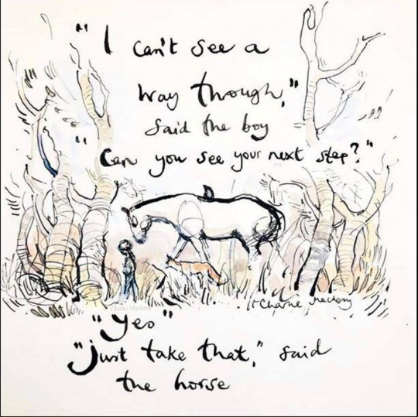
Wellbeing
Stay Active
Stay Connected
Surround yourself with positive people
Have a plan
Look after physical health (sleep, hydration & food, exercise)
Ask for help

Slide 26


Slide 27
Setting subject targets
Setting target grades are very important, otherwise its difficult to see progress.
Log into eportal regularly
Write target grade for each subject into journal – page 29a
Reflect on all results – did you reach your target, why/why not, what can you do to ensure you improve your grade, is target realistic, does target need to be reviewed
Work towards reaching target in each module and class assessment
Work must start NOW!

Slide 28
Attendance
Importance of Attendance/Punctuality
If student absent, late or signing out early, please let the school know by using the school iclass app. or alternatively email as soon as possible to let me know reason, for Eportal updating
Marianne.bergin@borrisokanecc.ie
Follow through TEAMS or homework buddy if absent, important to catch up if well enough

Slide 29
Signing Out
Students under 18 must be collected at the school
Please send a note through the App/back of journal
Students get a sign out slip
Students hand in the sign out slip at the office as they leave
Cars- Students are not permitted use their car or to sit in cars during the day.

Slide 30

School Uniform
New PE uniform
The PE Uniform is available to order online at the following website: www.xgear.ie/collections/borrisokanecommunity-college

Slide 31
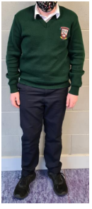
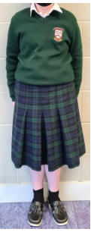
Uniform
Blackwatch tartan skirt (Skirt must not be altered in length and worn below the knee)
Navy uniform trousers – For girls the Hunter brand or equivalent uniform trousers. For boys plain navy school uniform trousers. Fashion navy trousers will not be acceptable. (Further details available by checking the sample at the school).
Bottle green v-neck jumper with college crest. White shirt (2).
Navy School Jacket with Crest.
Footwear: Black, Brown, Navy Shoes. Black, Brown, Navy and Navy/Green Decks. The only runners that can form part of the school uniform are complete black runners. Canvas, Uggs, Vans or similar footwear are not allowed.

Slide 32
Uniform
Students wear the school uniform at all times.
PE uniform on PE days only- school leggings must have the school crest
If students have no PE uniform or it’s dirty- wear uniform and change into sports gear for PE
School jackets only on school premises.

Slide 33
Anything we should know?
Feel free to contact us at any time.

Slide 34
Eportal
School System to record student information
  Timetable
  Attendance
  Calendar of School Activities/Events
  Positive Comments
  Behaviour Record
  Examination Results
  Monthly assessments on Eportal. Teacher and student set target and compare achievement to target each month.
  Log on details sent to parents - username and password. If log in details lost contact school and we can email them to you.
  Log on from school website – www.borrisokanecc.ie
    Link to Eportal at top of Home Page.

Slide 35
Assessments
5th House Exams
December – Results and Formative Comment on EPortal
May/June - Results and Formative Comment on EPortal
Report uploaded to EPortal.

Slide 36
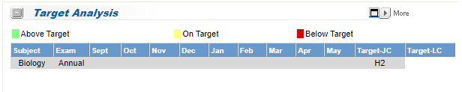
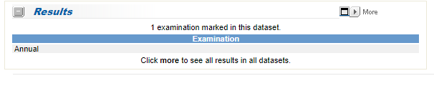
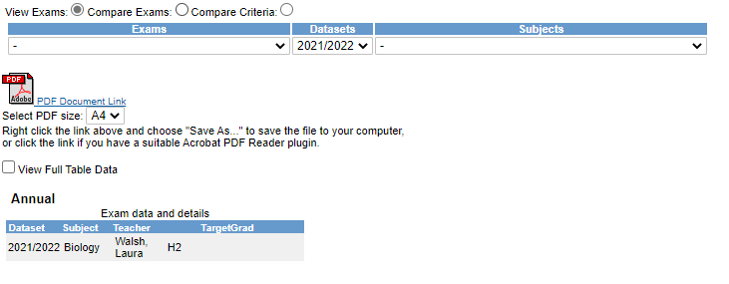
EPortal
Click More
Select Year from Datasets dropdown menu

Slide 37
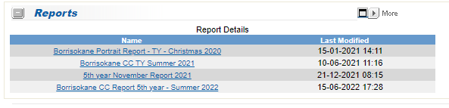
EPortal – Reports

Slide 38
Data Protection
Eportal – Personal Data.
Reports to Student – over 18 parents have no access to Eportal unless with students permission.
Forms for permission on school website – Click Here.

Slide 40
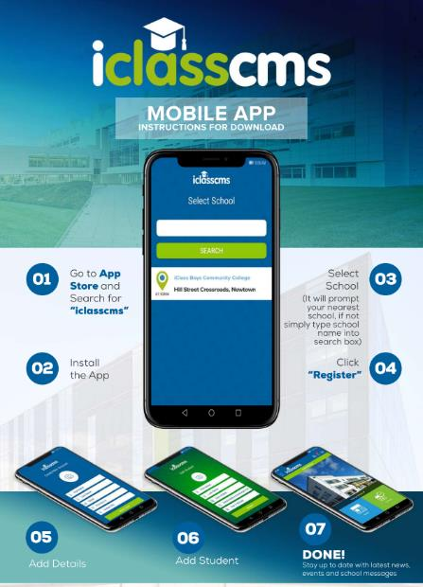
School App
iClass App
Verification Code
RT@7T4
News
Events
Send Notes to School – Absence/Lates/Leave early

Slide 41
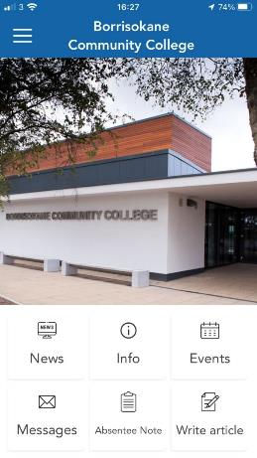
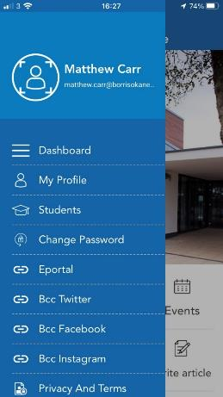
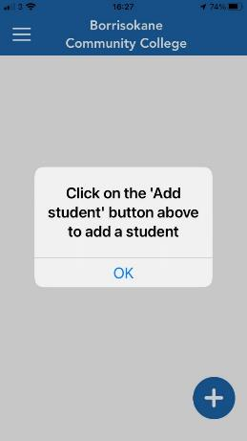
Add a Student

Slide 42


Slide 43
If student ill then do not send student to school
If students out of school follow class work/homework on TEAMS.
Follow a structure using timetable- if working from home.
Any queries email subject teachers.

Slide 44
Parent Teacher Meetings
If you need to speak to an individual teacher please contact the teacher or school office – 067 27268 or email info@borrisokanecc.ie or email the teacher.
Parent/Student/Teacher Meeting 5th Year - Thursday January 26th 4.15 pm to 6.45pm
Contact Year Head, Principal and Deputy Principal.

Slide 45
Parents Committee
Huge support to the school over the years
Encourage parents to join the committee
Voice of parents in the school
Parents Association AGM on Monday October 3rd at 7.30pm. Talk from Stella O’Malley Psychotherapist on How to Support your Child through the Teenage Years
€50 Parents Association Family Levy

Slide 46
Final Word what can you do to help?
Allow/ Encourage the dream
Facilitate Schoolwork/Homework/Research/Independence
Inform yourself
Support and Encourage
Praise
Leaving Certificate Applied Programme across the two years – four sessions.
Choose Work Experience wisely.
Ultimately decisions are student’s own, allow them to take responsibility.
Help your child set short term goals and build on them.
Follow progress on Eportal

