Slide 1
Welcome to Borrisokane Community College
First year Parent Induction Evening
September 2022.
Notes:
Community – you are a part of that community.

Slide 2
20th September 2022
School Procedures
Assessments
Other Information
Questions & Answers
Ms. Ryan – Year Head
Ms Molloy – Deputy Principal
Mr. Carr - Principal

Slide 3
Mission Statement
We seek to promote a caring and
committed school community
which will facilitate the education of our students
and where each individual is valued
as a unique human being.
“Is ar scáth a chéile a mhairimid”
Notes:
we live in the shadow of each other

Slide 4
Classes
Five class groups for all subjects
1A
1B
1C
1D
1E
1F for practical subjects and CSPE
Notes:
Classes formed so some students from same Primary School together.
English Maths Science, Options

Slide 5
Core Subjects
Irish, English, Maths, History, Science.
Option Subjects
Geography, French, German, Business Studies, Art, Home Economics, Music, Engineering, Wood Technology, Graphics.
Choose three towards end of First Year to commence studying in Second Year.
Notes:
Project Maths, Gaeilge
Number of periods for each subject.
Oral Irish

Slide 6
Short Courses
Wellbeing
Physical Education
Social, Personal and Health Education, (S.P.H.E.)
Civic Social & Political Education (CSPE)
Wellbeing class.
Digital Skills/Coding
Additional Subjects
Religious Education
Guidance – (6 week Block)
Notes:
No. Of periods of each subject.

Slide 7
Class setup in Second Year
Irish, English and Maths – students placed in Higher or Ordinary Level Classes.
Students will remain in their current classes for Science and History.
New classes formed for option subjects
Further meeting on how students choose subjects will take place on Wednesday April 19th at 8pm.

Slide 8
Assessment
Class tests from time to time. Also homework and classwork.
Screening Tests:
CAT4 Test
Reading Test
Maths Test
Later in the year:
PASS Test – Pupils Attitude to Self and School

Slide 9
Assessment
Results of tests can be used to help students set targets for various subjects.
After screening test we will contact parents if it is felt further assessment is required
Learning Difficulties
Psychological Assessment
Resource / Learning Support Teaching
Results of Assessment Test can be made available to parents on request.

Slide 10
New Junior Cycle - Grading of Subjects
Grade Descriptor | Percentage
Distinction | ≥ 90 to 100
Higher Merit | ≥ 75 and < 90
Merit | ≥ 55 and <75
Achieved | ≥ 40 and < 55
Partially Achieved | ≥ 20 and < 40
Not Graded (NG) | ≥ 0 and < 20

Slide 11
Grading of Classroom Based Assessments
Graded by Subject Teachers against nationally devised Success Criteria.
Exceptional
Above Expectations
In Line with Expectations
Yet to Meet Expectations

Slide 14
Year Head: Ms. Louise Ryan
Leader of Teaching and Learning focusing on First Year.
Support students and parents throughout the school year.
Monitoring the attendance, punctuality and engagement of each student.
Monitoring uniform (including PE uniform)
Ensuring that students adhere to the code of behaviour and behave in a positive manner in line with the ethos of our school.
Active communication is very important.

Slide 15
Class Mentors
Class Mentors teach their specific class group. As a result, they become very familiar with their students. They provide a link between students and the Year Head and constantly provide additional support and guidance to students.
1A: Ms. Fogarty and Ms Cahalan
1B: Ms. Doolan and Ms. Duffy
1C: Ms. Collison and Ms. Morgan
1D:Mr.MacLochlainn and Ms. Kennedy
1E: Ms. Maher and Mr. Dillon
All staff email addresses can be found on the school website.

Slide 16
School Journal
Allows vital communication between teachers and parents. Parents see what students need to engage with at home and can provide support.
Helps students to write down important reminders.
Provides detailed information in relation to the Code of behaviour and important school policies such as, Anti Bullying Policy, Acceptable use policy, Student Rights and Responsibilities. Etc.
Parents should check the journal daily.
Sign each evening preferable / at the end of each week mandatory. Regular checks take place.
Centre Pages – Study tips, Revision Points, Setting Targets and Goals.
Notes:
Records – behaviour, attendance.

Slide 17
Attendance and Punctuality
Attendance is key to success in school. Please encourage this with your children.
When absent – find out what was covered in class and complete homework – Use Teams.
A note explaining absence/late must be sent into the school via the school app or emailed to Year Head – louise.ryan1@borrisokanecc.ie
TUSLA – over 20 days absent.
Medical certificate or reason given where possible
Records of each month in Journal.

Slide 18
Attendance and Punctuality
Arriving Late or Leaving Early
If a student arrives late or is signing out early, a reason must be submitted via the school app. This will inform the Year Head and Secretary, who can update the records system.
The School App (Mentioned again later)
All students have received detailed information via email on how to set up the school app.
Absent/ late/ sign out notes sent are received by the Secretary who filters them the Year head.
The Year Head makes amendments to the attendance records on ePortal.

Slide 19
Homework - Study
Working with your child in relation to homework
Study includes revision. We have monthly/ bi-monthly assessments.
Encourage reading. Be mindful of screen time. This can be checked on the iPad.
Time for homework/study – 1 to 1.5 hours each night.
Each night check timetable for tomorrow to ensure that all books, materials, uniform, lunch, etc. are ready for the next day.
Ensure iPad is charged and in schoolbag each morning.

Slide 20
After School Study
Monday to Thursday 4.00pm to 6.15pm.
Cost €3 per evening – Subsidised by Parents Association.
Notes:
First years are welcome to take part in study – majority of students are 3rd 5th and 6th years.

Slide 21
Student Supports
Year Head
Mentor
Any class Teacher
Principal and Deputy Principal
Student Support Team
Cairde
Student Council
The Decider Programme
AEN Department
Guidance Counsellors
Counselling Service

Slide 22
Uniform
Must be worn everyday with exception of PE day.
PE uniform must be worn.
T- Shirts worn under uniform must be white with no collar.
Girls Trousers – Hunter Brand or similar. 63 style not uniform.
Skirts must not be shortened – worn below the knee.
Footwear – Black or brown shoes or boots.
Black runners allowed – Complete Black.
School Jacket. This is the best option as it can be worn both inside and outside the school building.
Notes:
No runners. If looks like runners then no. No canvas footwear.

Slide 23
Uniform
Sport and PE classes – PE uniform and runners or boots for field games.
Wear PE Uniform to school on PE Day.
Identification tags.
Protect valuables
Note if issue – accidents etc. – Keep to minimum.

Slide 24
Positive Discipline
Positive Comments
Catch students doing right
Praise, Thank you.
Reward good behaviour.
Respect is a two way process.
Notes:
Rewards – No homework, game in class, watch DVD, Taken on tours, given credits

Slide 25
Extra Curricular Activities
Permission to take part in activities – Note in Journal to be signed pg 32a.
Basketball, Athletics, Hurling, Soccer, Camogie, Badminton all commencing this year.
Helmets required for hurling at all times.
Walkway used by students at breaks
Positive Behaviour is very important (trips, matches away etc)

Slide 27
Ipads -
All students are required to have an iPad.
Books etc purchased through school- €350. Final instalment €50 in December for those not paid in full.
Includes Books, Personal Accident Insurance, Journal, CAT Test, Locker and Ipad Insurance year one.
Payment for iPad Insurance each year €30.
Take care of Ipad. Charge each night.
Teachers will be uploading class notes to TEAMS and other Apps.
Assignments and Projects
Notes:
Two thirds of group are part of scheme.
Purpose to reduce cost
€47

Slide 28
Data Protection
Photos – Need permission to use photos - Newspapers, Website, Social Media, Prospectus.
Forms returned from all Parents – Thank You.
Don’t name students in photos on Social Media, Name Group only.

Slide 29
Management
Department of Education
Tipperary Education & Training Board
Board of Management
Principal and Staff

Slide 30
ETB Schools Core Values
ETB schools are state, coeducational, multidenominational schools underpinned by the core values of:
Excellence in Education
Care
Equality
Community
Respect

Slide 31
Board of Management
Members
ETB members – Virginia O’Dowd, Shane Lee
Parent Reps. – Dave Lawless, Deirdre O’Brolchain.
Teacher Reps. – Ms. Marie D’Arcy, Mr. Mark McGinn.
Community Reps. – John O’Farrell, Joe Murphy, Maura Kennedy, Ann Tierney.
Chairperson – Joe Murphy.
Secretary – Matthew Carr.
Recording Secretary: Ms Paula Molloy

Slide 32
Eportal
School System to record student information
Timetable
Attendance
Calendar of School Activities/Events
Positive Comments
Behaviour Record
Examination Results
Monthly assessments on EPortal. Teacher and student set target and compare achievement to target each month.
Log on details sent to parents - username and password. If log in details lost contact school and we can email them to you.
Log on from school website – www.borrisokanecc.ie
Link to EPortal at top of Home Page.
Check EPortal weekly.

Slide 33
Assessments
Assessment Policy on School website.
Monthly Assessment – on EPortal. Result and Grade
October
December
January/February
March/April
Targets set at beginning of year and can be adjusted as year moves on.

Slide 34
Assessments
House Exams – in class tests.
December – Results and Formative Comment on EPortal
June – Results and Formative Comment on EPortal
Report uploaded to EPortal.

Slide 35
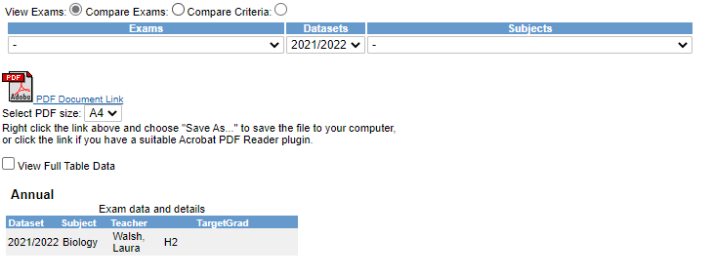
EPortal
Click More
Select Year from Datasets dropdown menu

Slide 36
EPortal – Reports

Slide 37
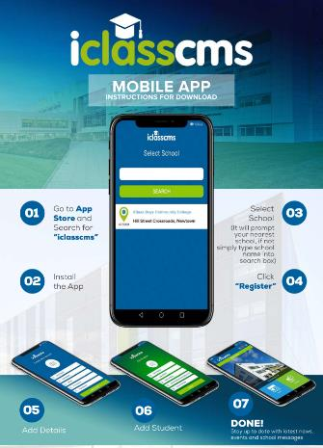
School App
iClass App
Verification Code
RT@7T4
News
Events
Send Notes to School – Absence/Lates/Leave early

Slide 38
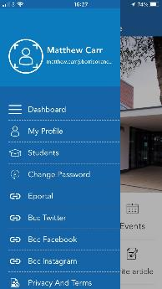
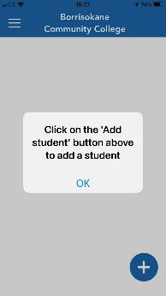
Add a Student

Slide 40
If student ill then do not send student to school
If students out of school follow class work/homework on TEAMS or use a homework buddy.
Follow a structure using timetable- if working from home.
Any queries email subject teachers.

Slide 41
Parent Teacher Meetings
If you need to speak to an individual teacher please contact the teacher or school office – 067 27268 or email info@borrisokanecc.ie or email the teacher.
Parent/Student/Teacher Meeting 1st Year:
Thursday November 24th 4.15 pm to 6.45pm and
Thursday 23rd March 4.15pm to 6.45pm.
Contact Year Head, Principal and Deputy Principal.

Slide 42
Parents Committee
Huge support to the school over the years
Encourage parents to join the committee
Voice of parents in the school
Parents Association AGM on Monday October 3rd at 7.30pm. Talk from Stella O’Malley Psychotherapist on How to Support your Child through the Teenage Years
€50 Parents Association Family Levy

Slide 43
Points - Good Parenting
Work with your child
Give them time
Listen to them
Be firm and fair
Be positive
Get them involved in activities
Know where they are
Practice what you preach
Respect
Look to self for solutions

Slide 44
IF I HAD MY CHILD TO RAISE ALL OVER AGAIN
I’d finger-paint more and point the finger less.
I’d do less correcting and more connecting.
I’d take my eyes off my watch, and watch with my eyes.
I would care to know less and know to care more.
I’d take more hikes and fly more kites.
I’d stop playing serious, and seriously play.
I’d run through more fields and gaze at more stars.
I’d do more hugging and less tugging.
I would be firm less often and affirm much more.
I’d build self-esteem first , and the house later.
I’d teach less about the love of power, and more about the power of love. (Diane Loomans)

Slide 45
Contact Details
Telephone – 067 27268
Email
School – info@borrisokanecc.ie
Year Head – louise.ryan1@borrisokanecc.ie
Deputy Principal – paula.molloy@borrisokanecc.ie
Principal – matthew.carr@borrisokanecc.ie
Class teachers – List available on school website – Information tab.

Slide 46
Slides available on school website in next few days.
School Website, School App and Social Media will keep you up to date on Borrisokane Community College activities.
Questions?

